Slide 1
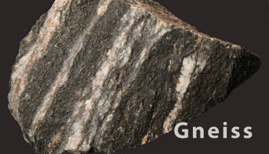
Rocks #1
The geology of any two regions of Earth may be completely different from each other. Some areas have different types of rock while others are completely covered with sediments. Which of the following areas is most likely to form metamorphic rocks such as gneiss and slate?
A sea floor
A windblown desert
A site deep underground
A site covered by a glacier.
By: Ms. Kristin Wilkinson

Slide 2
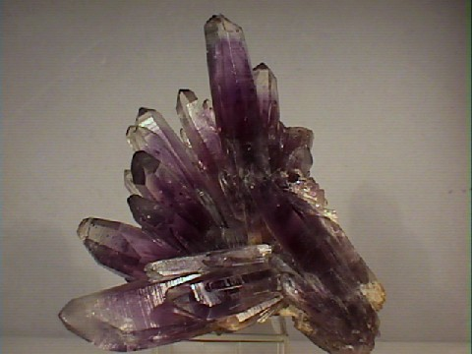
Rocks #2
Which of the following are characteristic(s) of a rock. List as many as you see ;)
abiotic (nonliving)
biotic (living)
occurs naturally
man-made
liquid
solid
By: Ms. Kristin Wilkinson

Slide 3
Rocks #3
Match the following properties to the correct rock type:
_____ Igneous A. Made from layers of compacting rock
_____ Metamorphic B. Made from cooling mantle
_____ Sedimentary C. Made from heat and
pressure.
By: Ms. Kristin Wilkinson

Slide 4
Rocks #4
Fill in the blank to define the 5 characteristics that make up a mineral:
Occurs ____________. Not artificial or man-made.
Found as a _______, having a definite volume and shape.
Has a definite __________ composition, either as an element or a compound.
Atoms arranged in a ______________ pattern.
Are not made by life processes, ___________ or nonliving.
naturally
solid
chemical
crystalline
abiotic
By: Ms. Kristin Wilkinson

Slide 5
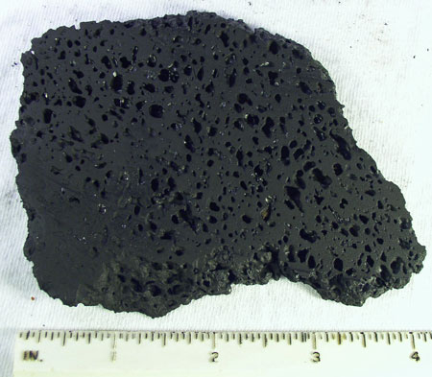
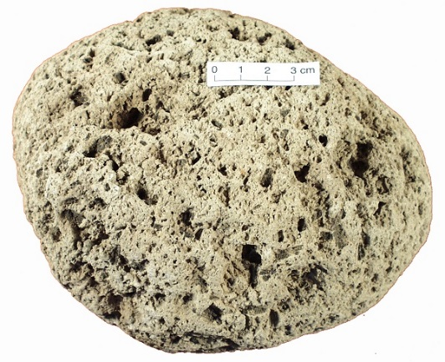
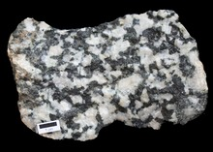
Rocks #5
Match the following pictures to the correct igneous rock. 4. `Which of these make up the oceanic crust?
Pumice
Basalt
Diorite
2.
3.
1.
By: Ms. Kristin Wilkinson

Slide 6
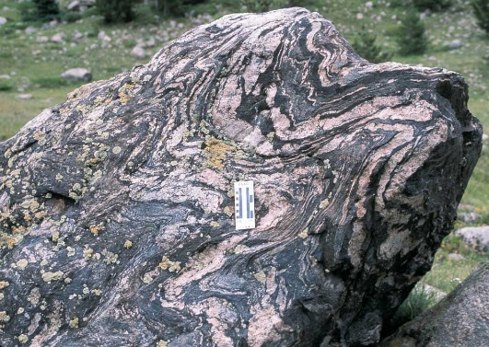
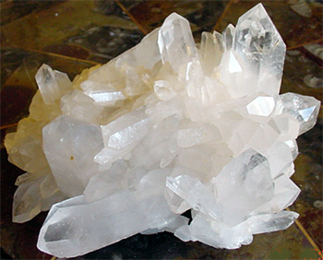
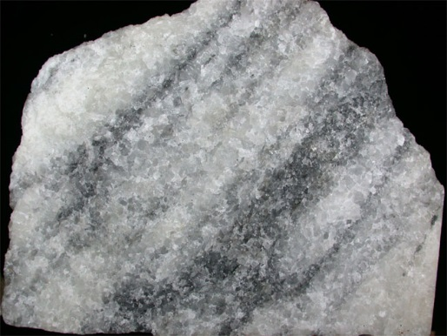
Rocks #6
Match the following pictures to the correct metamorphic rock.
Marble
Gneiss
Quartz
2.
3.
1.
By: Ms. Kristin Wilkinson

Slide 7
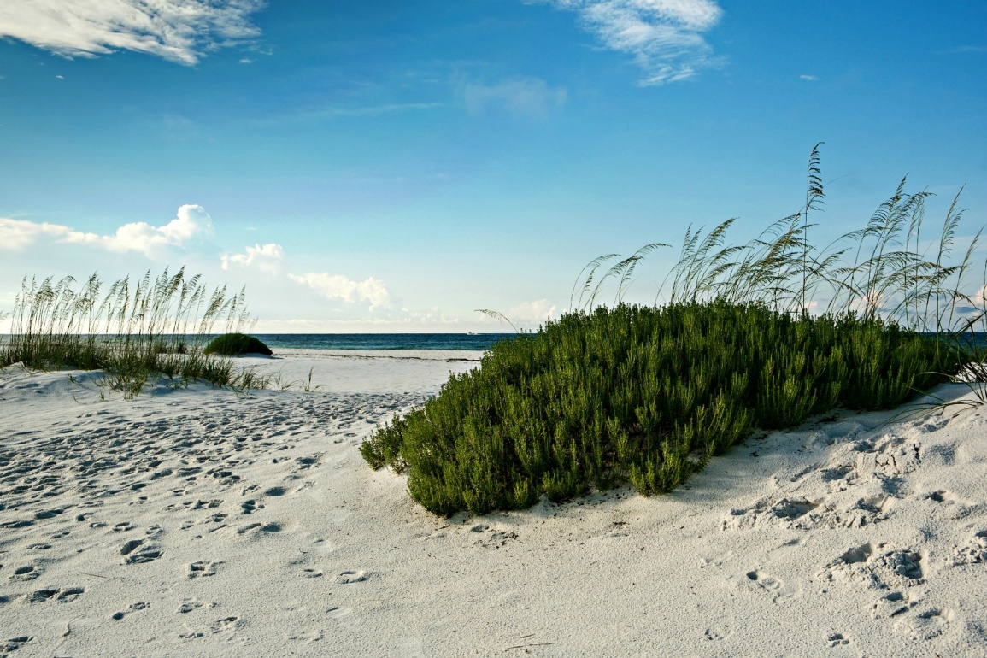
Rocks #7
Humans have beneficial and negative impacts on Earth’s rock cycle. Which of the following is a negative impact that allows for an increase in soil erosion.
pollution
deforestation
urbanization
Both B and C
All of the above
By: Ms. Kristin Wilkinson

