Slide 1
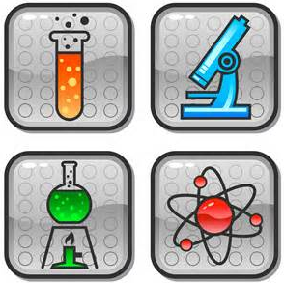
Science Starter
Science comics
Daily challenge

Slide 2
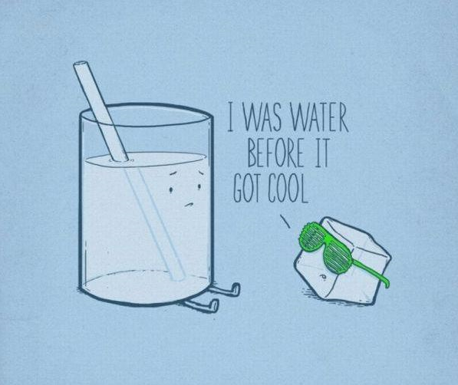
Explain the science behind this comic.

Slide 3
Ice is made when water gets cool (frozen). The ice cube is “cool”

