Slide 1
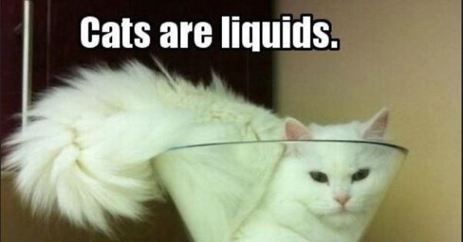
Why is this picture correct? (think scientifically)

Slide 2
