Slide 1
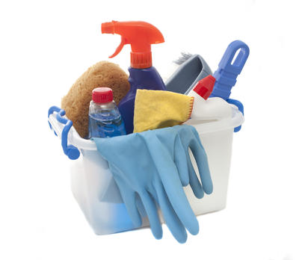

Acids
and
Bases
# 4

Slide 2
Number your paper 1- 4.
Answer the questions.
1. What does “pH” stand for ?
2. Who invented the pH scale?
3. Describe 2 things that can
happen when you combine
an acid with a base?
4. Where on the pH scale are the
weakest acids and bases found?

Slide 3
1. What does “pH” stand for ?
2. Who invented the pH scale?
3. Describe 2 things that can happen when
you combine an acid with a base?
4. Where on the pH scale are the weakest
acids and bases found?

Slide 4
1. What does “pH” stand for ?
Power of Hydrogen or Potential of Hydrogen
2. Who invented the pH scale?
3. Describe 2 things that can happen when
you combine an acid with a base?
4. Where on the pH scale are the weakest
acids and bases found?
Closest to neutral (the middle of the pH scale)

Slide 5
1. What does “pH” stand for ?
Power of Hydrogen or Potential of Hydrogen
2. Who invented the pH scale?
Soren Sorenson
3. Describe 2 things that can happen when
you combine an acid with a base?
4. Where on the pH scale are the weakest
acids and bases found?
Closest to neutral (the middle of the pH scale)

Slide 6
1. What does “pH” stand for ?
Power of Hydrogen or Potential of Hydrogen
2. Who invented the pH scale?
Soren Sorenson
3. Describe 2 things that can happen when
you combine an acid with a base?
1. create a neutral substance
2. cause a chemical reaction
4. Where on the pH scale are the weakest
acids and bases found?

Slide 7
1. What does “pH” stand for ?
Power of Hydrogen or Potential of Hydrogen
2. Who invented the pH scale?
Soren Sorenson
3. Describe 2 things that can happen when
you combine an acid with a base?
1. create a neutral substance
2. cause a chemical reaction
4. Where on the pH scale are the weakest
acids and bases found?
Closest to neutral (the middle of the pH scale)

