Slide 1
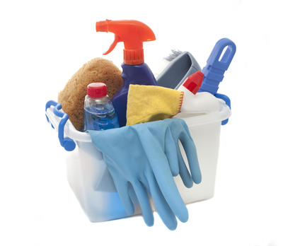
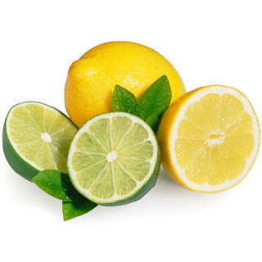
Acids and Bases
# 2

Slide 2
Choose the best answer from the word box below.
1. The strength of an acid is called ____.
2. The strength of a base is called ____.
3. In a reaction, acids give away ____ ions.
4. In a reaction, bases give off ____ ions.
5. If a substance has a low number on the pH scale,
it is a(n) ____.
6. If a substance has a high number on the pH scale,
it is a(n) ____.
7. A substance with a pH of 7 is ___.
Hydroxide B. alkalinity C. Hydronium
D. base E. neutral F. acidity G. acid

Slide 3
The answers are:
1. The strength of an acid is called ____.
2. The strength of a base is called ____.
3. In a reaction, acids give away ____ ions.
4. In a reaction, bases give off ____ ions.
5. If a substance has a low number on the pH scale,
it is a(n) ____.
6. If a substance has a high number on the pH scale,
it is a(n) ____.
7. A substance with a pH of 7 is ___.
Hydroxide B. alkalinity C. Hydronium
D. base E. neutral F. acidity G. acid

Slide 4
The answers are:
1. The strength of an acid is called F .
2. The strength of a base is called ____.
3. In a reaction, acids give away ____ ions.
4. In a reaction, bases give off ____ ions.
5. If a substance has a low number on the pH scale,
it is a(n) ____.
6. If a substance has a high number on the pH scale,
it is a(n) ____.
7. A substance with a pH of 7 is ___.
Hydroxide B. alkalinity C. Hydronium
D. base E. neutral F. acidity G. acid

Slide 5
The answers are:
1. The strength of an acid is called F .
2. The strength of a base is called B .
3. In a reaction, acids give away ____ ions.
4. In a reaction, bases give off ____ ions.
5. If a substance has a low number on the pH scale,
it is a(n) ____.
6. If a substance has a high number on the pH scale,
it is a(n) ____.
7. A substance with a pH of 7 is ___.
Hydroxide B. alkalinity C. Hydronium
D. base E. neutral F. acidity G. acid

Slide 6
The answers are:
1. The strength of an acid is called F .
2. The strength of a base is called B .
3. In a reaction, acids give away C ions.
4. In a reaction, bases give off ____ ions.
5. If a substance has a low number on the pH scale,
it is a(n) ____.
6. If a substance has a high number on the pH scale,
it is a(n) ____.
7. A substance with a pH of 7 is ___.
Hydroxide B. alkalinity C. Hydronium
D. base E. neutral F. acidity G. acid

Slide 7
The answers are:
1. The strength of an acid is called F .
2. The strength of a base is called B .
3. In a reaction, acids give away C ions.
4. In a reaction, bases give off A ions.
5. If a substance has a low number on the pH scale,
it is a(n) ____.
6. If a substance has a high number on the pH scale,
it is a(n) ____.
7. A substance with a pH of 7 is ___.
Hydroxide B. alkalinity C. Hydronium
D. base E. neutral F. acidity G. acid

Slide 8
The answers are:
1. The strength of an acid is called F .
2. The strength of a base is called B .
3. In a reaction, acids give away C ions.
4. In a reaction, bases give off A ions.
5. If a substance has a low number on the pH scale,
it is a(n) G .
6. If a substance has a high number on the pH scale,
it is a(n) ____.
7. A substance with a pH of 7 is ___.
Hydroxide B. alkalinity C. Hydronium
D. base E. neutral F. acidity G. acid

Slide 9
The answers are:
1. The strength of an acid is called F .
2. The strength of a base is called B .
3. In a reaction, acids give away C ions.
4. In a reaction, bases give off A ions.
5. If a substance has a low number on the pH scale,
it is a(n) G .
6. If a substance has a high number on the pH scale,
it is a(n) D .
7. A substance with a pH of 7 is ___.
Hydroxide B. alkalinity C. Hydronium
D. base E. neutral F. acidity G. acid

Slide 10
The answers are:
1. The strength of an acid is called F .
2. The strength of a base is called B .
3. In a reaction, acids give away C ions.
4. In a reaction, bases give off A ions.
5. If a substance has a low number on the pH scale,
it is a(n) G .
6. If a substance has a high number on the pH scale,
it is a(n) D .
7. A substance with a pH of 7 is E .
Hydroxide B. alkalinity C. Hydronium
D. base E. neutral F. acidity G. acid

