Slide 1
Quarter 1
Week 1
Hyperlinks built in to help navigate to each day
My class helpers will open the file each day and set it up for the students to view on the Smart Board.
T. Tomm 2008 Updated 2020 http://sciencespot.net/

Slide 2
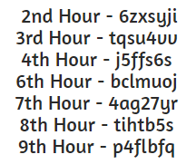
1 – Go to G-MAIL or DRIVE.
2 - Click the GRID
3 - Click MORE
4 - Click CLASSROOM
5 – Click → JOIN A CLASS
6 - Enter the CODE for your class.
This slide will be used as a PNG background on the digital student notebook as well as displayed in class.

Slide 3
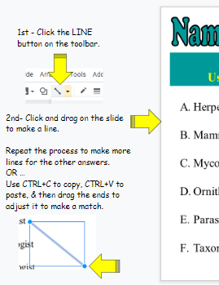
Science Starters
Q1-W1-Mon
This slide will be used as a PNG background on the digital student notebook as well as displayed in class.
Quarter – Week - Day
Click to go Google Classroom.
Go to your SCIENCE CLASS.
Click CLASS WORK.
Open the assignment for Science Starters Qtr 1 Week 1.
Open the attachment.
The first slide you see is for today.
Use the tips in the gray areas to help you.
Use the info at the top to keep track of the daily challenges.
You may work ahead on the other challenges if you finish early.

Slide 4
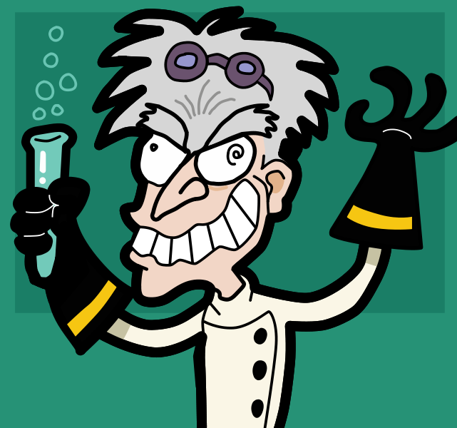
Name-The-Ologist 1
Q1-W1-Mon
This slide will be used as a PNG background on the digital student notebook.
You will add the interactive components in Google Slides.
What does each scientist study? Use the line tool on the toolbar to make matches.
Herpetologists
Mammalogist
Mycologist
Ornithologist
Parasitologist
Taxonomist
Fungi
Birds
Reptiles & amphibians
Classification
Mammals
Parasites
T. Tomm 2008 http://sciencespot.net/

Slide 5
The answers are …
This slide will be used as to review the answers at the start of each class.
Herpetologists
Mammalogist
Mycologist
Ornithologist
Parasitologist
Taxonomist
Fungi
Birds
Reptiles & amphibians
Classification
Mammals
Parasites
It has the same information as the previous slide.
But I have added lines along with animations to share the answers as I present this in class.
If you missed any, correct them!

Slide 6
Science Starter Procedure
This slide will be used as a PNG background on the digital student notebook as well as displayed in class.
We will review the ANSWERS for the daily challenges at the BEGINNING of each class.
This means you should have the challenge for TUESDAY done BEFORE you come to class tomorrow.
You may do them all the challenges for the week at one time or one at a time – just make sure the one that is due is completed before class starts that day. Don’t wait until class starts to try to get your challenge done – that will cost your class minions!
You will turn in your weekly Science Starter assignment on GC on Friday, but wait until we review the answers for that day.
DO NOT TURN IN EARLY→ Cannot make corrections.
Remote Learners – E-mail me when you turn in the weekly assignment. I will check to see if you need to make corrections.

Slide 7
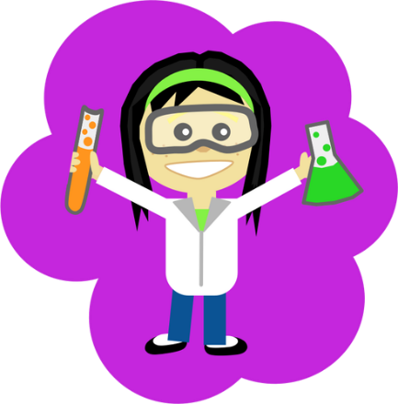
Name-The-Ologist 2
Q1-W1-Tues
This slide will be used as a PNG background on the digital student notebook.
You will add the interactive components in Google Slides.
Can you unscramble all the words below?
Type your answer in the textboxes.
GOLOZOIST
1. Animals
LEGOGOIST
2. Rocks & minerals
MCHSEIT
3. Atoms & molecules
ISOLTOBGI
4. Living things
GSEISOSLOMIT
5. Earthquakes
Hint: First letter of each word is underlined.

Slide 8
The answers are …
This slide will be used as to review the answers at the start of each class.
ZOOLOGIST
GOLOZOIST
1. Animals
It has the same information as the previous slide.
But I have added text boxes along with animations to share the answers as I present this in class.
GEOLOGIST
LEGOGOIST
2. Rocks & minerals
CHEMIST
MCHSEIT
3. Atoms & molecules
BIOLOGIST
ISOLTOBGI
4. Living things
SEISMOLOGIST
GSEISOSLOMIT
5. Earthquakes
If you missed any, correct them!

Slide 9
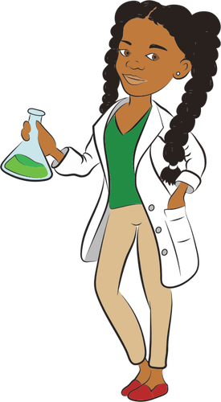
Name-The-Ologist 3
Q1-W1-WEDS
This slide will be used as a PNG background on the digital student notebook.
You will add the interactive components in Google Slides.
What does each scientist study? Use the line tool to draw a line to make matches
Physicist
Astronomer
Paleontologist
Oceanographer
Entomologist
Ichthyologist
Archeologist
Remains of human life & civilizations
Fish
Oceans and ocean life
Insects
Remains of animal life
Motion, forces, & energy
Planets, stars, and solar system

Slide 10
The answers are …
This slide will be used as to review the answers at the start of each class.
Physicist
Astronomer
Paleontologist
Oceanographer
Entomologist
Ichthyologist
Archeologist
Planets, stars, and solar system
Motion, forces, & energy
Fish
Oceans and ocean life
Remains of human life & civilizations
Remains of animal life
Insects
It has the same information as the previous slide.
But I have added lines along with animations to share the answers as I present this in class.
If you missed any, correct them!

Slide 11
Do You Know #1
Q1-W1-THURS
This slide will be used as a PNG background on the digital student notebook.
You will add the interactive components in Google Slides.
Answer these questions based on what you learned from the Survival Guide.
1. What is the most important class rule?
2. What grade would you earn for each score? 75% = _____ 92% = _____ 89.4% = _____ 55% = ______
3. What percent of your grade comes from quizzes & tests?
4. What happens if you don’t turn in an assignment?
5. What happens if you forget your materials?

Slide 12
The answers are …
Make smart choices!
What is the most important class rule?
2. What grade would you earn for each score? 75% = _____ 92% = _____ 89.4% = _____ 55% = ______
3. What percent of your grade comes from quizzes & tests? _______
4. What happens if you don’t turn in an assignment?
5. What happens if you forget your materials?
This slide will be used as to review the answers at the start of each class.
It has the same information as the previous slide.
But I have added text boxes along with animations to share the answers as I present this in class.
C
A
B
F
Homework = 50%
50%
You get a ZERO!
Unless you submit a hallway pass or use an excuse card.
Excuse Card
5 Excuse Cards = 1 After School Detention
If you missed any, correct them!

Slide 13
Do You Know #2
Q1-W1-FRI
This slide will be used as a PNG background on the digital student notebook.
You will add the interactive components in Google Slides.
Which of these would NOT be SMART CHOICES?
Drag the Xs in front of the ones that are not smart choices!
Doing all class work on time on your own.
Packing up your materials before the end of class
Participating in class discussions and activities
Treating others (and their property) with respect.
Clicking the touch pad on another student’s laptop.
Having your cell phone ring or ding when it is in your pocket.
Talking to other students while I am talking.
Working on homework (or other school stuff) until the bell rings
Getting up to throw away something during class.
Raising your hand to make a comment or ask a question.
Rolling your eyes when someone answers a question.
Sharing your homework with another student because he/she was absent.

Slide 14
The answers are …
Doing all class work on time on your own.
Packing up your materials before the end of class
Participating in class discussions and activities
Treating others (and their property) with respect.
Clicking the touch pad on another student’s laptop.
Having your cell phone ring or ding when it is in your pocket.
Talking to other students while I am talking.
Working on homework (or other school stuff) until the bell rings
Getting up to throw away something during class.
Raising your hand to make a comment or ask a question.
Rolling your eyes when someone answers a question.
Sharing your homework with another student because he/she was absent.
This slide will be used as to review the answers at the start of each class.
X
It has the same information as the previous slide.
But I have added Xs (word art) along with animations to share the answers as I present this in class.
X
X
X
X
X
X
If you missed any, correct them!

Slide 15
Have you reviewed the answers for Friday’s challenge in class?
If so, it’s TURN IN TIME!
Go to GC to turn in your daily challenges for Week 1.
Open the assignment for Science Starters Qtr 1 Week 2. (Directions on the next slide)
This slide will be used as a PNG background on the digital student notebook as well as displayed in class.
Remember … you may complete all of them early, but do not turn them in early. Wait until we discuss all the challenges in class.

Slide 16
Science Starters
This slide will be used as a PNG background on the digital student notebook as well as displayed in class.
Go to your SCIENCE CLASS in Google Classroom (if you are not already there.)
Click CLASS WORK.
Open the assignment for Science Starters Qtr 1 Week 2.
Open the attachment.
The first slide you see is for Monday. You need to have it completed BEFORE you come to class on Monday.
You may work ahead on the other challenges if you finish early.

