Slide 1
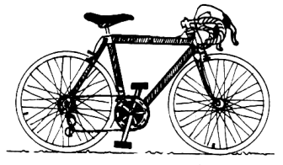
Compound Machines
How many different simple machines can you find in the bike?
http://www.sciencetech.technomuses.ca/english/schoolzone/activities_mach3.cfm
T. Tomm 2021 https://sciencespot.net

Slide 2
Label your answers on the diagram.
http://www.sciencetech.technomuses.ca/english/schoolzone/activities_mach3.cfm

