Slide 1
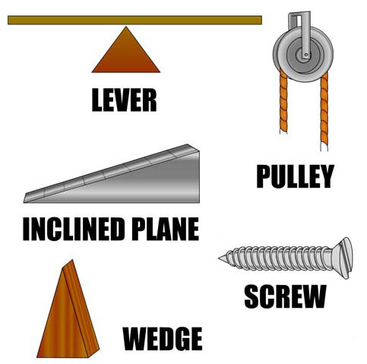
Simply Machines 2
Identify each simple machine. Tell how you can increase the mechanical advantage (MA) of each one.
To increase MA:
To increase MA:
A. ________________
To increase MA:
B. ________________
C. ________________
To increase MA:
To increase MA:
D. ________________
E. ________________
T. Tomm 2021 https://sciencespot.net
http://dln.nasa.gov/dln/media/images/full_08_04_2008_46__nes.jpg

Slide 2
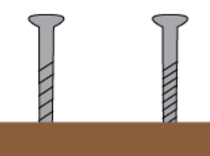
Simply Machines 2
The answers are …
To increase MA:
To increase MA:
move the fulcrum closer to the load.
Use two or more pulleys together.
A. ________________
?
LEVER
To increase MA:
Use a longer ramp with less slope.
B. ________________
PULLEY
OR
To increase MA:
C. __________________
INCLINED PLANE
Use a screw with more threads.
To increase MA:
Use a longer, thinner wedge.
D. ________________
SCREW
OR
OR
E. ________________
WEDGE
http://dln.nasa.gov/dln/media/images/full_08_04_2008_46__nes.jpg

