Slide 1
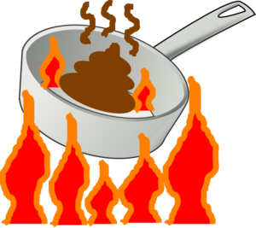
Heat Transfer Review
What type of heat transfer is illustrated by the examples?
Three types – CONDUCTION, CONVECTION, and RADIATION
A
Air heats up to become less dense and rise to the top; as it cools it sinks to the bottom.
B
The end of the handle becomes hot even though it is not directly over the flame.
Air near the radiator heats up and rises to the top of the room, but sinks again when it cools.
C
Heat is given off by the radiator and warms objects directly in its path.
D
E
The chocolate touching the marshmallow melts.
T. Tomm https://sciencespot.net

Slide 2
Heat Transfer Review
The answers are …
A
Air heats up to become less dense and rise to the top; as it cools it sinks to the bottom.
CONVECTION
B
The end of the handle becomes hot even though it is not directly over the flame.
CONDUCTION
Air near the radiator heats up and rises to the top of the room, but sinks again when it cools.
C
CONVECTION
Heat is given off by the radiator and warms objects directly in its path.
D
RADIATION
E
The chocolate touching the marshmallow melts.
CONDUCTION or RADIATION

