Slide 1
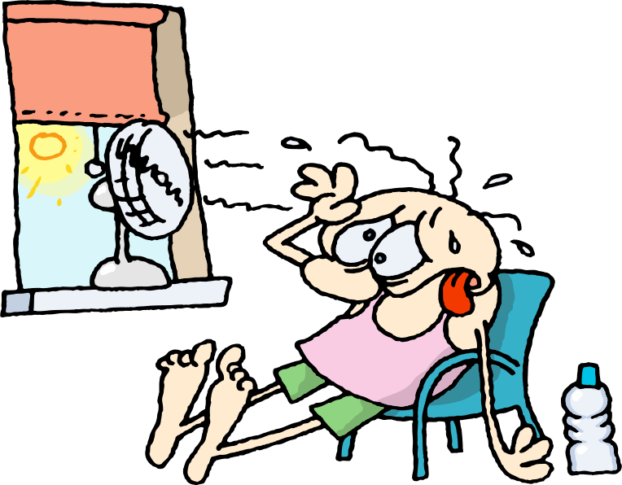
Heat Transfer
How is heat transferred?
This Photo by Unknown Author is licensed under CC BY-NC-ND
T. Tomm 2019

Slide 2
Choose the BEST answer for each.
Video link: https://www.khanacademy.org/partner-content/mit-k12/mit-k12-physics/v/heat-transfer
What type of camera can measure temperatures? A. Spectral B. Conductive C. Thermal
Which type of heat transfer occurs when heat moves through a piece of metal, such as a metal spoon? A. Conduction B. Convection C. Radiation
Which type of heat transfer involves rising warm air and sinking cold air? A. Conduction B. Convection C. Radiation
Heat from the sun that reaches us directly is called: A. Conduction B. Convection C. Radiation
Challenge: How would a lava lamp illustrate all three types of heat transfer?

Slide 3
The answers are …
What type of camera can measure temperatures? A. Spectral B. Conductive C. Thermal
Which type of heat transfer occurs when heat transfers through a piece of metal? A. Conduction B. Convection C. Radiation
Which type of heat transfer involves rising warm air and sinking cold air? A. Conduction B. Convection C. Radiation
Heat from the sun that reaches us is called: A. Conduction B. Convection C. Radiation
Challenge: How would a lava lamp illustrate all three types of heat transfer?
Go to next slide →

Slide 4
Challenge: How would a lava lamp illustrate all three types of heat transfer?
Convection
Radiation
Conduction

