Slide 1
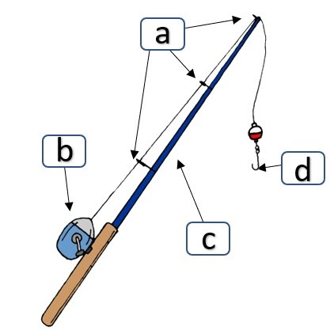
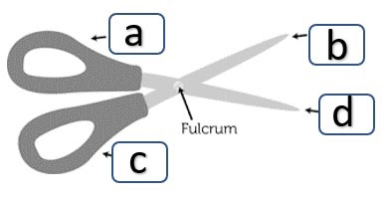
Name That Machine
Identify each type of simple machine.
The eyelets on the pole are ____
Word List:
Lever
Pulley
Wedge
Screw
Inclined Plane
Wheel & Axle
#1
The sharp part of the hook is a(n): ____.
The reel is a(n) ____.
The pole itself is a(n): ____.
#2
The cutting edges are _____.
A & C are both ____.
T. Tomm 2021 https://sciencespot.net

Slide 2
Name That Machine
The answers are:
Pulleys
The eyelets on the pole are ____
Word List:
Lever
Pulley
Wedge
Screw
Inclined Plane
Wheel & Axle
#1
The sharp part of the hook is a(n): ____.
Wedge
The reel is a(n) ____.
The pole itself is a(n): ____.
Lever
Wheel & Axle
#2
The cutting edges are _____.
Wedges
Levers
A & C are both ____.

