Slide 1
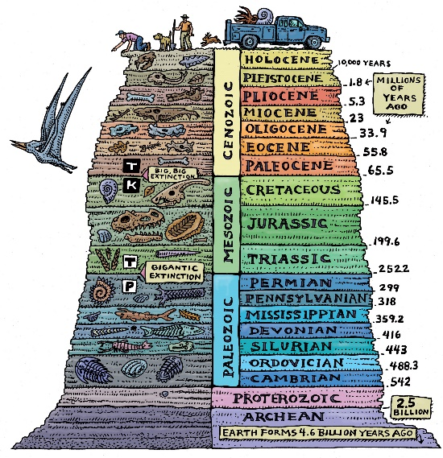
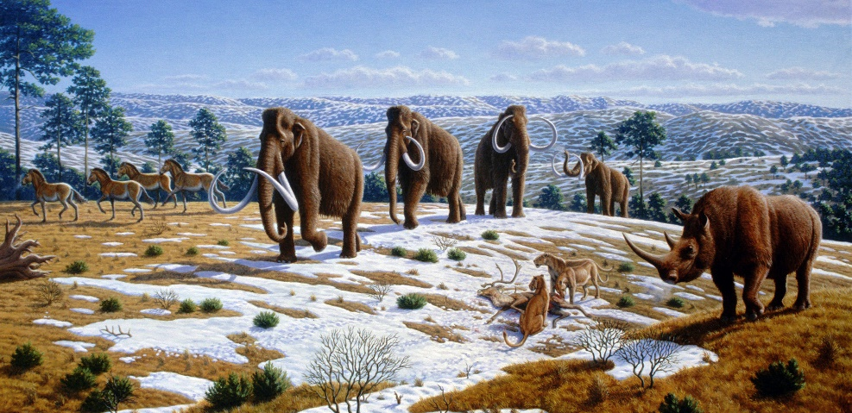
Geologic Time
Challenge 1
Created by S. LaMaster 2016

Slide 2
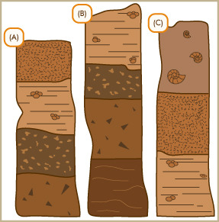
What do you know about using geology to understand evolution?
The picture to the left shows three ______________ ______________
The top layers are ____________ than the bottom layers.
The sample that has the youngest layer is letter _____.
The sample with the oldest layer is letter ______.

Slide 3
What do you know about using geology to understand evolution?
The picture to the left shows three stratigraphic columns.
The top layers are younger than the bottom layers.
The sample that has the youngest layer is letter C.
The sample with the oldest layer is letter B.

