Slide 1
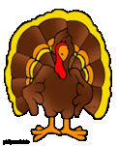
Choose the BEST answer for each.
Turkey Trivia
1. How many pounds of turkey does the average American eat in a year? A. 15 B. 18 C. 25
2. The Native American name for turkey is:
A. Firkee B. Miwok C. Siqua
3. How many feathers does the average adult turkey have?
A. 2500 B. 3500 C. Over 5000
4. True or False? Wild turkeys can fly up to 55 miles/hour.
5. True or False? The shape of a female turkey’s scat is a J.
6. True or False? The heaviest turkey on record weighed in at 86 pounds.
No Google – Take your best guess!
T. Tomm 2019 https://sciencespot.net/

Slide 2
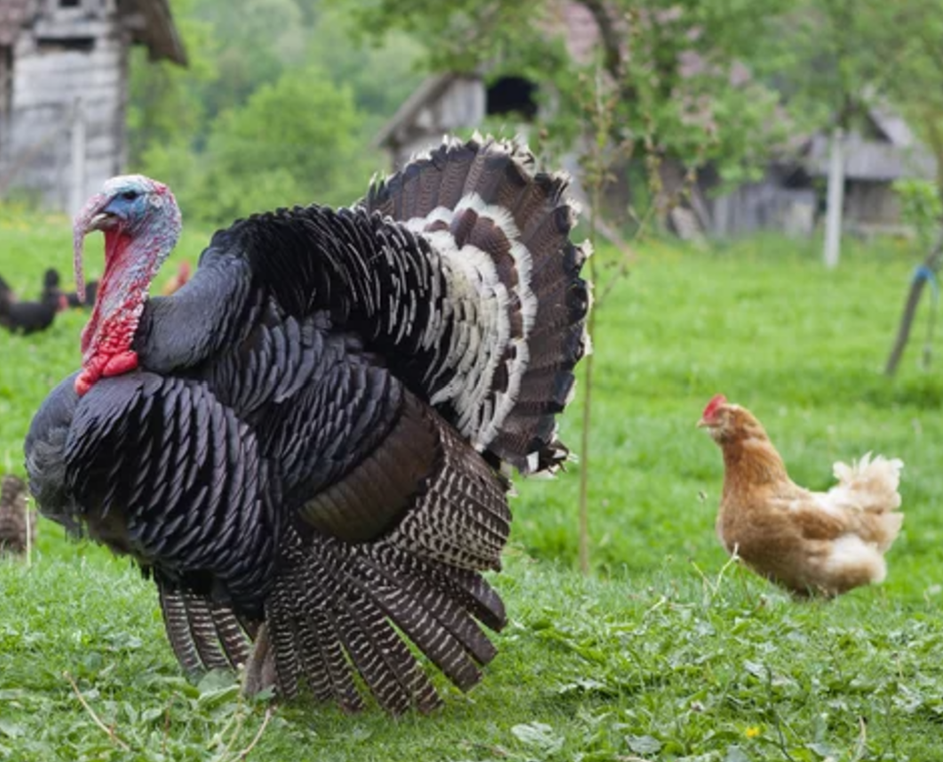
Turkey Trivia - The answers are …
1. How many pounds of turkey does the average American eat in a year? A. 15 B. 18 C. 25
2. The Native American name for turkey is:
A. Firkee B. Miwok C. Siqua
3. How many feathers does the average adult turkey have?
A. 2500 B. 3500 C. Over 5000
4. True or False? Wild turkeys can fly up to 55 miles/hour.
5. True or False? The shape of a female turkey’s scat is a J.
6. True or False? The heaviest turkey on record weighed in at 86 pounds.
= Chicken
= Pig
Bald Eagles – Closer to 7000 feathers
They can run up to 25 mph.
TYSON

Slide 3
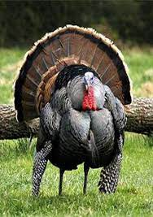
Exploring More - Turkey Math Challenge
1. If a wild turkey can run 25 mph, how far could it go in 5 minutes?
2. Based on the weight of 86 pounds for the largest turkey on record, how many people would this feed at a Thanksgiving feast if each person ate 1.5 pounds?
3. It takes an average of 4 pounds of poultry feed to add a pound of meat to a turkey. How many pounds of feed did the largest turkey, Tyson, consume?
5 mins/60 mins =
.083 hours
X 25 mph =
2.075 miles
86 lbs ÷1.5 lbs/person=
57 people
86 x 4 =
344 pounds

