Slide 1


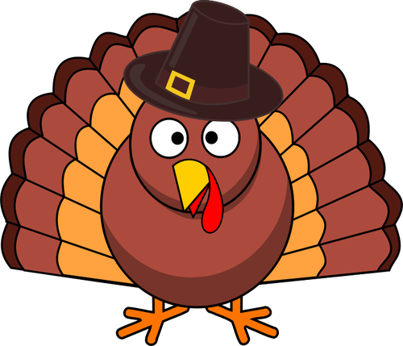
Thanksgiving Science
Watch the VIDEO to help you answer these questions.
When does brining typically take place?
A. Before cooking B. As it cooks C. After it is cooked
What scientific process explain how brining works?
A. Diffusion B. Osmosis C. Evaporation
Which process caused the greatest loss of nutrients in cranberries?
A. Blanching B. Pressing C. Freezing
What is seitan?
A. Wheat “meat” B. Tofu C. Veggie turkey
Which of these might be used to fight bacteria?
A. Onions B. Garlic C. Cinnamon
What gas is produced when antacids react with your stomach acids?
A. H₂0 B. CO C. CO₂
T. Tomm 2017 https://sciencespot.net/

Slide 2
Thanksgiving Science - The answers are …
When does brining typically take place?
A. Before cooking B. As it cooks C. After it is cooked
What scientific process explain how brining works?
A. Diffusion B. Osmosis C. Evaporation
Which process caused the greatest loss of nutrients in cranberries?
A. Blanching B. Pressing C. Freezing
What is seitan?
A. Wheat “meat” B. Tofu C. Veggie turkey
Which of these might be used to fight bacteria?
A. Onions B. Garlic C. Cinnamon
What gas is produced when antacids react with your stomach acids? A. H₂0 B. CO C. CO₂

Slide 3
Exploring more …
Identify these chemical compounds that may be found at your Thanksgiving feast.
C₁₂ H₂₂ O₁₁ Might be used to make your desserts
NaCl Common seasoning used to flavor foods
NaCHO₃ Use to make breads and desserts
H₂O Liquid needed to help digestion
CH₃COOH Acid found in salad dressings
Table Sugar
Salt
Baking soda
Water
Vinegar

