Slide 1


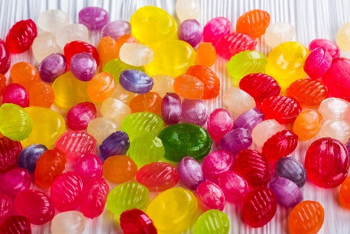
Chemistry of Flavor
Watch the VIDEO to help you answer these questions.
What factor besides taste plays a big role in flavor?
A. Temperature B. Smell C. Texture
What “taste” does umami represent?
A. Sweet & salty B. Bitter C. Savory (meats)
How many different flavor compounds are found in chocolate?
A. 300 B. 800 C. Over 1,000
How many compounds are needed to recreate an orange flavor, such as the one in Tang?
A. 6 B. 116 C. 200
Which of these is the main component of vinegar?
A. Carbolic acid B. Acetic acids C. Ethanol
T. Tomm 2017 https://sciencespot.net/

Slide 2
Chemistry of Flavor - The answers are …
What factor besides taste plays a big role in flavor?
A. Temperature B. Smell C. Texture
What “taste” does umami represent?
A. Sweet & salty B. Bitter C. Savory (meats)
How many different flavor compounds are found in chocolate?
A. 300 B. 800 C. Over 1,000
How many compounds are needed to recreate an orange flavor, such as the one in Tang?
A. 6 B. 116 C. 200
Which of these is the main component of vinegar?
A. Carbolic acid B. Acetic acid C. Ethanol

Slide 3

Exploring more …
Does eating turkey make you sleepy?
Click the turkey to find out!

