Slide 1
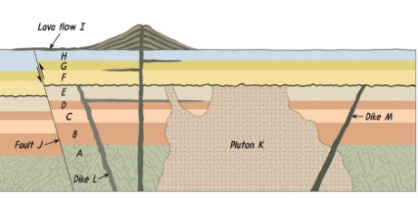
Stratigraphy Challenge 4
Answer the questions based on the diagram.
1. Which layer/feature is the oldest?
2. Which layer/feature is the youngest?
3. Which is older: Layer E or Layer F?
4. Which is older: Dike M or Pluton K?
5. Which is older: Fault J or Lava Flow I?
6. Which is older: Dike L or Fault J?
T. Tomm Updated 2022 https://sciencespot.net

Slide 2
Stratigraphy Challenge 4
The answers are …
1. Which layer/feature is the oldest?
2. Which layer/feature is the youngest?
Layer A
Lava Flow I
Layer E
3. Which is older: Layer E or Layer F?
4. Which is older: Dike M or Pluton K?
5. Which is older: Fault J or Lava Flow I?
6. Which is older: Dike L or Fault J?
Pluton K
Fault J
Dike L
T. Tomm Updated 2022 https://sciencespot.net

