Slide 1
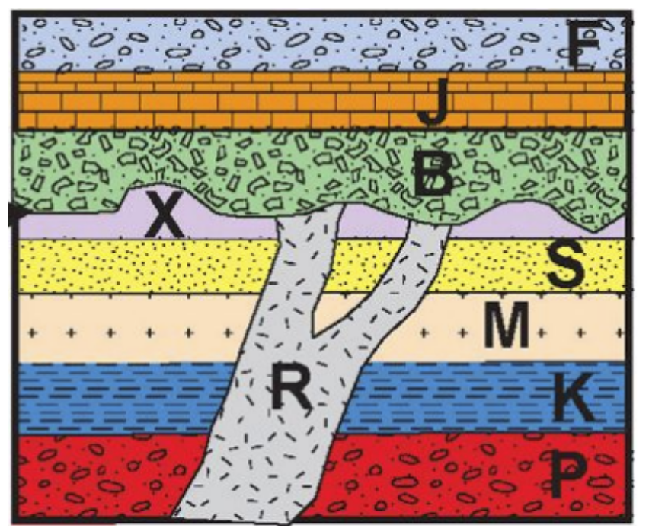
Stratigraphy Challenge 2
Put the layers/features in order from oldest to youngest.
A
B
C
D
E
F
G
H
I
___ → ___ → ___ → ___ → ___ → ___ → ___ → ___ → ___
Oldest
Youngest
T. Tomm Updated 2022 https://sciencespot.net

Slide 2
Stratigraphy Challenge 2
Put the layers/features in order from oldest to youngest.
A
B
C
D
E
F
G
H
I
I
H
F
E
D
G
C
B
A
___ → ___ → ___ → ___ → ___ → ___ → ___ → ___ → ___
Oldest
Youngest
T. Tomm Updated 2022 https://sciencespot.net

