Slide 1
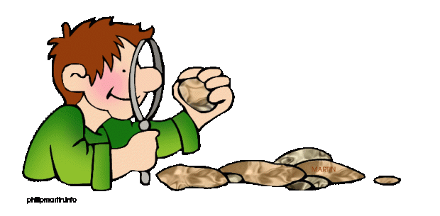
Science Scramble
Earth Science – Rocks & Minerals
T. Tomm 2017 http://sciencespot.net/
This Photo by Unknown Author is licensed under CC BY-SA-NC

Slide 2
Can you unscramble the names of these minerals or rocks?
1. I’m a type of quartz with different colors and really cool patterns.
TAGAE
2. I’m made from limestone that has been changed by heat and pressure.
EBAMLR
3. I’m used to make arrowheads & am also called “flint” because I can make fire
CETHR
NGITERA
4. I’m the instrusive “cousin” to rhyolite.
RUFLOTIE
5. I’m the Illinois state mineral.

Slide 3
The answers are …
1. I’m a type of quartz with different colors and really cool patterns.
TAGAE
AGATE
2. I’m made from limestone that has been changed by heat and pressure.
EBAMLR
MARBLE
3. I’m used to make arrowheads & am also called “flint” because I can make fire
CHERT
CETHR
GRANITE
NGITERA
4. I’m the instrusive “cousin” to rhyolite.
RUFLOTIE
FLUORITE
5. I’m the Illinois state mineral.

