Slide 1
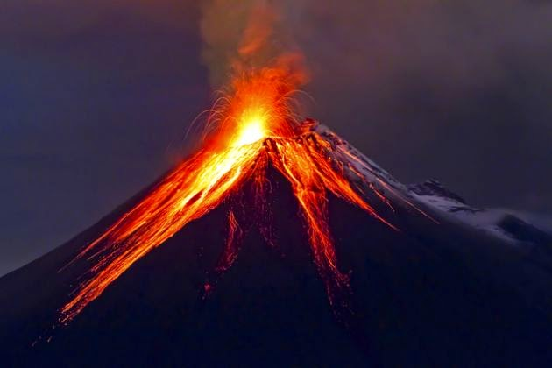
National Geographic Volcanoes 101
Click the picture to watch the video and then answer the questions on the next slide.
T. Tomm 2019 http://sciencespot.net/
This Photo by Unknown Author is licensed under CC BY-NC

Slide 2
Answer these questions after the video.
How many eruptions occur each year? A. 50 B. 75 C. 90 D. Over 100
How many plates make up the Earth’s surface? A. 7 B. 17 C. 27 D. 35
How many active volcanoes are there? A. 250 B. 500 C. Over 1000
Which tectonic plate is surrounded by the Ring of Fire? A. North American B. Asian C. Pacific
What percent of all volcanoes occur around the Ring of Fire? A. 50 B. 75 C. 90
What percent of all earthquakes occur around the Ring of Fire? A. 50 B. 75 C. 90
This Photo by Unknown Author is licensed under CC BY-NC-ND

Slide 3
The answers are …
How many eruptions occur each year? A. 50 B. 75 C. 90 D. Over 100
How many plates make up the Earth’s surface? A. 7 B. 17 C. 27 D. 35
How many active volcanoes are there? A. 250 B. 500 C. Over 1000
Which tectonic plate is surrounded by the Ring of Fire? A. North American B. Asian C. Pacific
What percent of all volcanoes occur around the Ring of Fire? A. 50 B. 75 C. 90
What percent of all earthquakes occur around the Ring of Fire? A. 50 B. 75 C. 90

