Slide 1

Picture Challenge
Can you identify these metamorphic rocks by their pictures?
C. Bals 2016

Slide 2
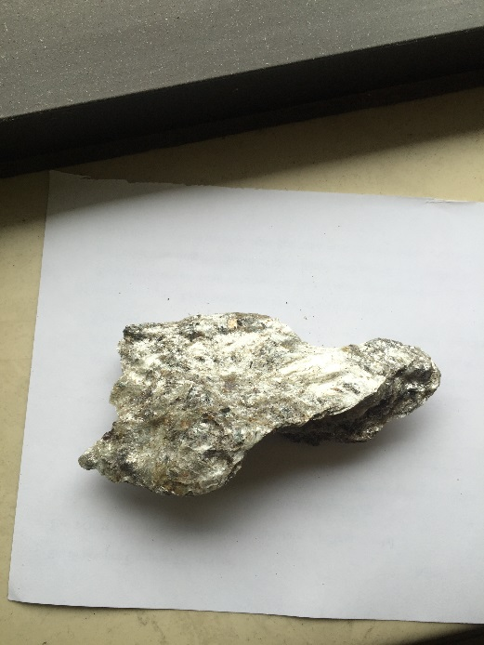
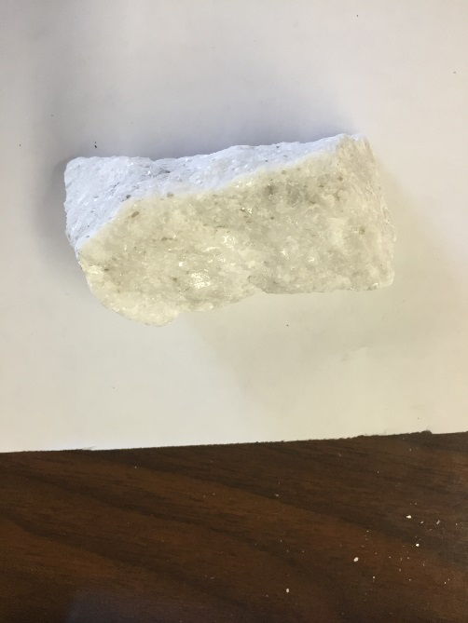
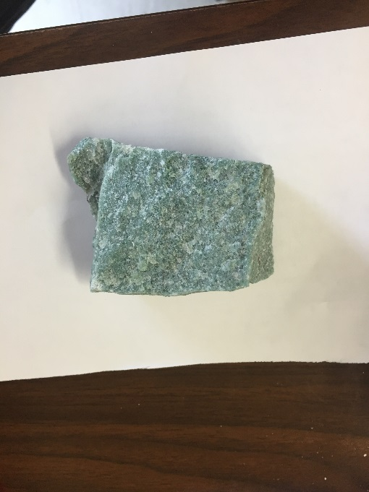
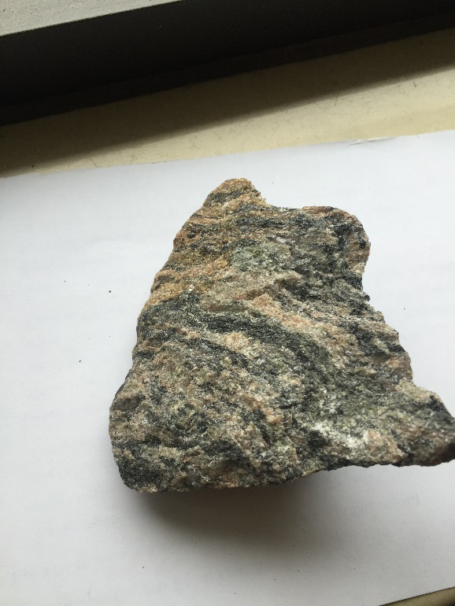
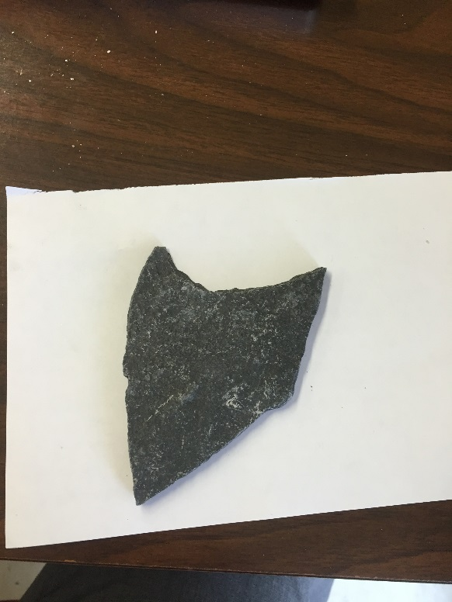
#1
#2
#3
Quartzite Gneiss Schist Slate Marble
#4
#5

Slide 3





The answers are …
1.
SCHIST
MARBLE
2.
GNEISS
4.
3.
QUARTZITE
SLATE
5.

