Slide 1
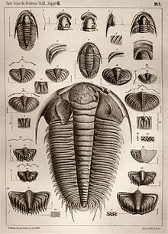
Trouble with Trilobites
Sci Show Video
T. Tomm 2019 http://sciencespot.net/
This Photo by Unknown Author is licensed under CC BY-SA

Slide 2
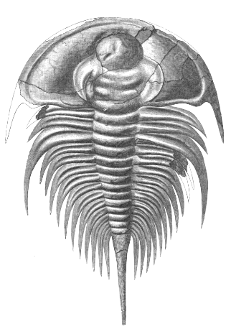
Watch the video to help you answer these questions.
How long did trilobites survive on Earth? A. 270 million B. 500 million C. 1 billion
In what types of habitats were they likely to be found? A. Marine B. Terrestrial C. Both of these
What type of animal is believed to be its ancestors? A. Brachiopods B. Jellyfish C. Worms
How were trilobites classified? A. Mollusks B. Arthropods C. Cnidarians
Which extinction is thought to have been the final blow to trilobites? A. Cambrian B. Devonian C. Permian-Triassic
How many different species of trilobites lived on earth? A. 1,500 B. 15,000 C. 15,000,000
This Photo by Unknown Author is licensed under CC BY-SA

Slide 3
The answers are …
How long did trilobites survive on Earth? A. 270 million B. 500 million C. 1 billion
In what types of habitats were they likely to be found? A. Marine B. Terrestrial C. Both of these
What type of animal is believed to be its ancestors? A. Brachiopods B. Jellyfish C. Worms
How were trilobites classified? A. Mollusks B. Arthropods C. Cnidarians
Which extinction is thought to have been the final blow to trilobites? A. Cambrian B. Devonian C. Permian-Triassic
How many different species of trilobites lived on earth? A. 1,500 B. 15,000 C. 15,000,000

