Slide 1
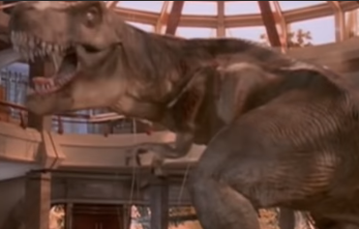
Tree of Life
Did dinosaurs go extinct?
T. Tomm 2019 http://sciencespot.net/

Slide 2
Watch the video to help you answer these questions.
Dinosaurs like other animals have four limbs and are called: A Quadrapod B. Tripod C. Tetrapod
Which formed the first branch of these 4-limbed organisms? A. Reptiles B. Amphibians C. Birds
Which branch included dinosaurs? A. Archosaurs B. Crocodilians C. Aetosaurs
Scientists believe the link between dinosaurs and birds was the: A. Pterodactyl B. Velociraptor C. Archaeopteryx
True or False? Scientists believe dinosaurs with feathers did exist.
True or False? Scientists believe some dinosaurs could fly.

Slide 3
The answers are …
Dinosaurs like other animals have four limbs and are called: A Quadrapod B. Tripod C. Tetrapod
Which formed the first branch of these 4-limbed organisms? A. Reptiles B. Amphibians C. Birds
Which branch included dinosaurs? A. Archosaurs B. Crocodilians C. Aetosaurs
Scientists believe the link between dinosaurs and birds was the: A. Pterodactyl B. Velociraptor C. Archaeopteryx
True or False? Scientists believe dinosaurs with feathers did exist.
True or False? Scientists believe some of the dinosaurs with feathers could fly.

