Slide 1
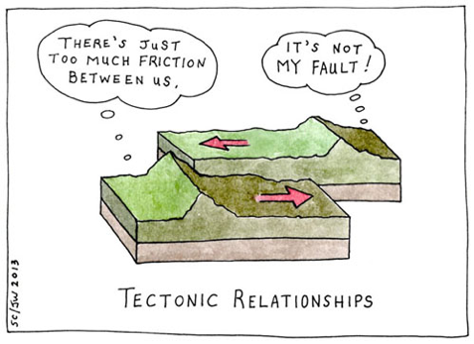
Geology Jokes 4
Unscramble the letters to figure out these jokes!
Why wasn’t the geologist hungry?
He lost his __________.
2. What did the geology teacher say to her students?
I _______you all very much!
3. Where can you find sleeping stones?
Look in the ___________!
4. What’s the punch line?
It’s not my _________.
Remember … Use what is underlined as the answer!
TIAPAET
AVAL
DBEKRCO
LAFUT
T. Tomm Updated 2022 https://sciencespot.net

Slide 2
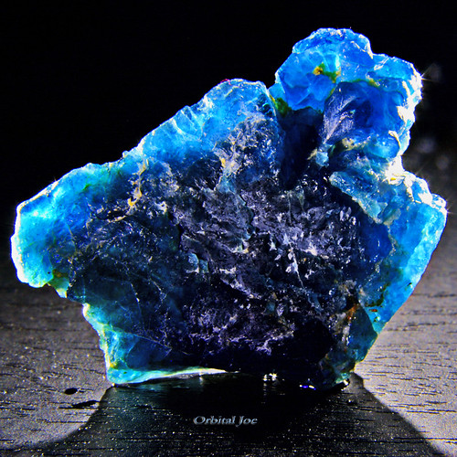
Geology Jokes 4
The answers are …
Why wasn’t the geologist hungry?
He lost his __________.
2. What did the geology teacher say to her students?
I _______you all very much!
3. Where can you find sleeping stones?
Look in the ___________!
4. What’s the punch line?
It’s not my _________.
TIAPAET
APATITE
AVAL
LAVA
This Photo by Unknown Author is licensed under CC BY-NC-ND
DBEKRCO
BEDROCK
LAFUT
FAULT
Remember … Use what is underlined as the answer!
T. Tomm Updated 2022 https://sciencespot.net

