Slide 1
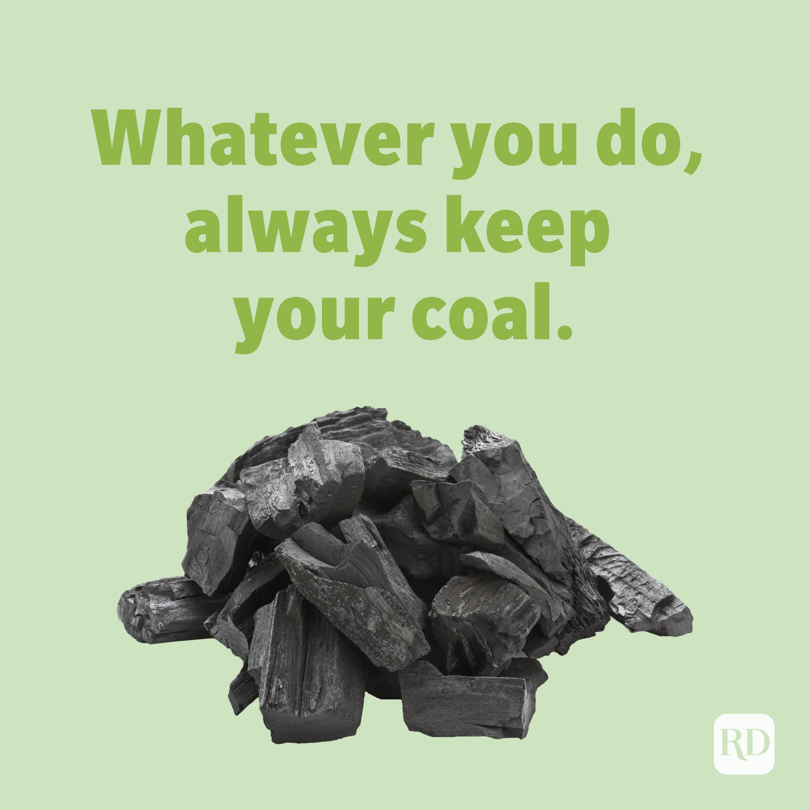
Geology Jokes 3
Unscramble the letters to figure out these jokes!
Why should you always be patient with geologists?
They all have their ________.
2. What did the geologist say to the astronomer? May the _________ be with you!
3. What is a geologists favorite restaurant? _______ _______ Cafe
4. What did the teacher say to the student who lied about their homework? You are full of _________.
SFALUT
UAQTRZ
DAHR COKR
CSISTH
T. Tomm Updated 2022 https://sciencespot.net

Slide 2
Geology Jokes 3
The answers are …
Why should you always be patient with geologists?
They all have their ________.
2. What did the geologist say to the astronomer? May the _________ be with you!
3. What is a geologists favorite restaurant? _______ _______ Cafe
4. What did the teacher say to the student who lied about their homework? You are full of _________.
Remember … Use what is underlined as the answer!
FAULTS
SFALUT
UAQTRZ
QUARTZ
DAHR COKR
HARD ROCK
CSISTH
SCHIST

