Slide 1
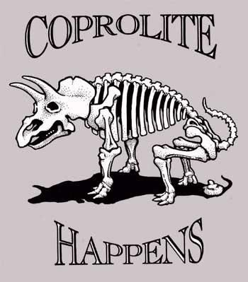
Geology Jokes 2
Unscramble the letters to figure out the punch lines!
What's a geologist's favorite flavor of ice cream?
What do you call a famous geologist?
3. What did one geologist say to the other?
4. Did you hear about the geologist who found a really long rock?
KORC REOED
A RCOK RTSA
Don’t take me for RGAITNE
It was a SELMITEON
T. Tomm Updated 2022 https://sciencespot.net

Slide 2
Geology Jokes 2
Unscramble the letters to figure out the punch lines!
What's a geologist's favorite flavor of ice cream?
What do you call a famous geologist?
3. What did one geologist say to the other?
4. Did you hear about the geologist who found a really long rock?
KORC REOED
ROCK ERODE
Make sure the words that are highlighted ad underlined are your answers.
A RCOK RTSA
A ROCK STAR
Don’t take me for RGAITNE
Don’t take me for GRANITE
It was a SELMITEON
It was a MILESTONE

