Slide 1
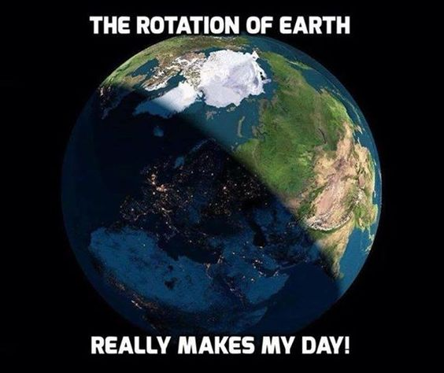
Geology Jokes 1
Unscramble the letters to figure out the punch lines!
1. What do you call an Irish gem that isn't real?
2. What do you call a rock that won't go to school?
3. How does a geologist like to relax?
4. What's a geologist's favorite band?
A ASMH-ORCK
A ISPKINPG SNOET
IN A OGRCIKN CIRHA
LNOLRIG TEOSNS
T. Tomm Updated 2022 https://sciencespot.net

Slide 2
Geology Jokes 1
Unscramble the letters to figure out the punch lines!
1. What do you call an Irish gem that isn't real?
2. What do you call a rock that won't go to school?
3. How does a geologist like to relax?
4. What's a geologist's favorite band?
A ASMH-ORCK
A SHAM-ROCK
A ISPKINPG SNOET
A SKIPPING STONE
IN A OGRCIKN CIRHA
IN A ROCKING CHAIR
LNOLRIG TEOSNS
ROLLING STONES
T. Tomm Updated 2022 https://sciencespot.net

