Slide 1
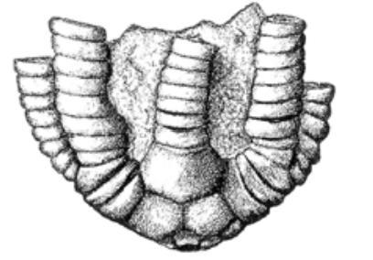
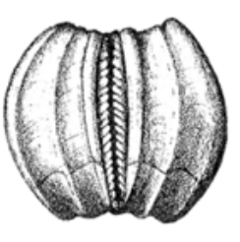
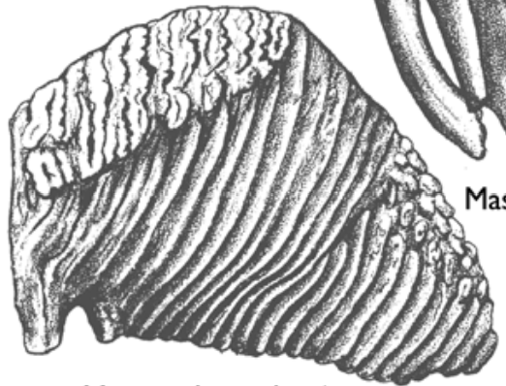
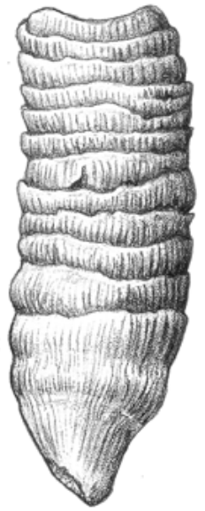
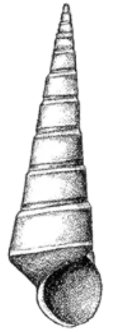
Fossil ID Challenge 1
Identify each fossil using the word list.
1
5
4
2
Ammonite
Blastoid
Coral
Crinoids
Gastropod
Mammoth Tooth
Trilobite
6
7
3
T. Tomm 2022 https://sciencespot.net

Slide 2
Fossil ID Challenge 1
The answers are …
1
Crinoids
5
Ammonite
4
Trilobite
2
6
Ammonite
Blastoid
Coral
Crinoids
Gastropod
Mammoth Tooth
Trilobite
Blastoid
Mammoth Tooth
7
3
Gastropod
Coral
T. Tomm 2022 https://sciencespot.net

