Slide 1
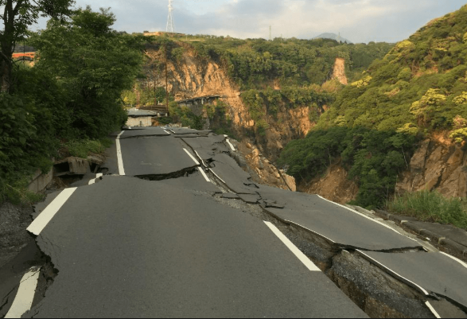
Earthquakes
Nat Geo Video
T. Tomm 2019
https://www.canterbury.ac.nz/research/specialties/earthquakes-disasters-and-resilience/

Slide 2
Watch the video to answer these questions.
Into how many major plates is Earth’s crust divided? A. 12 B. 20 C. 28
True or False? The deeper the epicenter of a quake, the more violent it will tend to be and cause more damage.
What happens at a subduction zone? A. One plate is pushed up to create a mountain range B. One plate is pushed under another causing it be forced inside the earth. C. One plate pushes into another plate causing it to crack.
How many detectable earthquakes happen around the world each year? A. 100 B. 100,000 C. 500,000
How much stronger is a quake with a rating of 6 than one rated at a 4? A . 2 times B. 10 times C. 100 times
Name one thing that designers are using to help prevent earthquake damage to buildings.

Slide 3
The answers are …
Into how many major plates is Earth’s crust divided? A. 12 B. 20 C. 28
True or False? The deeper the epicenter of a quake, the more violent it will tend to be and cause more damage.
What happens at a subduction zone? A. One plate is pushed up to create a mountain range B. One plate is pushed under another causing it to melt. C. One plate pushes into another plate causing it to crack.
How many detectable earthquakes happen around the world each year? A. 100 B. 100,000 C. 500,000
How much stronger is a quake with a rating of 6 than one rated at a 4? A . 2 times B. 10 times C. 100 times
Name one thing that designers are using to help prevent earthquake damage to buildings.
Flexible structures, stronger foundations, & lighter roofs

