Slide 1

Cell Division
Do you remember the
stages in mitosis?
T. Trimpe 2008 http://sciencespot.net/

Slide 2
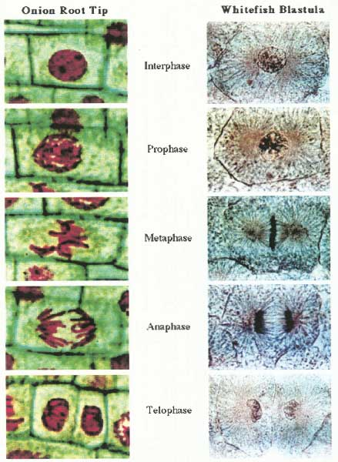
Answer the questions using the cell images shown below.
A
B
C
D
E
1. What type of cell is shown in the pictures above? Plant or Animal
2. Which cell is in the first phase of cell division? _____
3. Which cell is in anaphase? _____
4. What stage is shown in cell A? ______________
5. Which stage is shown in cell B? _______________
6. List the cells in the order they occur in cell division. ___ → ___ → ___ → ___ → ____
Image: http://www.seop.yale.edu/imgs/mitosis.jpg

Slide 3
The answers are …
A
B
C
D
E
D
1. What type of cell is shown in the pictures above? Plant or Animal
2. Which cell is in the first phase of cell division? _____
3. Which cell is in anaphase? _____
4. What stage is shown in cell A? ______________
5. Which stage is shown in cell B? _______________
6. List the cells in the order they occur in cell division. ___ → ___ → ___ → ___ → ____
E
C
PROPHASE
TELOPHASE
E
A
D
C
B

