Slide 1

Cell Division
Do you remember the
stages in mitosis?
T. Trimpe 2008 http://sciencespot.net/

Slide 2
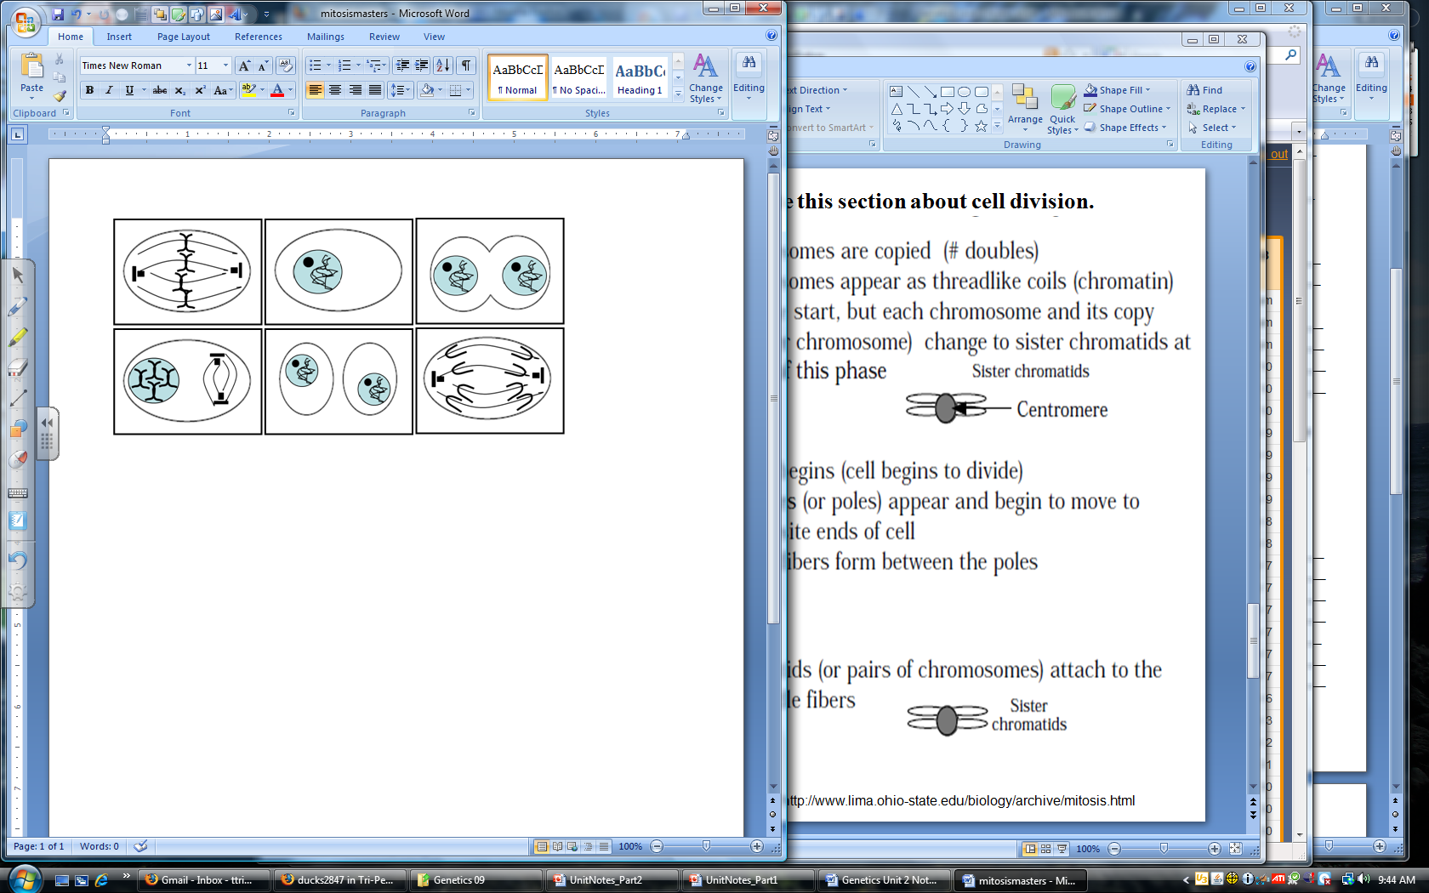
Identify each stage in cell division.
A
D
Interphase _____
Prophase _____
Metaphase _____
Anaphase _____
Telophase _____
Cytokinesis _____
B
E
C
F

Slide 3
The answers are …
A
D
Interphase _____
Prophase _____
Metaphase _____
Anaphase _____
Telophase _____
Cytokinesis _____
B
F
C
B
E
D
A
C
F
E

