Slide 1

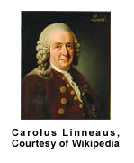
Scientific Words
Challenge 1
Created by B. Bowlby 2012

Slide 2
Unscramble the following words.
yohepnogl
cmreotde
ooblsiigt
lnreau
vheobrier
The underlined letter is the first letter of each word.

Slide 3
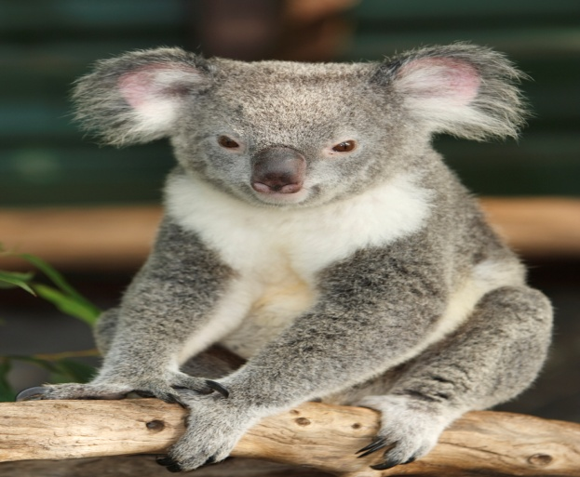
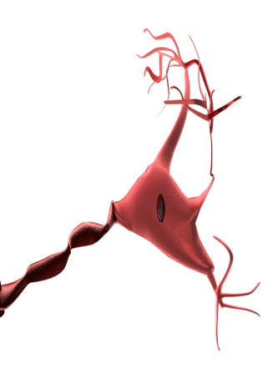
Unscramble the following words.
Phenology
ectoderm
biologist
neural
herbivore
Study of appearance
Outside skin
One who studies life
Having the characteristics of a nerve
Plant eaters

