Slide 1
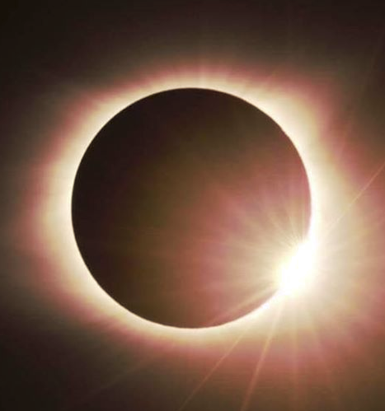
Eclipse Basics
You need to write down an answer for EACH question – even if it is just your best guess!
T. Tomm 2017 http://sciencespot.net/

Slide 2
Choose the best answer for each.
1. During which phase does a solar eclipse occur? A. New moon B. Full moon C. It can be both.
2. Which of these cities was in the path of totality? A. Washington, DC B. Nashville, TN C. Savannah, GA
3. What do we call the outer atmosphere of the sun? A. Solar flare B. Corona C. Sun sphere
4. Which is larger: A. Earth B. Sun C. Moon
5. Which of these would most likely be the view from Chicago, IL? A. B. C. D.

Slide 3
The answers are …
1. During which phase does a solar eclipse occur? A. New moon B. Full moon C. It can be both.
2. Which of these cities was in the path of totality? A. Washington, DC B. Nashville, TN C. Savannah, GA
3. What do we call the outer atmosphere of the sun? A. Solar flare B. Corona C. Sun sphere
4. Which is larger: A. Earth B. Sun C. Moon
5. Which of these would most likely be the view from Chicago, IL? A. B. C. D.
Miss something …
Cross out the wrong answer and write the correct one.

