Slide 1
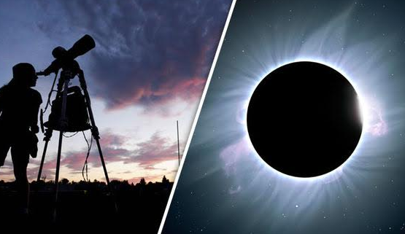
Eclipse Basics
You need to write down an answer for EACH question – even if it is just your best guess!
T. Tomm 2017 http://sciencespot.net/

Slide 2
Choose the best answer for each.
What is the correct order for a solar eclipse? A. S→ M→ E B. M→ S → E C. S→ E→ M
2. Which of these cities was in the path of totality? A. Los Angeles, CA B. Kansas City, KS C. Miami, FL
3. True or False? It is safe to look at the sun when there isn’t an eclipse.
4. When will the next eclipse be? A. 2024 B. 2043 C. 3017
5. How much larger is the sun than the moon? A. 390 B. 400 C. 790
6. Why does the moon appear to be the same size as the sun? A. It is closer to Earth during a solar eclipse. B. It’s distance from earth is proportional to the sun making it appear the same size. C. The sun’s corona is not as large during an eclipse making it appear smaller.

Slide 3
The answers are …
What is the correct order for a solar eclipse? A. S→ M→ E B. M→ S → E C. S→ E→ M
2. Which of these cities was in the path of totality? A. Los Angeles, CA B. Kansas City, KS C. Miami, FL
3. True or False? It is safe to look at the sun when there isn’t an eclipse.
4. When will the next eclipse be? A. 2024 B. 2043 C. 3017
5. How much larger is the sun than the moon? A. 390 B. 400 C. 790
6. Why does the moon appear to be the same size as the sun? A. It is closer to Earth during a solar eclipse. B. It’s distance from earth is proportional to the sun making it appear the same size. C. The sun’s corona is not as large during an eclipse making it appear smaller.

