Slide 1
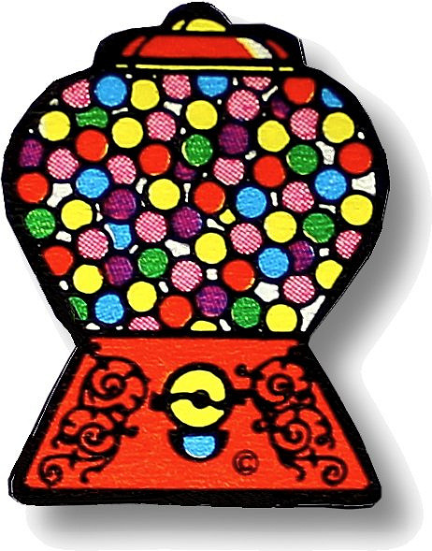
Bubble Time
Let’s help Patrick …
Which brands make the biggest bubbles?
T. Tomm 2003 Updated 2020 http://sciencespot.net/

Slide 2
Bubble Time
Patrick loves bubble gum and would like to be able to blow bigger bubbles than anyone else in Bikini Bottom. To prepare for the Bikini Bottom Big Bubble Contest, he bought four different brands of bubble gum and needs your help to find the brand that creates the biggest bubbles.
Part A: Identifying Variables & Controls
1) What is the independent variable in this experiment? ____________________
2) What is the dependent variable in this experiment? _____________________

Slide 3
3) What other variables would be involved in this experiment? List at least three and explain how will you set up your experiment to control these variables.
Bubble Blowing Ability
Bubble Gum Brand
Measurement Errors
Other?

Slide 4

3) What other variables would be involved in this experiment? List at least three and explain how will you set up your experiment to control these variables.
POSSIBLE RESPONSES
Chew time → Need to chew all at the same amount of time
Technique →Need to blow bubbles the same way every time (consistency) using the same method and amount of air
Bubble Blowing Ability
Bubble Gum Brand
Measurement Errors
Number of brands → How many do we need to test?
Size & Mass – Compare before and after to see how much sugar/flavorings are in it (OPTIONAL)
Number of trials → Use best 5 out of 7
Observations – Make notes about how elastic it is, how easy it is to blow bubbles, its texture, stickiness, etc.
Measurement → Need to measure the same way every time; use chart and phones to improve accuracy
Dude Perfect Bubblegum Challenge

Slide 5
Bubble Time Experiment Procedure
Be sure to include all the info from the questions we discussed!

Slide 6
Part B: Experiment - Write an experiment on the page below this worksheet to test the bubble power of the bubble gum brands and help Patrick win the contest. Remember to include all the necessary parts to ensure your results are accurate and reliable.
SAMPLE PROCEDURE
Procedure:
1 - Chew gum for two minutes.
2 - Blow one bubble and have the group mates determine the length (distance from the lips). Record in the chart.
3 - Repeat #4 six more times using the same method. Record each in the chart.
4 - Use the best 5 scores to calculate the average. Record in the chart along with any observations you made (texture, elasticity, thickness, etc.)
5 - Repeat steps 1-6 for the other four brands. Record data in the chart.

Slide 7
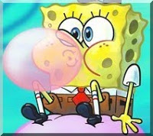
TIME TO TEST
Which brand are we testing today? _______________________
What do we need to do?
1st – Chew the gum for ____ minutes.
2nd – Try blowing bubbles ____ times and have someone measure each attempt.
3rd – Record the size of the bubbles cm in your chart and calculate the average.
Repeat for other brands tested

Slide 8
Bubble Time Results
Brand → | Double Bubble | Big League | Cry Baby | Extra
AVERAGES → | 5.26 | 5.63 | 3.92 | 4.19
Class Averages
2nd Hour | 5.43 | 5.57 | 3.85 | 4.26
3rd Hour | 4.93 | 5.55 | 3.13 | 3.68
7th Hour | 5.40 | 5.78 | 4.79 | 4.64
SAMPLE
Go to Google Drive → Shared with Me → Patrick’s Bubble Gum Challenge to see the results for all classes.

Slide 9
Brand → | Double Bubble | Big League | Cry Baby | Extra
AVERAGES → | 5.26 | 5.63 | 3.92 | 4.19
Class Averages
2nd Hour | 5.43 | 5.57 | 3.85 | 4.26
3rd Hour | 4.93 | 5.55 | 3.13 | 3.68
7th Hour | 5.40 | 5.78 | 4.79 | 4.64
SAMPLE
1) Which brand had the highest average for YOU? ________________________
2) Which brand had the highest average OVERALL? ________________________
3) Did your results match the overall results? Explain using the data.

Slide 10
Bubble Time Results
Brand → | Double Bubble | Big League | Cry Baby | Extra
AVERAGES → | 5.26 | 5.63 | 3.92 | 4.19
Class Averages
2nd Hour | 5.43 | 5.57 | 3.85 | 4.26
3rd Hour | 4.93 | 5.55 | 3.13 | 3.68
7th Hour | 5.40 | 5.78 | 4.79 | 4.64
SAMPLE
4. Which brand would you recommend Patrick use in the contest? Why?

Slide 11
Bubble Time Results
Brand → | Double Bubble | Big League | Cry Baby | Extra
AVERAGES → | 5.26 | 5.63 | 3.92 | 4.19
Class Averages
2nd Hour | 5.43 | 5.57 | 3.85 | 4.26
3rd Hour | 4.93 | 5.55 | 3.13 | 3.68
7th Hour | 5.40 | 5.78 | 4.79 | 4.64
SAMPLE
5. Is the data accurate and reliable? Explain.

