Slide 1
Science of Rainbows
Presentation by T. Tomm 2019 sciencespot.net
This Photo by Unknown Author is licensed under CC BY-NC-ND

Slide 2
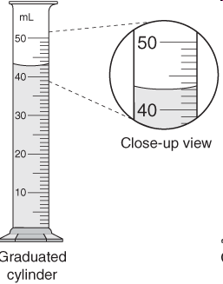
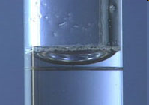
Measuring Volume
We will be using graduated cylinders to find the volume of liquids and other objects.
Read the measurement based on the bottom of the meniscus or curve. When using a real cylinder, make sure you are eye-level with the level of the water.
What is the volume of water in the cylinder? _____mL
What causes the meniscus?
A concave meniscus occurs when the molecules of the liquid attract those of the container. The glass attracts the water on the sides.
Top Image: http://www.tea.state.tx.us/student.assessment/resources/online/2006/grade8/science/images/20graphicaa.gif Bottom Image: http://morrisonlabs.com/meniscus.htm

Slide 3
Part A: Measurement Challenge
Materials for EACH GROUP: Dry erase marker
6 Test tubes w/ rack (carry by the base)
3 small cups – 1 with red, 1 with yellow, and 1 with blue water
2 Graduated Cylinders
2 Eyedroppers
Challenge:
Follow the directions on the next slide to complete this challenge.
Measure carefully → accuracy is very important to get the correct results.
Before we begin … Put the test tubes in each spot → A, B, C, D, E, F Fill the small beakers with colored water –red, yellow, and blue.

Slide 4
Directions:
1 – Measure 19 mL from the beaker of red water and add to A.
2 - Measure 18 mL from the beaker of yellow water and add to C.
3 - Measure 18 mL from the beaker of blue water and add to E.
4 - Measure 4 mL from C and pour into D.
5 – Measure 7 mL from E and add to D. Mix.
6 – Measure 4 mL from the beaker of blue water and add to F.
7 – Measure 7 mL from the beaker of red water and to F. Mix.
8 – Measure 8 mL from A and pour into B.
9 – Measure 3 mL from C and add to B. Mix.
Done? Show your teacher and then complete the chart on your worksheet based on your results.

Slide 5
Part A Continued
Data Chart
3. How did your results compare to other groups?
4. Why was accuracy important in this lab?

Slide 6
Science of Rainbows
What is ROYGBIV?
How do rainbows form?
What is the importance of “42”?
What exactly is “white” light?
Look it up … What are sun dogs? What are moon dogs?
This Photo by Unknown Author is licensed under CC BY
Video Link: https://www.youtube.com/watch?v=5pYnC-ONdXQ

Slide 7
Extension Activity: Color Wheels
Materials:
Water soluble markers – red, yellow, blue
Filter paper – 1 circle per person
Beaker of water with eyedropper
Directions:
Place three dots in the center of the filer paper as shown above.
Place the filter paper on top of a cup
Add THREE drops of water TO THE CENTER of the paper one at a time waiting a few seconds between drops.
Continue adding drops of water one at a time until the water reaches the edges of the paper.
After the water has reached the edge of the paper, record your observations on your worksheet.

Slide 8
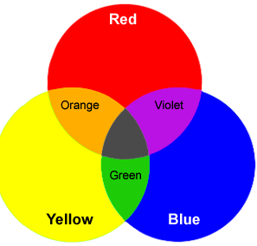
Discuss It
1. What were your results? Explain using words and diagrams.
2. Work with your tablemates to write a definition for each with examples.
Primary colors
Secondary colors
Image: https://www.open.edu/openlearn/science-maths-technology/science/chemistry/separate-coloured-ink-experiment

Slide 9
Challenge: Cool Colors
Which cool color challenge will you try? Watch the video to get ideas.
You may work with a partner. Bring the materials you’ll need to class tomorrow and be prepared to share it with your classmates.
Discussion Questions:
What did you observe as you completed your experiment?
How did you experiment compare to the one in the video?
In scientific terms, explain your observations.

