Slide 1
DaVinci Bridges
Instructions: https://www.instructables.com/id/Da-Vinci-Popsicle-Stick-Bridge/
Presentation by T. Tomm 2019 sciencespot.net
Logo: https://thayermemoriallibrary.org/steam-logo-1/

Slide 2
What is a DaVinci bridge?
It is a SELF-SUPPORTING BRIDGE based on one of Leonardo Da Vinci's designs with NO FASTENERS OR ADHESIVES.
Your team will need to WEAVE the sticks together so that the TENSION between the sticks keeps the bridge together and lifts it off the ground.
The bridge is strong when it comes to a DOWNWARD FORCE but any LATERAL FORCE (from the sides) may cause it to topple. Moving the bridge while it stands (even slightly) could cause it to fall apart, so be careful and work with your tablemates to create the bridge.
Source: https://www.instructables.com/id/Da-Vinci-Popsicle-Stick-Bridge/

Slide 3
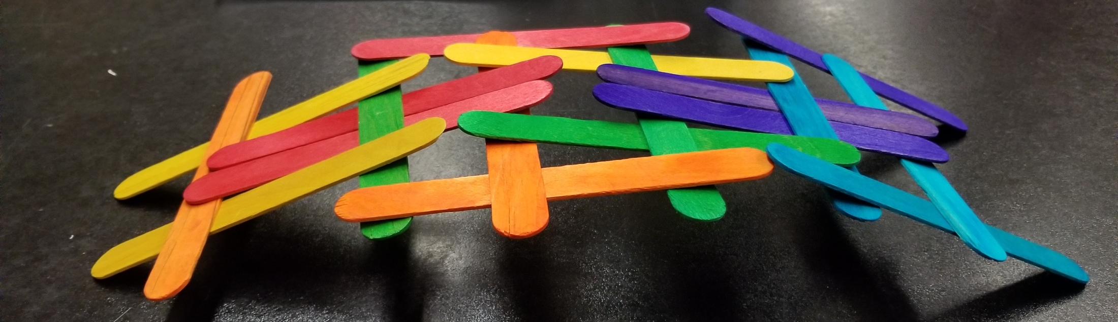
Directions
Work with your tablemates to build a DaVinci bridge using only the popsicle sticks provided.
Instructions available at https://www.instructables.com/id/Da-Vinci-Popsicle-Stick-Bridge/ (or do a Google search to find the page).

Slide 4
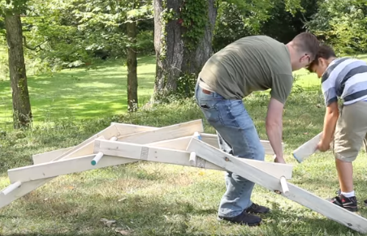
Need more help …
Let’s watch this video to see how they make the bridge
Your team may also look for other tutorials online. Share the good ones with your teacher!

Slide 5
Discuss It
Were you able to make the bridge? If so, how many sticks did you use – all of them?
What was the hardest part of the challenge?
What might have made it easier – bigger or smaller sticks, longer or shorter sticks?
Could you use other materials? If so, what should we try?

Slide 6
Scientist Spotlight
Who was Leonardo DaVinci?
What did he invent?
Would you consider him an artist or scientist?
What questions might you ask him if you could?
What STEAM areas did this project involve?
Video Link: https://www.youtube.com/watch?v=KJboCFa4iVQ

Slide 7
Scientist Spotlight
Who was Leonardo DaVinci?
What did he invent?
Would you consider him an artist or scientist?
What questions might you ask him if you could?
What STEAM areas did this project involve?
A peasant with little education beyond the basics
Bridges, flying machines, parachutes, water wheels, cannons, scuba suits + studies of anatomy
?
?
Science, Engineering, & Art

Slide 8
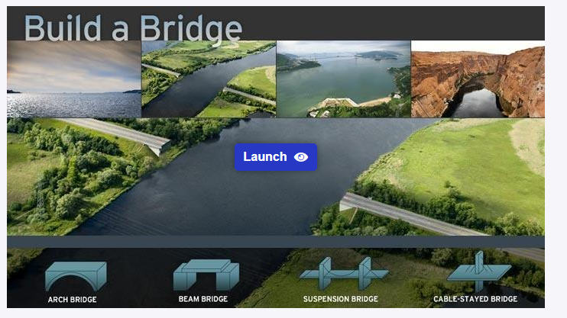
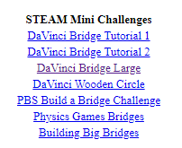
Going further …
Go to mrstomm.com → Science Spot Kid Zone → Physics Links to find the PBS Build A Bridge Challenge
Work with a classmates to complete all four challenges.

