Slide 1
Nature of Science Unit
Slide/Page Format
Slide size – 11x8.5 One page per slide
(Prints on standard paper landscape view)
Click here for a link to make a copy of the STUDENT MASTERS
(digital notebook) that goes along with this presentation.
Check the margin areas and speaker notes on each slide for teaching notes and resources.
Section 1: “What is Science?”
Science Connections (SS #2)
Definition – NGSS & more (SS #3)
Branches of Science (SS #4)
Ologies Choice Board (SS #5)
Smillionaires (Optional)
Section 2: Scientific Method(s)
Scientific Method & Variables (SS #6)
Observation vs. Inference (SS #7-8)
Data & Relationships (SS #9-10)
Qualitative vs. Quantitative (SS #11)
Reliability vs. Accuracy (SS #12)
Lab Equipment (SS #13)
Science Safety w/ SpongeBob (SS #14)
Safety Lesson – What’s the mistake? (SS #15)
Section 3: Investigations
Sinkin’ Lincoln Lab (SS #16-17)
Bikini Bottom Experiments (SS #18-20)
Bubble Time (SS #21-24)
Your Turn (Optional) (SS #25)
GIMKIT – Unit Review (SS #26)
Additional Resources:
Ologies Choice Board Assignment
Penny Lab – Your Turn (Google Form)
Bubble Gum Data (Google Form)
Student Masters (Used for backgrounds)
SS = Student Slides
SS #16-17 indicates the
Sinkin’ Lincoln Lab is on pages 16-17 of the student notebook
TIP: Preview the presentation to see the animations on each slide prior to using it with your students.
Teacher Masters
Notes:
Designed for 7th & 8th grade science by T.Tomm
Updated 2020 http://sciencespot.net/

Slide 2
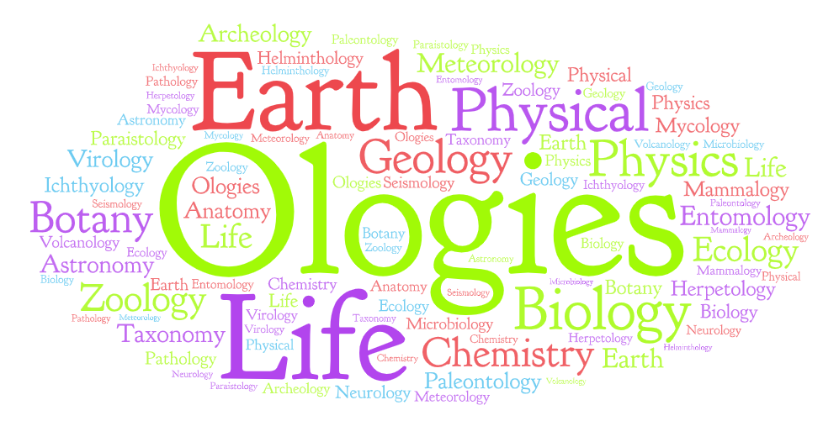
Section 1: What is science?
Image created using
https://wordart.com/create
Notes:
Designed for 7th & 8th grade science by T.Tomm
Updated 2020 http://sciencespot.net/

Slide 3
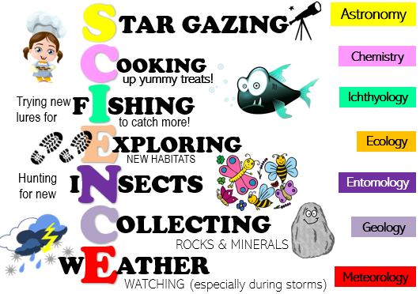
SCIENCE CONNECTIONS
How does science connect to your world? Use each of the letters in SCIENCE to create words (or phrases) to connect your hobbies & interests to science. Add images to go with each one.
Astronomy
NOTE: These labels will be used for an activity on Slide 6.
Chemistry
Ichthyology
Ecology
EXAMPLE
Entomology
Geology
Meteorology

Slide 4
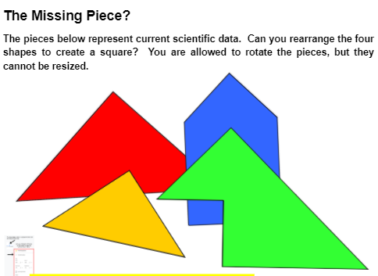
What is science?
Science is both a body of KNOWLEDGE and the PROCESSES and PRACTICES used to add to that body of knowledge. It is a way of knowing used by many PEOPLE, not just SCIENTISTS.
Science knowledge is CUMULATIVE and many people, from many generations and nations, have contributed to the refinement of, and changes to, THEORIES, IDEAS, and BELIEFS over time.
Science investigations do not follow just ONE specific scientific method. There are MANY methods to learning about the world around us. The STEPS we follow and the ORDER in which we complete them depends on what we are investigating.
Fill in your notes as we discuss this in class
Challenge: Missing piece?
Find your assignment on GC
Notes:
Notes slide – Use for class presentation; students will need this information to complete their notes.
Also available from the Science Learning Hub - Scrambled Sentences

Slide 5
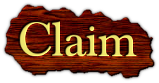
CLAIM-EVIDENCE-REASONING (CER)
A claim is a statement that answers the question. It does not include any explanation, reasoning, or evidence.
The evidence is the data used to support the claim. It can be either quantitative (numerical, measured) or qualitative (descriptive). Evidence should directly support the claim.
The reasoning is the explanation of “why and how” the evidence supports the claim. The underlying science concept that produced the evidence or data should also be included.
Notes:
CER Resources
Better Lesson CER - https://betterlesson.com/lesson/628742/using-claim-evidence-reasoning-to-support-student-ideas-in-science
NSTA Learning Hub - https://learningcenter.nsta.org/discuss/default.aspx?tid=OLqoCB8mHIU_E
Real Science Challenge - https://www.realsciencechallenge.com/cer-examples-ig-nobel-prize/

Slide 6
CLAIM-EVIDENCE-REASONING (CER)
Assignment: Watch the video on YOUTUBE. Fill in the rest of the table based on the video and the definitions above.
Question | What happened to the cat?
Claim
Evidence
Reasoning
Notes:
Go to https://www.modelteaching.com/education-articles/writing-instruction/claim-evidence-reasoning-cer for more details about the Doritos CER.

Slide 7
CLAIM-EVIDENCE-REASONING (CER)
Your Turn: Follow your teacher’s directions to complete the CER below.
Question
Claim
Evidence
Reasoning
Notes:
She Shed CER - https://docs.google.com/presentation/d/1kdHiDdxu0bbMv5RDpG2GvkP0x4sGobIeIDQ8sjZTF3o/copy

Slide 8
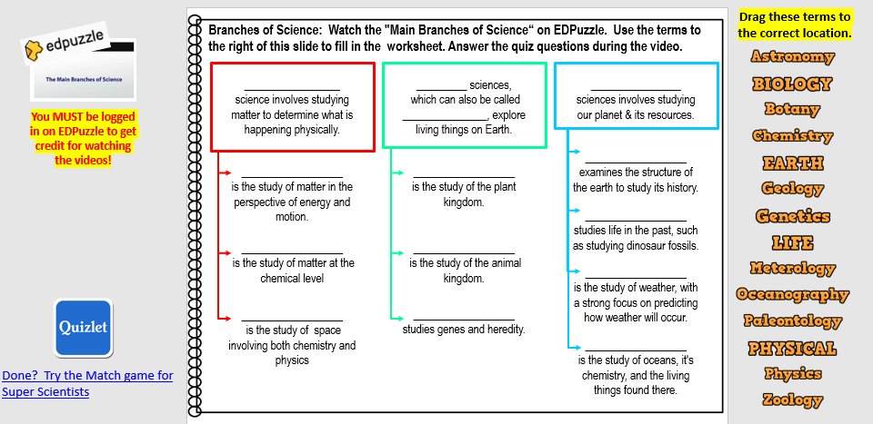
Your assignment: Watch the EDPuzzzle video to help you fill in the answers on the Branches of Science slide – Slide #4.
Try the Quizlet Match game when you are done!
Notes:
Notes slide – Use for class presentation; students will need this information to complete their notes.

Slide 9
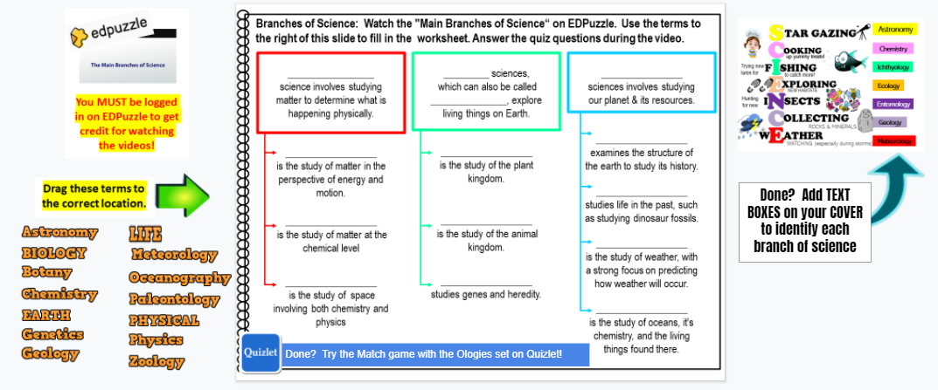
Drag these terms to the correct location.
Your assignment: Watch the EDPuzzzle video to help you fill in the answers on the Branches of Science slide.
You MUST be logged in on EDPuzzle using your school account to get credit for watching the videos!
Students MUST be logged in to your classroom on EDPuzzle in order for teachers to view their results!
EDPuzzle is free for teachers. It will import your Google Classroom rosters to make the process of setting up classes easy!
Done? Try the Match game with the Ologies vocab set!
Notes:
Notes slide – Use for class presentation

Slide 10
Branches of Science - Watch the "Main Branches of Science“ video. Drag each term from the right of this slide to the correct locations Answer the quiz questions during the video.
Drag these terms to the correct location.
_________________ science involves studying matter to determine what is happening physically.
_________ sciences, which can also be called _______________, explore living things on Earth.
________________ sciences involves studying our planet & its resources.
Students MUST be logged in to your classroom on EDPuzzle in order for teachers to view their results!
EDPuzzle is free for teachers. It will import your Google Classroom rosters to make the process of setting up classes easy!
__________________ examines the structure of the earth to study its history.
__________________ is the study of matter in the perspective of energy and motion.
__________________ is the study of the plant kingdom.
__________________ studies life in the past, such as studying dinosaur fossils.
__________________ is the study of matter at the chemical level
__________________ is the study of the animal kingdom.
__________________
is the study of weather, with a strong focus on predicting how weather will occur.
__________________ is the study of space involving both chemistry & physics
__________________ studies genes and heredity.
__________________ is the study of oceans, it's chemistry, and the living things found there.
Done? Try the Match game with the Ologies vocab set!
Notes:
Notes slide – Use for class presentation

Slide 11
SCIENCE CONNECTIONS
Which “Ologies” do you enjoy? Identify each area on your cover.
Astronomy
Chemistry
Ichthyology
Ecology
Entomology
Geology
Meteorology

Slide 12
Directions: Pick projects that will earn you at least 50 points. Place a star on the boxes for the projects you complete.
UPick Project: Ologies
Pts | Science Connections | Ologies | Vocabulary
5 | Find five examples of science in your home or yard to create a display to teach others about science in our daily lives. Organize the examples into the 3 branches of science. | Many “ologies” can be classified into more than one branch of science. Identify at least 5 “ologies” that address 2 or more branches. Give a description to tell what each studies. | Play the Match game on Quizlet and earn a time under 10 seconds to get 5 points. Add a screenshot of your entire screen to the assignment in Google Classroom.
10 | Create a cartoon for younger students to explain how the main branches of science are connected to the world around them. The cartoon may be on paper or in the form of an animation or video. | Create a song or book for little kids about the different branches of science. Your song will need to include at least 10 of the “ologies” along with information to explain what is studied. | Find a newspaper article or video about recent scientific discoveries. Identify the types of scientists involved in the discovery and how they contributed to our understanding of the discovery.
15 | Pick a day to record at least 20 activities you do, such as eating breakfast, walking to class, etc. Create a display to show how each relates to the branches of science . | Develop a job posting for one of the “ologies” that includes the education, daily activities, and types of tools or equipment the scientist would need to use to perform his/her job. | Create 10 questions using the “Ologies” set that your teacher could use for online games or tests. Each question must have 4 answer choices with the correct answer identified.
NOTE: You may also draw it by hand and upload a picture to this slide!
Use the Ologies vocab set to help you!
NOTE: You may create paper versions. Take a picture to upload to a slide for credit and turn in to your teacher.
Notes:
Notes slide – Use for class presentation

Slide 13
Super Scientist Smillionaire
Challenge students to a “Who Wants to be a Millionaire” version created on Quia. Instead of $, they earn smileys, which is why it’s called “Smillionaire”.
I usually post this slide on my SmartBoard for students to add their names after they earn a million smileys. They must show me their screen for credit (or a screenshot showing the entire screen.)
I do allow them to use tally marks to show how many they have earned, and it often becomes quite the competition. I limit credit to class time only, but encourage them to work on it outside class.
NOTE: This is a flash-based activity, but they have an HTML version.
SMILLIONAIRES
Notes:
Notes slide – Use for class presentation

Slide 14
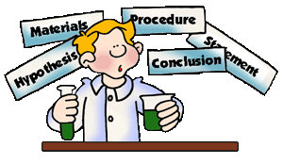
Section 2: Scientific Method
Notes:
Designed for 7th & 8th grade science by T.Tomm
Updated 2020 http://sciencespot.net/

Slide 15
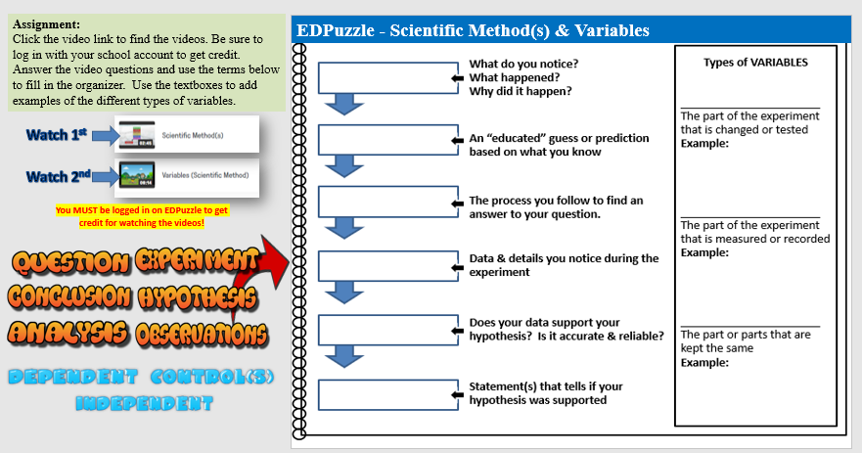
Assignment:
Click the video links to find the videos. Be sure to log in with your school account to get credit. Answer the video questions and use the terms provided to fill in the organizer. Use the textboxes to add examples of the different types of variables.
Watch 1st
Watch 2nd
NOTE: Students MUST be logged in on EDPuzzle to get credit for watching the videos!
Notes:
Notes slide – Use for class presentation

Slide 16
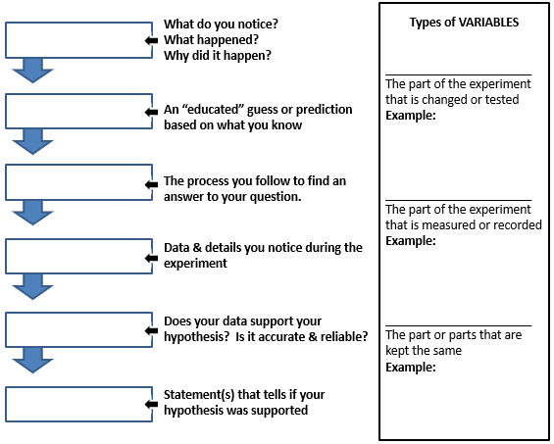
EDPuzzle - Scientific Method & Variables
Go to the next slide to check your notes on variables.
Notes:
Notes slide – Use for class presentation

Slide 17
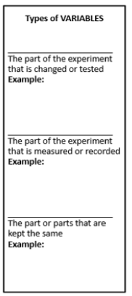
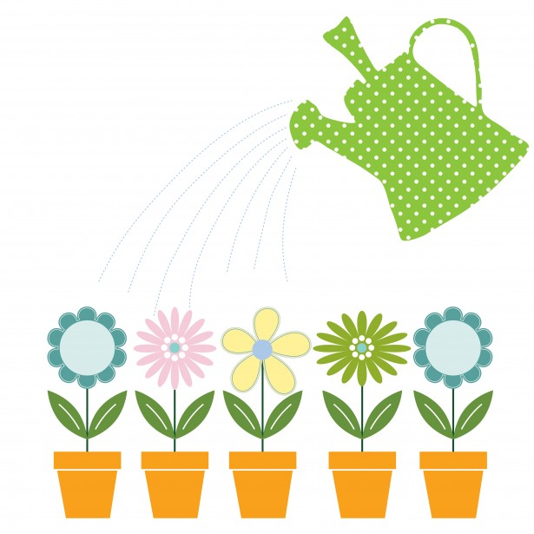
Types of Variables
What is changed or tested?
DEPENDS ON
How often the plants were watered
What is measured or observed?
In an experiment to determine if watering a plant every day will make a plant grow better than watering it every three days. We will use the same brand & amount of soil, same amount of water, and place them in the same location in a sunny window.
How much the plants grew
What is kept the same?
Same soil, same amount of light & water
Notes:
Notes slide – Use for class presentation

Slide 18
Observations vs. Inferences
Information gathered with your senses; may be quantitative or qualitative
Process of drawing a conclusion
based on background knowledge and/or evidence
Task #1: I am going to read three observations. You will need to make an inference about where I was AFTER I have read all three, but do not share it with anyone yet!
I saw many people.
A lot of people were screaming.
Where was I?
What was your inference?
I could smell popcorn.
Does this change your inference? How?
Another clue … People were eating hot dogs and ice cream
Task #2: Read the following sentences carefully. For each sentence, highlight each observation and underline the inference.
The people down the street must be having a barbecue because the air smells of smoke and burnt chicken.
There is a baseball in my driveway and my car windshield is broken. Someone playing ball must have shattered my windshield.
The rock has scratches and is very polished. This rock was carved by a glacier.
The people down the street must be having a barbecue because the air smells of smoke and burnt chicken.
B. There is a baseball in my driveway and my car windshield is broken. Someone playing ball must have shattered my windshield.
C. The rock has scratches and is very polished. This rock was carved by a glacier.
Notes:
Notes slide – Use for class presentation
Source: http://blogs.bethel.k12.or.us/npetersen/files/2013/09/ObservationInferenceHW.pdf

Slide 19
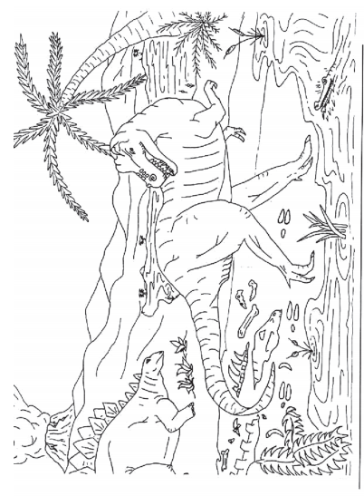
Task 3: Examine the scene to help you sort the statements into each section.
OBSERVATIONS
INFERENCES
1. The volcano is erupting.
16. Some more bones are in the water.
15. The camptosaurus killed the animal.
2. The camptosaurus is going to eat the stegosaurus.
4. The camptosaurus is leaving tracks in the ground.
18. Lava is corning down the sides of the volcano.
17. The camptosaurus can’t swim and will drown.
3. The stegosaurus will run into the water to escape.
19. The camptosaurus has sharp teeth.
20. The camptosaurus is a carnivore.
6. There are plants growing in the water.
5. The ground where the camptosaurus is walking is wet.
8. There is a tree growing next to the river.
7. The camptosaurus is going into the water to eat the plants.
9. The tree looks like a palm tree.
10. The climate is warm.
11. The stegosaurus is eating the plant.
12. The stegosaurus is an herbivore.
13. There are bones by the edge of the water.
14. The bones from a dead dinosaur.
Notes:
Notes slide – Use for class presentation
Source: https://www.nps.gov/flfo/learn/education/upload/Unit1Lesson6.pdf

Slide 20
Video Source: https://study.com/academy/lesson/identifying-trends-patterns-relationships-in-scientific-data.html
NOTE: Study.com is a subscription-based website. They offer free 30-day trials.
Extension: Challenge students to analyze data sets to identify trends, patterns, or relationships. Some helpful websites are:
Data Nuggets
NASA JPL Data Activities
Also check out these fun projects:
PBS Learning Media Fish Sampling
Ant Picnic (Student-gathered data)
Data & Relationships
Scientific data is gathered from that are designed to test variable at a time. data is categorized based on traits and characteristics, while data can be counted, measured, and expressed using numbers.
Data can be analyzed by looking at:
The general tendency of a set of data to change, such as the average temperatures on Earth increasing each year.
Data repeats in a predictable way, such as the appearance of traits in different generations of pea plants.
Clear mathematical relationships between the variables.
– Both variable increase or decrease.
- One variable goes up, the other goes down
INFORMATION
EXPERIMENTS
ONE
QUALITATIVE
QUANTITATIVE
TRENDS
PATTERNS
RELATIONSHIPS
DIRECT
INDIRECT
Notes:
Notes slide – Use for class presentation

Slide 21
Video Source: https://study.com/academy/lesson/identifying-trends-patterns-relationships-in-scientific-data.html
NOTE: Study.com is a subscription-based website. They offer free 30-day trials.
Extension: Challenge students to analyze data sets to identify trends, patterns, or relationships. Some helpful websites are:
Data Nuggets
NASA JPL Data Activities
Turner Graph of the Week
Graph of the Day
Also check out these fun projects:
PBS Learning Media Fish Sampling
Ant Picnic (Student-gathered data)
Data Challenge
Directions: Examine the graph to help you answer these questions.
1) Which age groups sleeps the most per day?
2) How many hours a day would you expect a 13-year-old to sleep?
3) Describe the trend that appears in the data.
4) What type of relationship exists between age and total sleep time/day?
5) Based on your own knowledge and observations, do you believe this graph is an accurate representation of sleep time vs. age?
1-15 Days (Babies)
10 hours
As the age of a person increases, the time spent sleeping decreases.
Indirect
?????????
Notes:
Notes slide – Use for class presentation

Slide 22
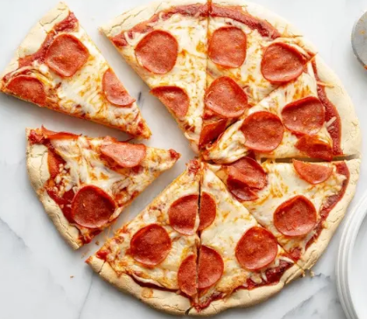
Qualitative vs. Quantitative
Watch the video to complete this slide.
Quantitative data is
Qualitative data is
Identify each example as QA for qualitative or QN for quantitative.
____ We saw many pretty butterflies. ____ It took us 10 minutes to get to town.
____ I have 10 pennies in my pocket. ____ My cats are black and white “tuxedo” kitties.
____ It is hot outside. ____ Mrs. Tomm’s brownies are very chocolatey.
____ The water temperature is 90ºF. ____ A pan of Mrs. Tomm’s brownies weighed 2 lbs.
Give two examples of each type of data that would relate to this image.
NUMERICAL ; counted or measured; can be graphed
DESCRIPTIVE; observations; uses words
QA
QN
QN
QA
QA
QA
QN
QN
Qualitative
Quantitative
Notes:
Notes slide – Use for class presentation

Slide 23
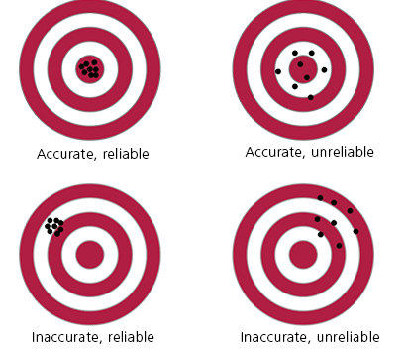
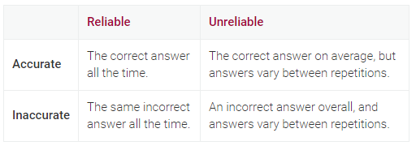
Reliability vs. Accuracy
Image Source: https://www.matrix.edu.au/the-beginners-guide-to-physics-practical-skills/physics-practical-skills-part-2-validity-reliability-accuracy-experiments/
Write a definition for each term.
Reliability
Accuracy
Drag the labels to describe each bullseye diagram.
What can we do during experiments to improve the reliability of our results?
What can we do to improve the accuracy of our results?
How close measurements are to each other
How close the result is to the correct or accepted value.
Accurate
Reliable
Accurate
Unreliable
Inaccurate
Reliable
Inaccurate
Unreliable
Repeat the experiment over and over again; i.e. perform 10 trials instead of 1
Make good measurements using the same method(s); calibrate instruments
Notes:
Notes slide – Use for class presentation

Slide 24
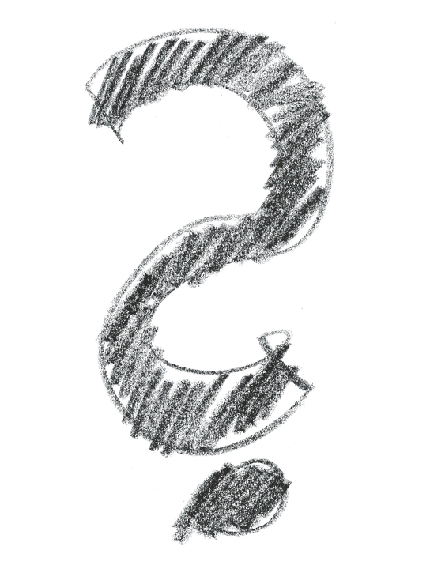
Science Lab Equipment - What is it?
Which equipment can you name? How is each used? Enter the names for each piece of equipment or tool and then find how each one is used in a science lab.
Need help? Use the Lab Equipment Vocabulary set on.
Notes:
Notes slide – Use for class presentation

Slide 25
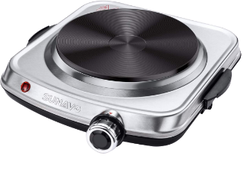
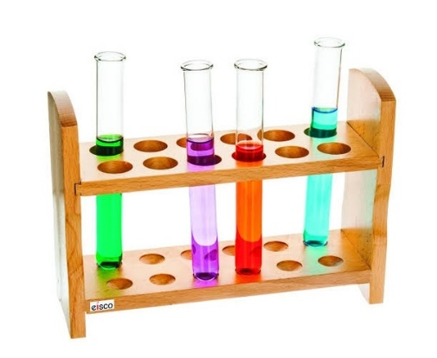
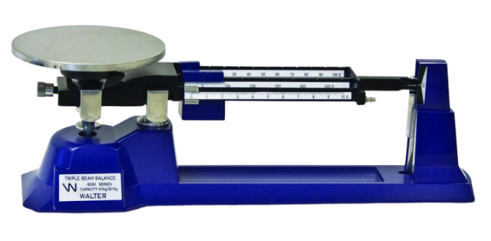
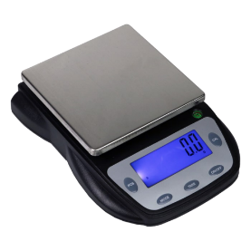
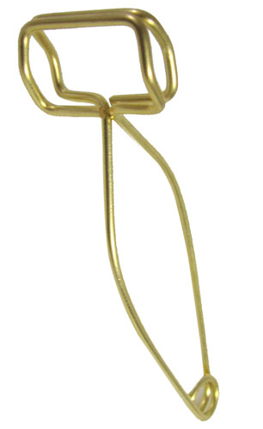
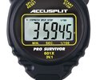
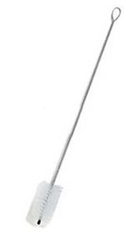
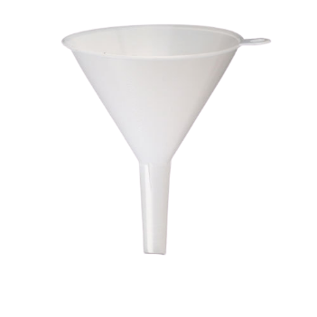
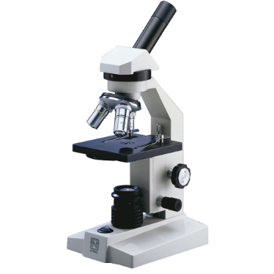
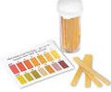
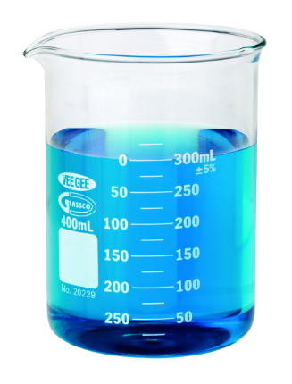
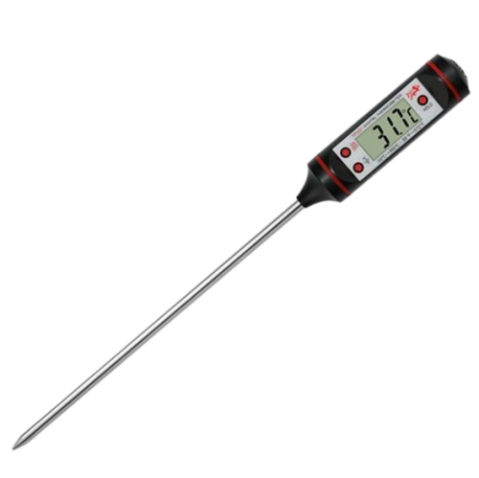
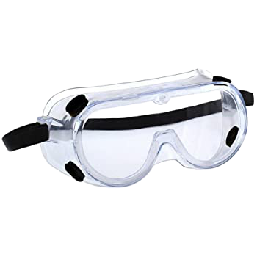
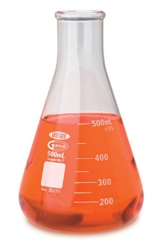
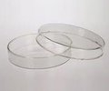
Science Equipment ANSWER KEY
Test Tubes
Hot Plate
Test Tube Rack
Metric Ruler
Balances
Stopwatch
Test Tube Brush
Test Tube Tongs
Telescope
Graduated cylinder
Funnel
Microscope
Hand lens
pH Paper
Beaker
Goggles
Thermometer
Petri Dish
Erlenmeyer Flask
https://quizlet.com/518465628/lab-equipment-flash-cards/
Notes:
Notes slide – Use for class presentation

Slide 26
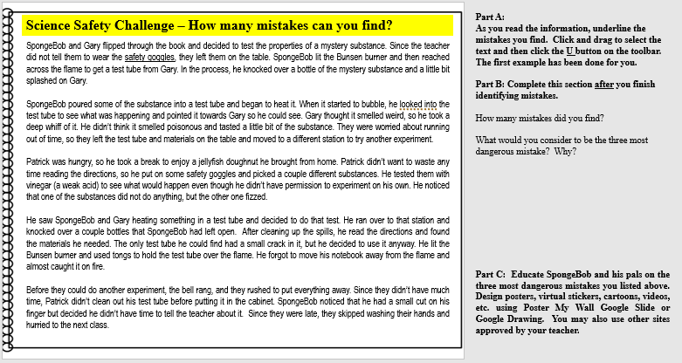
Science Safety Challenge
Background Information:
SpongeBob, Patrick, and Gary were thrilled when Mr. Krabbs gave their teacher a chemistry set! Mr. Krabbs warned them to be careful and reminded them to follow the safety rules they had learned in science class. The teacher passed out the materials and provided each person with an experiment book.
Follow the directions shown to the right of your slide.
Notes:
Notes slide – Use for class presentation

Slide 27
SpongeBob and Gary flipped through the book and decided to test the properties of a mystery substance. Since the teacher did not tell them to wear the safety goggles, they left them on the table. SpongeBob lit the Bunsen burner and then reached across the flame to get a test tube from Gary. In the process, he knocked over a bottle of the mystery substance and a little bit splashed on Gary.
SpongeBob poured some of the substance into a test tube and began to heat it. When it started to bubble he looked into the test tube to see what was happening and pointed it towards Gary so he could see. Gary thought it smelled weird, so he took a deep whiff of it. He didn’t think it smelled poisonous and tasted a little bit of the substance. They were worried about running out of time, so they left the test tube and materials on the table and moved to a different station to try another experiment.
Patrick was hungry, so he took a break to enjoy a jellyfish doughnut he brought from home. He didn’t want to waste any time reading the directions, so he put on some safety goggles and picked a couple different substances. He tested them with vinegar (a weak acid) to see what would happen even though he didn’t have permission to experiment on his own. He noticed that one of the substances did not do anything, but the other one fizzed.
SpongeBob and Gary flipped through the book and decided to test the properties of a mystery substance. Since the teacher did not tell them to wear the safety goggles, they left them on the table. SpongeBob lit the Bunsen burner and then reached across the flame to get a test tube from Gary. In the process, he knocked over a bottle of the mystery substance and a little bit splashed on Gary.
SpongeBob poured some of the substance into a test tube and began to heat it. When it started to bubble he looked into the test tube to see what was happening and pointed it towards Gary so he could see. Gary thought it smelled weird, so he took a deep whiff of it. He didn’t think it smelled poisonous and tasted a little bit of the substance. They were worried about running out of time, so they left the test tube and materials on the table and moved to a different station to try another experiment.
Patrick was hungry, so he took a break to enjoy a jellyfish doughnut he brought from home. He didn’t want to waste any time reading the directions, so he put on some safety goggles and picked a couple different substances. He tested them with vinegar (a weak acid) to see what would happen even though he didn’t have permission to experiment on his own. He noticed that one of the substances did not do anything, but the other one fizzed.
Notes:
Notes slide – Use for class presentation

Slide 28
He saw SpongeBob and Gary heating something in a test tube and decided to do that test. He ran over to that station and knocked over a couple bottles that SpongeBob had left open. After cleaning up the spills, he read the directions and found the materials he needed. The only test tube he could find had a small crack in it, but he decided to use it anyway. He lit the Bunsen burner and used tongs to hold the test tube over the flame. He forgot to move his notebook away from the flame and almost caught it on fire.
Before they could do another experiment, the bell rang, and they rushed to put everything away. Since they didn’t have much time, Patrick didn’t clean out his test tube before putting it in the cabinet. SpongeBob noticed that he had a small cut on his finger but decided he wouldn’t tell the teacher about it. Since they were late, they skipped washing their hands and hurried to the next class.
He saw SpongeBob and Gary heating something in a test tube and decided to do that test. He ran over to that station and knocked over a couple bottles that SpongeBob had left open. After cleaning up the spills, he read the directions and found the materials he needed. The only test tube he could find had a small crack in it, but he decided to use it anyway. He lit the Bunsen burner and used tongs to hold the test tube over the flame. He forgot to move his notebook away from the flame and almost caught it on fire.
Before they could do another experiment, the bell rang, and they rushed to put everything away. Since they didn’t have much time, Patrick didn’t clean out his test tube before putting it in the cabinet. SpongeBob noticed that he had a small cut on his finger but decided he wouldn’t tell the teacher about it. Since they were late, they skipped washing their hands and hurried to the next class.
Top answers usually include …
Reaching across a flame
Letting your stuff get too close to the flame
Looking into a test tube or pointing at another person
Sniffing or tasting chemicals
Testing things without permission or not following directions
See the next slide for my top 3!→
Part B: Complete this section after you finish identifying mistakes.
(1) How many mistakes did you find?
(2) What would you consider to be TOP 3 most dangerous mistakes they made? Why?
??????
??????

Slide 29
Check out these resources: Flinn’s Safety Contract
Detailed listing of rules
Carolina Lab Safety Lesson
Lab images illustrating mistakes
Amoeba Sisters Lab Safety
Online video for lab safety
Safety Rules
1 - Read and follow all directions exactly as they are written. Ask your teacher for help if you are not sure what to do! You should never mix chemicals or perform tests/experiments without your teacher’s permission.
2 - Always wear safety goggles (& other equipment) whenever you are working with chemicals or other substances that might get into your eyes or on your skin.
3 - Keep your work area clean and keep all materials (clothing, hair, papers, etc.) away from a flame or heat source. (This includes not reaching across a flame!)
4 - Immediately notify your teacher if you get hurt or any chemical gets on your skin or clothing.
5 -Always point a test tube away from you and others when heating it over a flame or other heat source. Never look directly into a test tube when mixing or heating chemicals.
6 - Never smell a chemical directly from the container. Wave your hand over the opening of the container and “waft” the fumes towards your nose.
7 - Never taste a chemical unless you are instructed by your teacher to do so.
8 - Always clean up your work area and equipment after an experiment is completed. Equipment must be returned to its proper place.
9 - Keep lids on bottles and containers when not in use
10 - Don’t use broken equipment or chipped glassware.
11 – Good behavior is always expected in the lab.
12 - Wash your hands before and after each experiment.
= My top 3

Slide 30
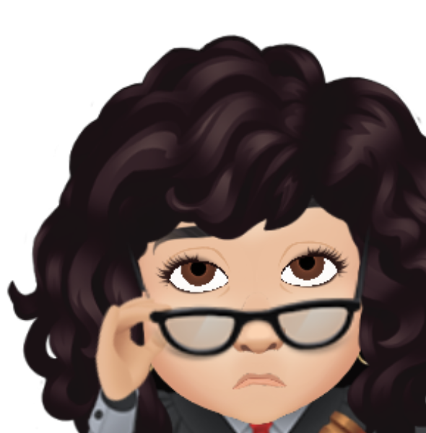
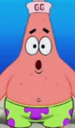
Part C: Educate SpongeBob and his pals on lab safety. Design a virtual sticker, cartoon, video, etc. using tech tools approved by your teacher, such as Poster My Wall, Google apps (Docs, Slides, Drawing), or other sites approved by your teacher.
Patrick, did you the directions?
Don’t be like Patrick!
Always read the directions – all of them - and listen to your teacher to make sure you know what to do!
Ready for a challenge? Click the logo →

Slide 31
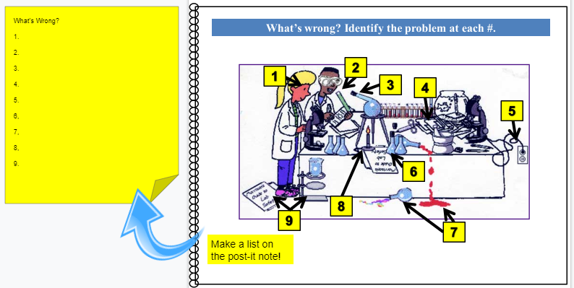
Lab Safety Review - What’s wrong?
Examine the picture to find mistakes. Make a list of the mistakes at each number. There may be more than one that applies!
Notes:
Image: http://morrisonlabs.com/lab_safety.htm

Slide 32
2 - Don’t smell directly from a container - WAFT.
4 - Keep your lab area neat and clean.
1 - Always wear safety goggles during a lab.
3 - Don’t heat closed containers & point them away from you/others
The answers are …
2
5 - Unplug equipment when not in use.
1
3
4
5
6
Don’t place lab materials near the edge of the table.
8
9
7
7 - Clean up spills immediately
8 - Keep papers and other objects away from flames.
9 - Don’t leave materials laying on the floor.
Image: http://morrisonlabs.com/lab_safety.htm

Slide 33
Section 3: Investigations
Format
Slide size – 11x8.5 One page per slide
Click here for a link to make a copy of the STUDENT MASTERS
(digital notebook) that goes along with this presentation.
TIP: Preview the presentation to see the animations on each slide prior to using it with your students.
Notes:
Designed for 7th & 8th grade science by T.Tomm
Updated 2020 http://sciencespot.net/

Slide 34
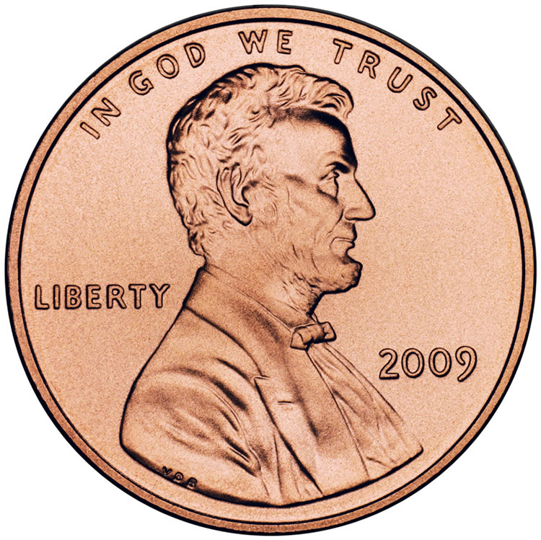
Think About It! What safety rules will we need to follow? Make a list on a posit-it note! →
What safety rules will we need to follow? Wear goggles & an apron!
Don’t taste substances.
Good behavior expected.
Clean up spills immediately.
Keep the lids on containers.
Penny Lab – Your Turn (Google Form)
You will be asked to make a copy, which you can edit for your students. The data will be available in a spreadsheet you can use for class discussions and data analysis practice.
Sinkin’ Lincoln Lab
Part A: Make a prediction based on your current knowledge.
I think a penny will be able to hold _____ drops of water before it runs over the edge.
Part B: Perform a CONTROL test for comparison with later results.
Step 1: Rinse a penny in tap water and dry completely.
Step 2: Place the penny on paper towel.
Step 3: Use an eye dropper to place drops of WATER on the penny (1 at a time) until ANY amount of water runs over the edge of the penny.
Step 4: Record the number of drops for that trial in the table.
Repeat Steps 1 - 4 three more times before calculating your average.
Part C: Perform tests with the TESTING LIQUID following these steps.
Step 1: Dip a clean penny into the testing liquid to coat it.
Step 2: Place the penny on paper towel.
Step 3: Use an eye dropper to place drops of WATER on the penny (1 at a time) until ANY amount of water runs over the edge.
Step 4: Record the number of drops for that trial in the table.
Repeat Steps 1 - 4 three more times before calculating your average.
Trial | Plain Water | Testing Liquid
1
2
3
4
5
Average
NOTE: Students are still putting drops of water on the penny. They need to dip the penny into the testing liquid to coat it. They should NOT put drops of the testing liquid on the penny. (There are several students each year who try this!)
Average: Add all #s, HIT equal size, and then divide by 4 (Round to one decimal place!)
Notes:
Notes slide – Use for class presentation
Go to https://sciencespot.net/Media/pennylab.pdf for more information about this lab.

Slide 35
Part C: Answer each question related to the experiment.
1.How do your results from the control and testing groups compare? Explain.
2. How do your results compare to the other groups in your class? Provide at least 2 possible reasons for any similarities and differences you identified.
3. Write a definition for each term.
Cohesion -
Surface Tension -
4. Explain your results from both parts of the experiment in terms of cohesion and surface tension.
5. What other liquids could you use? What would happen? Give 2 examples (& a prediction).
Example: The results from the control group were _______ than those in the testing group, because ____________________________________________________________________.
Example: “My results were higher than __________, because ____________________.”
Force of attraction between water molecules
The tension on the surface of a liquid caused by the attraction of the particles, such as the “skin”
The soapy water reduced the cohesion and the water was not able to “stick” together as well to form the skin (less surface tension). It would not form as large a bubble as it did with just a clean penny (not dipped in anything.)
Example: Hair conditioner – it will help the penny hold more drops by increasing the surface tension of water.
Notes:
Notes slide – Use for class presentation
Extension Idea – Have students identify other variables they could test – different testing liquids, different coins, etc. Require students to develop their procedure and have it approved before testing.

Slide 36
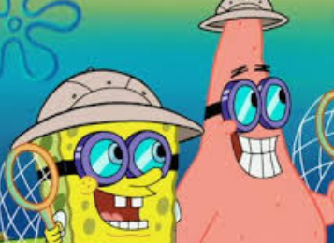
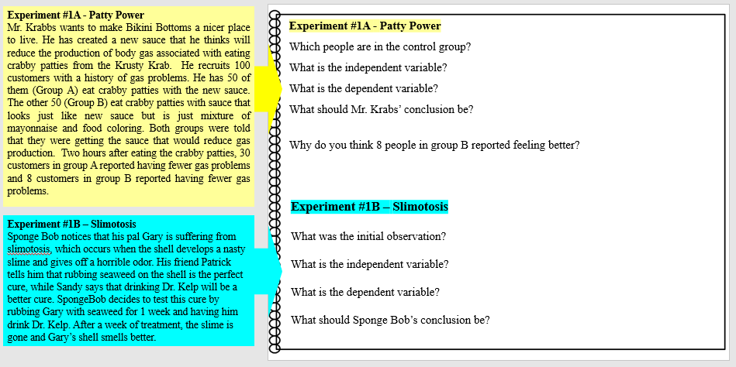
Bikini Bottom Experiments
The Bikini Bottom gang loves science class but are having trouble understanding the scientific method. Let’s see how well you understand it!
Directions: Read the description for each experiment. Review any data that is included. Answer the questions based on what you have learned so far.
Notes:
Notes slide – Use for class presentation

Slide 37
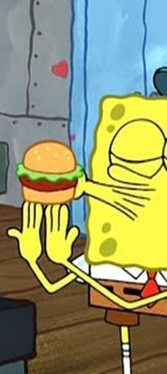
Experiment #1 - Patty Power
Mr. Krabbs wants to make Bikini Bottoms a nicer place to live. He has created a new sauce that he thinks will reduce the production of body gas associated with eating crabby patties from the Krusty Krab. He recruits 100 customers with a history of gas problems. He has 50 of them (Group A) eat crabby patties with the new sauce. The other 50 (Group B) eat crabby patties with sauce that looks just like new sauce but is just mixture of mayonnaise and food coloring. Both groups were told that they were getting the sauce that would reduce gas production. Two hours after eating the crabby patties, 30 customers in group A reported having fewer gas problems and 8 customers in group B reported having fewer gas problems.
Which people are in the control group?
What is the independent variable?
What is the dependent variable?
What should Mr. Krabs’ conclusion be?
Why do you think 8 people in group B reported feeling better?
Group B (regular sauce)
Type of sauce (secret ingredient)
Gas production
It appears the new sauce helps for 60% of the people, but more data would be helpful.
Placebo effect – They thought they were getting the right stuff.
Notes:
Notes slide – Use for class presentation

Slide 38
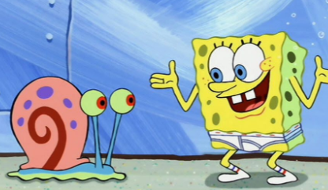
Experiment #2 – Slimotosis
Sponge Bob notices that his pal Gary is suffering from slimotosis, which occurs when the shell develops a nasty slime and gives off a horrible odor. His friend Patrick tells him that rubbing seaweed on the shell is the perfect cure, while Sandy says that drinking Dr. Kelp will be a better cure. SpongeBob decides to test this cure by rubbing Gary with seaweed for 1 week and having him drink Dr. Kelp. After a week of treatment, the slime is gone and Gary’s shell smells better.
What was the initial observation?
What is the independent variable?
What is the dependent variable?
What should Sponge Bob’s conclusion be?
Gary had a slime on his shell that smelled bad
Type of treatment (Dr. Kelp & seaweed)
Whether or not the slime/odor disappeared
Both cures appeared to work but based on how the experiment was conducted he cannot say which one worked.
Notes:
Notes slide – Use for class presentation

Slide 39
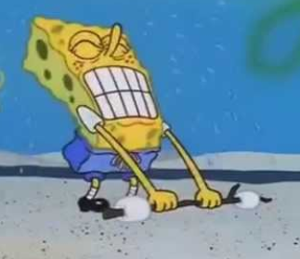
Experiment #3 – Marshmallow Muscles
Larry was told that a certain muscle cream was the newest best thing on the market and claims to double a person’s muscle power when used as part of a muscle-building workout. Interested in this product, he buys the special muscle cream and recruits Patrick and SpongeBob to help him with an experiment. Larry develops a special marshmallow weight-lifting program for Patrick and SpongeBob. He meets with them once every day for a period of 2 weeks and keeps track of their results. Before each session Patrick’s arms and back are lathered in the muscle cream, while Sponge Bob’s arms and back are lathered with the regular lotion.
Which person is in the control group?
What is the independent variable?
What is the dependent variable?
What should Larry’s conclusion be?
SpongeBob
Muscle cream
Time | Patrick | Sponge Bob
Initial | 18 | 5
After 1 week | 24 | 9
After 2 weeks | 33 | 17
# of marshmallows lifted
It appears that Patrick was able to lift the most, but SpongeBob held more if based on a %.
Notes:
Notes slide – Use for class presentation

Slide 40
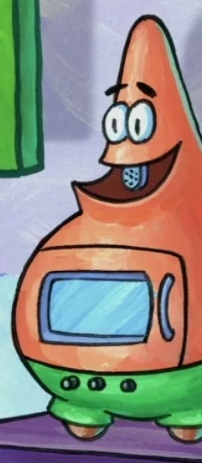
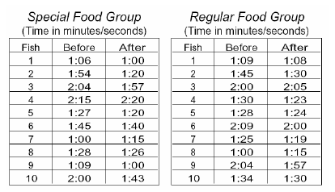
Experiment #4 – Microwave Miracle
Patrick believes that fish that eat food exposed to microwaves will become smarter and would be able to swim through a maze faster. He decides to perform an experiment by placing fish food in a microwave for 20 seconds. He has the fish swim through a maze and records the time it takes for each one to make it to the end. He feeds the special food to 10 fish and gives regular food to 10 others. After 1 week, he has the fish swim through the maze again and records the times for each.
What was Patrick’s hypothesis?
Which fish are in the control group?
What is the independent variable?
What is the dependent variable?
Look at the results in the charts. What should Patrick’s conclusion be?
Eating microwaved food would make fish smarter (reduce their time for a maze)
The ones that ate the regular food
Microwaved food
Time it took to complete the maze
Inconclusive – Although the special group had better times, the same number of fish improved in each group
Notes:
Notes slide – Use for class presentation

Slide 41
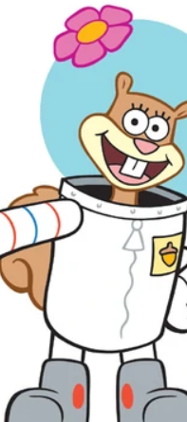
Experiment #5 - Flower Power
SpongeBob loves to garden and wants to grow lots of pink flowers for his pal Sandy. He bought a special Flower Power fertilizer to see if will help plants produce more flowers. He plants two plants of the same size in separate containers with the same amount of potting soil. He places one plant in a sunny window and waters it every day with fertilized water. He places the other plant on a shelf in a closet and waters it with plain water every other day.
What did SpongeBob do wrong in this experiment? Explain.
What should SpongeBob do to test the effectiveness of Flower Power fertilizer? Explain.
Different locations & different watering schedule
Place both plants in the sunny window.
Water them everyday.
One plant should receive the water with the fertilizer in it, while the other receives plain water (same amount, same time)
Notes:
Notes slide – Use for class presentation

Slide 42
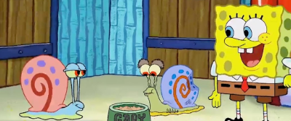
Experiment #6 - Super Snails
Gary is not the smartest snail in Bikini Bottom and believes he can improve his brain power by eating Super Snail Snacks. In order to test this hypothesis, he recruits SpongeBob and several snail friends to help him with the experiment. The snails ate one snack with each meal every day for three weeks. SpongeBob created a test and gave it to the snails before they started eating the snacks as well as after three weeks.
What is the independent variable?
What is the dependent variable?
Based on the data provided, do the Super Snail Snacks work? Explain
Snail | Before | After
Gary | 64% | 80%
Larry | 78% | 78%
Barry | 82% | 84%
Terry | 72% | 70%
Snacks
Score on a test
Inconclusive - It worked for only 2 of the snails. Gary cannot determine if it works or not based on this experiment. He needed to have a control group to use for comparison or have a lot more snails in the study.
Notes:
Notes slide – Use for class presentation

Slide 43
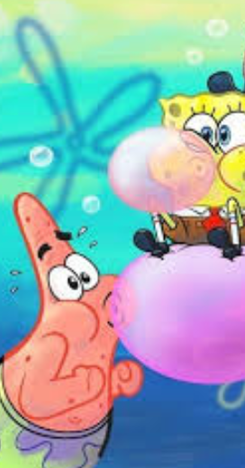
For more details on this challenge, download the teacher information page for the Bubble Time Lab.
More lessons for scientific method are available at https://sciencespot.net/Pages/classgen.html
Final Challenge: Bubble Time
Patrick loves bubble gum and would like to be able to blow bigger bubbles than anyone else in Bikini Bottom. To prepare for the Bikini Bottom Big Bubble Contest, he bought four different brands of bubble gum and needs your help to find the brand that creates the biggest bubbles. Write an experiment to test the bubble power of the bubble gum brands and help Patrick win the contest.
Part A: Identifying Variables & Controls
1) What is the independent variable in this experiment?
2) What is the dependent variable in this experiment?
3) What other variables could affect your results? List at least three and explain how will you set up your experiment to control these variables.
Data to collect:
Brand & Flavor
Mass before/after chewing time
Bubble Sizes – 5 trials
Bubble Gum Data (Google Form) It will make a copy you can edit for your experiment.
Brand of bubble gum
Size of bubble
Variables
Chew time → Need to chew all at the same amount of time
Measurement → Need to measure the same way every time; use phones to help accuracy
Bubble Blowing Ability → Need to blow bubbles the same way every time (consistency) using the same method and amount of air
Number of trials → Use best 5 out of 7
Mass – Compare before and after to see how much sugar/flavorings are in it; make sure it is a nice texture
Observations – Make notes about how elastic it is, how easy it is to blow bubbles, its texture, stickiness, etc.
Notes:
Notes slide – Use for class presentation

Slide 44
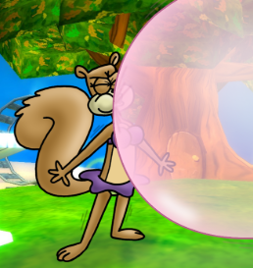
Final Challenge Part B: Experiment
Write an experiment to test the bubble power of the bubble gum brands and help Patrick win the contest. Remember to include all the necessary parts to ensure your results are accurate and reliable.
Example Procedure:
1 - Prepare one piece and find the mass. Record in your chart.
2 - Chew gum for two minutes.
3 - Find the mass again and record in the chart.
4 - Blow one bubble and have the group mates determine the length (distance from the lips). Record in the chart.
5 - Repeat #4 six more times using the same method. Record each in the chart.
6 - Use the best 5 scores to calculate the average. Record in the chart along with any observations you made (texture, elasticity, thickness, etc.)
7 - Repeat steps 1-6 for the other four brands. Record data in the chart.
Notes:
Notes slide – Use for class presentation

Slide 45
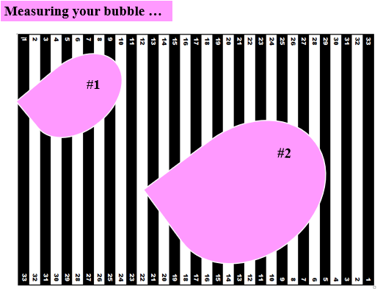
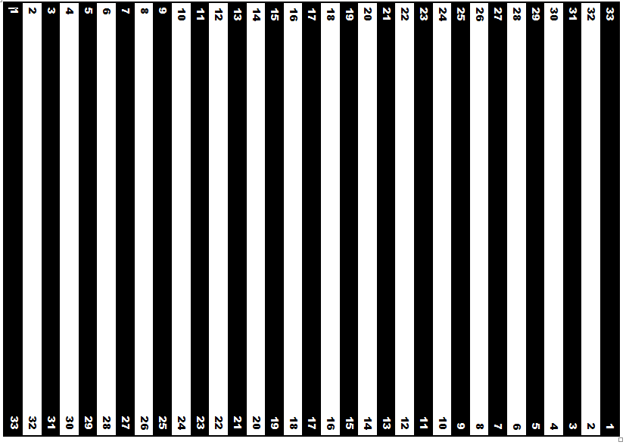
Measuring your bubble …
Measure at the widest point.
Calculate the distance if the beginning of the bubble is not at zero.
#1
#2
Notes:
Notes slide – Use for class presentation; use this slide to demonstrate how to use the measuring guide provided in class.

Slide 46
Final Challenge Part D: Bubble Time Analysis & Conclusion
Use your data along with the overall class data shared by your teacher to answer these questions.
Which brand had the highest average for you?
Which brand had the highest average overall?
Did your results match the overall results. Explain using the data.
Which brand would you recommend Patrick use in the contest? Why?
Is the data accurate and reliable? Explain.
Give good answers and use the data!
Notes:
Notes Slide – Used for class presentation; summarize the student responses during a class discussion of the results.

Slide 47
Optional
Give your students a chance to create their own bubble gum-related experiment. For example, they may choose to test different properties of gum (lasting time, “stretchability”, etc.) or choose 3 more types of gum to test (same brand, different flavors or same flavor, different brands).
Your Turn
What variables can you test using 3 brands (or less) of bubble gum?
Complete the worksheet as you create your experiments and show the teacher for approval.
Your team will need to bring their own materials (gum) but may use any tools I have available.
Deadlines
_____ Approval due by the end of the day
_____ Experiments will be conducted during class – bring your materials.
_____ Final reports with conclusions are due
Notes:
Notes & Student – Use for class presentation & digital notebook page for students

Slide 48
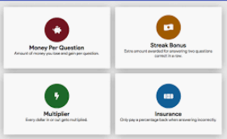
Click the link to view the kit on GIMKIT … https://www.gimkit.com/view/5e4188ddf6b1660022d4f8e9
It’s time for a GIMKIT Challenge! Use what you have learned about the SCIENTIFIC METHOD to complete the assignment on GIMKIT.
Your goal is to earn $200,000 to complete the assignment.
Google Classroom → Classwork → GIMKIT Link
Unit Review
Answer questions correctly to earn $$$.
Incorrect answers will cost you $$$.
Click SHOP to buy powerups and multipliers to help you earn more $$$ with each correct answer.
Take a screenshot of the “You did it!” screen and upload to the GimKit assignment on Google Classroom.
GOOD TO KNOW …
Your progress is saved automatically – you can start now and finish another time!
Don’t panic … It will reset to $0 when you reach the goal. Your teacher will be able to see your progress IF you accessed it using the link on Google Classroom.
Notes:
Notes Slide – Used for class presentation; summarize the student responses during a class discussion of the results.

Slide 49
Nature of Science
Student Masters for Digital Notebooks
Make edits to the following slides if you edit the teacher masters.
Go to FILE → Save as → PNG.
Follow the prompts to save the slides.
In Slides, use the PNG files as your background image. Add textboxes or other interactive features. I have also included the margin notes that will need to be added to the student slides.
Notes:
Designed for 7th & 8th grade science by T.Tomm
Updated 2020 http://sciencespot.net/

Slide 50
Nature of Science
Directions: See Slide #3 for directions on decorating your cover.
Example:
Notes:
Designed for 7th & 8th grade science by T.Tomm
Updated 2020 http://sciencespot.net/

Slide 51
Section 1: What is science?
Science is both a body of _______________ and the ______________ and ______________ used to add to that body of knowledge. It is a way of knowing used by many _______________, not just _______________.
Science knowledge is _______________ and many people, from many generations and nations, have contributed to the refinement of, and changes to, _______________, _______________, and _______________ over time.
Science investigations do not follow just _____ specific scientific method. There are _______________ methods to learning about the world around us. The __________ we follow and the ____________ in which we complete them depends on what we are investigating.
Notes:
Student – Used for digital notebook page for students

Slide 52
Drag these terms to the correct location.
Branches of Science: Watch the "Main Branches of Science“ on EDPuzzle. Use the terms to the right of this slide to fill in the worksheet. Answer the quiz questions during the video.
_________________ science involves studying matter to determine what is happening physically.
_________ sciences, which can also be called _______________, explore living things on Earth.
________________ sciences involves studying our planet & its resources.
You MUST be logged in on EDPuzzle to get credit for watching the videos!
__________________ examines the structure of the earth to study its history.
__________________ is the study of matter in the perspective of energy and motion.
__________________ is the study of the plant kingdom.
__________________ studies life in the past, such as studying dinosaur fossils.
__________________ is the study of matter at the chemical level
__________________ is the study of the animal kingdom.
__________________
is the study of weather, with a strong focus on predicting how weather will occur.
__________________ is the study of space involving both chemistry and physics
__________________ studies genes and heredity.
__________________ is the study of oceans, it's chemistry, and the living things found there.
Done? Try the Match game for Super Scientists
Notes:
Student – Used for digital notebook page for students

Slide 53
NOTE: Students may also create paper/pencil versions and upload a picture to the slides used for the assignment at Ologies Choice Board Assignment
Directions: Pick projects that will earn you at least 50 points. Place a star on the boxes for the projects you complete.
UPick Project: Ologies
Pts | Science Connections | Ologies | Vocabulary
5 | Find five examples of science in your home or yard to create a display to teach others about science in our daily lives. Organize the examples into the 3 branches of science. | Many “ologies” can be classified into more than one branch of science. Identify at least 5 “ologies” that address 2 or more branches. Give a description to tell what each studies. | Play the Match game on Quizlet and earn a time under 10 seconds to get 5 points. Add a screenshot of your entire screen to the assignment in Google Classroom.
10 | Create a cartoon for younger students to explain how the main branches of science are connected to the world around them. The cartoon may be on paper or in the form of an animation or video. | Create a song or book for little kids about the different branches of science. Your song will need to include at least 10 of the “ologies” along with information to explain what is studied. | Find a newspaper article or video about recent scientific discoveries. Identify the types of scientists involved in the discovery and how they contributed to our understanding of the discovery.
15 | Pick a day to record at least 20 activities you do, such as eating breakfast, walking to class, etc. Create a display to show how each relates to the branches of science . | Develop a job posting for one of the “ologies” that includes the education, daily activities, and types of tools or equipment the scientist would need to use to perform his/her job. | Create 10 questions using the “Ologies” set that your teacher could use for online games or tests. Each question must have 4 answer choices with the correct answer identified.
Use the Ologies vocab set to help you!
NOTE: You may create paper versions. Take a picture to upload to a slide for credit and turn in to your teacher.
Notes:
Notes slide – Use for class presentation

Slide 54
Assignment:
Click the video links below to find the videos. Be sure to log in with your school account to get credit. Answer the video questions and use the terms below to fill in the organizer. Use the textboxes to add examples of the different types of variables.
Section 2: Scientific Method(s) & Variables
Watch 1st
Watch 2nd
You MUST be logged in on EDPuzzle to get credit for watching the videos!
Notes:
Student – Used for digital notebook page for students

Slide 55
Information gathered with your senses; may be quantitative or qualitative
Process of drawing a conclusion
based on background knowledge and/or evidence
Task #1: I am going to read three observations. You will need to make an inference about where I was AFTER I have read all three, but do not share it with anyone yet!
Where was I?
Task #2: Read the following sentences carefully. For each sentence, highlight each observation and underline the inference.
Notes:
Notes slide – Use for class presentation
Source: http://blogs.bethel.k12.or.us/npetersen/files/2013/09/ObservationInferenceHW.pdf

Slide 56
1. The volcano is erupting.
11. The stegosaurus is eating the plant.
2. The camptosaurus is going to eat the stegosaurus.
Task 3: Examine the scene to help you sort the statements into each section.
12. The stegosaurus is an herbivore.
OBSERVATIONS
INFERENCES
3. The stegosaurus will run into the water to escape.
13. There are bones by the edge of the water.
14. The bones from a dead dinosaur.
4. The camptosaurus is leaving tracks in the ground.
15. The camptosaurus killed the animal.
5. The ground where the camptosaurus is walking is wet.
16. Some more bones are in the water.
6. There are plants growing in the water.
17. The camptosaurus can’t swim and will drown.
7. The camptosaurus is going into the water to eat the plants.
18. Lava is corning down the sides of the volcano.
8. There is a tree growing next to the river.
19. The camptosaurus has sharp teeth.
9. The tree looks like a palm tree.
20. The camptosaurus is a carnivore.
10. The climate is warm.
Notes:
Notes slide – Use for class presentation
Source: https://www.nps.gov/flfo/learn/education/upload/Unit1Lesson6.pdf

Slide 57
Data & Relationships
Video Source: https://study.com/academy/lesson/identifying-trends-patterns-relationships-in-scientific-data.html
Scientific data is ______________________ gathered from __________________ that are designed to test _____ variable at a time. ____________________ data is categorized based on traits and characteristics, while ___________________ data can be counted, measured, and expressed using numbers
Data can be analyzed by looking at:
______________ - The general tendency of a set of data to change, such as the average temperatures on Earth increasing each year.
______________ - Data repeats in a predictable way, such as the appearance of traits in different generations of pea plants.
______________ - Clear mathematical relationships between the variables.
______________ – Both variable increase or decrease.
______________ - One variable goes up, the other goes down
Drag the graphs to the correct relationship
Notes:
Student – Used for digital notebook page for students

Slide 58
Data Challenge
Directions: Examine the graph to help you answer these questions.
1) Which age groups sleeps the most per day?
2) How many hours a day would you expect a 13-year-old to sleep?
3) Describe the trend that appears in the data.
4) What type of relationship exists between age and total sleep time/day?
5) Based on your own knowledge and observations, do you believe this graph is an accurate representation of sleep time vs. age?
Notes:
Notes slide – Use for class presentation

Slide 59
Qualitative vs. Quantitative
Watch the video to complete this slide.
Quantitative data is
Qualitative data is
Identify each example as QA for qualitative or QN for quantitative.
____ We saw pretty butterflies ____ It took us 10 minutes to get to town.
____ I have 10 pennies in my pocket. ____ My cats are black and white “tuxedo” kitties.
____ It is hot outside. ____ Mrs. Tomm’s brownies are very chocolatey.
____ The water temperature is 90ºF. ____ A pan of Mrs. Tomm’s brownies weighed 2 lbs.
Give two examples of each type of data that would relate to this image.
Notes:
Notes slide – Use for class presentation

Slide 60
Reliability vs. Accuracy
Write a definition for each term.
Reliability
Accuracy
Drag the labels to describe each bullseye diagram.
What can we do during experiments to improve the reliability of our results?
What can we do to improve the accuracy of our results?
Notes:
Notes slide – Use for class presentation

Slide 61
Directions:
Enter the names for each piece of equipment or tool and then find how each one is used in a science lab.
Science Lab Equipment – What is it?
https://quizlet.com/518465628/lab-equipment-flash-cards/
Go to the Lab Equipment set on Quizlet to help you!
Notes:
Student slide – Use for digital notebook

Slide 62
Background Information:
SpongeBob, Patrick, and Gary were thrilled when Mr. Krabbs gave their teacher a chemistry set! Mr. Krabbs warned them to be careful and reminded them to follow the safety rules they had learned in science class. The teacher passed out the materials and provided each person with an experiment book.
Part A: As you read the information, HIGHLIGHT the mistakes you find. The first example has been done for you.
Part B: Complete this section after you finish identifying mistakes.
How many mistakes did you find?
What would you consider to be the three most dangerous mistake? Why?
Part C: Educate SpongeBob and his pals on the three most dangerous mistakes you listed. Design posters, virtual stickers, cartoons, videos, etc. using Poster My Wall, Google apps (Docs, Slides, Drawing), or other sites approved by your teacher.
Science Safety Challenge – How many mistakes can you find?
Highlighting Text
Click and drag to select the text and then click the pen button on the toolbar and pick a color. The first example has been done for you.
Notes:
Student – Used for digital notebook page for students

Slide 63
Lab Safety Review - What’s wrong?
2
1
3
4
5
6
8
9
7
Notes:
Image: http://morrisonlabs.com/lab_safety.htm

Slide 64
Sinkin’ Lincoln Lab
What safety rules will we need to follow?
Part A: Make a prediction based on your current knowledge.
I think a penny will be able to hold _____ drops of water before it runs over the edge.
Part B: Perform a CONTROL test.
Step 1: Rinse a penny in tap water and dry completely.
Step 2: Place the penny on paper towel.
Step 3: Use an eye dropper to place drops of WATER on the penny (1 at a time) until ANY amount of water runs over the edge of the penny.
Step 4: Record the number of drops for that trial in the table.
Repeat Steps 1 - 4 three more times before calculating your average.
Part C: Perform tests with the TESTING LIQUID.
Step 1: Dip a clean penny into the testing liquid to coat it.
Step 2: Place the penny on paper towel.
Step 3: Use an eye dropper to place drops of WATER on the penny (1 at a time) until ANY amount of water runs over the edge of the penny.
Step 4: Record the number of drops for that trial in the table.
Repeat Steps 1 - 4 three more times before calculating your average.
NOTE: You are still putting drops of water on the penny.
Dip the penny into the testing liquid to coat it. DO NOT put drops of the testing liquid on the penny.
Notes:
Student slide – Use as a page in the digital notebook

Slide 65
Part D: Answer each question based on your data and observations.
1.How do your results from the control and testing groups compare? Explain.
2. How do your results compare to the other groups in your class? Provide at least 2 possible reasons for any similarities and differences you identified.
3. Write a definition for each term.
Cohesion -
Surface Tension -
4. Explain your results from both parts of the experiment in terms of cohesion and surface tension.
5. What other liquids could you use? What would happen? Give 2 examples (& a prediction).
Notes:
Student slide – Use as a page in the digital notebook

Slide 66
Experiment #1 - Patty Power
Mr. Krabbs wants to make Bikini Bottoms a nicer place to live. He has created a new sauce that he thinks will reduce the production of body gas associated with eating crabby patties from the Krusty Krab. He recruits 100 customers with a history of gas problems. He has 50 of them (Group A) eat crabby patties with the new sauce. The other 50 (Group B) eat crabby patties with sauce that looks just like new sauce but is just mixture of mayonnaise and food coloring. Both groups were told that they were getting the sauce that would reduce gas production. Two hours after eating the crabby patties, 30 customers in group A reported having fewer gas problems and 8 customers in group B reported having fewer gas problems.
Experiment #1 - Patty Power
Which people are in the control group?
What is the independent variable?
What is the dependent variable?
What should Mr. Krabs’ conclusion be?
Why do you think 8 people in group B reported feeling better?
Experiment #2 – Slimotosis
What was the initial observation?
What is the independent variable?
What is the dependent variable?
What should Sponge Bob’s conclusion be?
Experiment #2 – Slimotosis
Sponge Bob notices that his pal Gary is suffering from slimotosis, which occurs when the shell develops a nasty slime and gives off a horrible odor. His friend Patrick tells him that rubbing seaweed on the shell is the perfect cure, while Sandy says that drinking Dr. Kelp will be a better cure. SpongeBob decides to test this cure by rubbing Gary with seaweed for 1 week and having him drink Dr. Kelp. After a week of treatment, the slime is gone and Gary’s shell smells better.
Notes:
Student – Used for digital notebook page for students

Slide 67
Experiment #3 – Marshmallow Muscles
Larry was told that a certain muscle cream was the newest best thing on the market and claims to double a person’s muscle power when used as part of a muscle-building workout. Interested in this product, he buys the special muscle cream and recruits Patrick and SpongeBob to help him with an experiment. Larry develops a special marshmallow weight-lifting program for Patrick and SpongeBob. He meets with them once every day for a period of 2 weeks and keeps track of their results. Before each session Patrick’s arms and back are lathered in the muscle cream, while Sponge Bob’s arms and back are lathered with the regular lotion.
Experiment #3 – Marshmallow Muscles
Which person is in the control group?
What is the independent variable?
What is the dependent variable?
What should Larry’s conclusion be?
Experiment #3 Data
Time | Patrick | Sponge Bob
Initial | 18 | 5
After 1 week | 24 | 9
After 2 weeks | 33 | 17
Experiment #4 – Microwave Miracle
What was Patrick’s hypothesis?
Which fish are in the control group?
What is the independent variable?
What is the dependent variable?
Look at the results in the charts. What should Patrick’s conclusion be?
Experiment #4 Data
Experiment # 4 – Microwave Miracle
Patrick believes that fish that eat food exposed to microwaves will become smarter and would be able to swim through a maze faster. He decides to perform an experiment by placing fish food in a microwave for 20 seconds. He has the fish swim through a maze and records the time it takes for each one to make it to the end. He feeds the special food to 10 fish and gives regular food to 10 others. After 1 week, he has the fish swim through the maze again and records the times for each.
Notes:
Student – Used for digital notebook page for students

Slide 68
Experiment #5 - Flower Power
What did SpongeBob do wrong in this experiment? Explain.
What should SpongeBob do to test the effectiveness of Flower Power fertilizer? Explain.
Experiment #5 - Flower Power
SpongeBob loves to garden and wants to grow lots of pink flowers for his pal Sandy. He bought a special Flower Power fertilizer to see if will help plants produce more flowers. He plants two plants of the same size in separate containers with the same amount of potting soil. He places one plant in a sunny window and waters it every day with fertilized water. He places the other plant on a shelf in a closet and waters it with plain water every other day.
Experiment #6 - Super Snails
What is the independent variable?
What is the dependent variable?
Based on the data provided, do the Super Snail Snacks work? Explain
Snail | Before | After
Gary | 64% | 80%
Larry | 78% | 78%
Barry | 82% | 84%
Terry | 72% | 70%
Experiment #6 - Super Snails
Gary is not the smartest snail in Bikini Bottom and believes he can improve his brain power by eating Super Snail Snacks. In order to test this hypothesis, he recruits SpongeBob and several snail friends to help him with the experiment. The snails ate one snack with each meal every day for three weeks. SpongeBob created a test and gave it to the snails before they started eating the snacks as well as after three weeks.
Notes:
Student – Used for digital notebook page for students

Slide 69
Final Challenge: Bubble Time
Patrick loves bubble gum and would like to be able to blow bigger bubbles than anyone else in Bikini Bottom. To prepare for the Bikini Bottom Big Bubble Contest, he bought four different brands of bubble gum and needs your help to find the brand that creates the biggest bubbles. Write an experiment to test the bubble power of the bubble gum brands and help Patrick win the contest.
Part A: Identifying Variables & Controls
1) What is the independent variable in this experiment?
2) What is the dependent variable in this experiment?
3) What other variables could affect your results? List at least three and explain how will you set up your experiment to control these variables.
Notes:
Student – Used for digital notebook page for students

Slide 70
Final Challenge Part B: Experiment
Write an experiment to test the bubble power of the bubble gum brands and help Patrick win the contest. Remember to include all the necessary parts to ensure your results are accurate and reliable.
Notes:
Notes slide – Use for class presentation

Slide 71
Final Challenge Part C: Data Collection
Create a table to record your data.
2. Calculate the average for each brand of gum to the nearest hundredth.
3. Follow your teacher’s directions to submit your averages for the overall results.
Sample Table – Students can create their own tables using the Insert → Table tools.
Brand | Trial 1 | Trial 2 | Trial 3 | Trial 4 | Trial 5 | Average
Notes:
Student – Used for digital notebook page for students

Slide 72
Final Challenge Part D: Bubble Time Analysis & Conclusion
Use your data along with the overall class data shared by your teacher to answer these questions.
Which brand had the highest average for you?
Which brand had the highest average overall?
Did your results match the overall results. Explain using the data.
Which brand would you recommend Patrick use in the contest? Why?
Is the data accurate and reliable? Explain.
Notes:
Student – Used for digital notebook page for students

Slide 73
Your Turn
What variables can you test using 3 brands (or less) of bubble gum?
Complete the worksheet as you create your experiments and show the teacher for approval.
Your team will need to bring their own materials (gum) but may use any tools I have available.
Deadlines
_____ Approval due by the end of the day
_____ Experiments will be conducted during class – bring your materials.
_____ Final reports with conclusions are due
Notes:
Notes & Student – Use for class presentation & digital notebook page for students

Slide 74
Click the link to view the kit on GIMKIT … https://www.gimkit.com/view/5e4188ddf6b1660022d4f8e9
It’s time for a GIMKIT Challenge! Use what you have learned about the SCIENTIFIC METHOD to complete the assignment on GIMKIT.
Your goal is to earn $200,000 to complete the assignment.
Google Classroom → Classwork → GIMKIT Link
Unit Review
Answer questions correctly to earn $$$.
Incorrect answers will cost you $$$.
Click SHOP to buy powerups and multipliers to help you earn more $$$ with each correct answer.
Take a screenshot of the “You did it!” screen and upload to the GimKit assignment on Google Classroom.
GOOD TO KNOW …
Your progress is saved automatically – you can start now and finish another time!
Don’t panic … It will reset to $0 when you reach the goal. Your teacher will be able to see your progress IF you accessed it using the link on Google Classroom.
Notes:
Notes Slide – Used for class presentation; summarize the student responses during a class discussion of the results.

Slide 75
Notes:
Extra Slide

