Slide 1
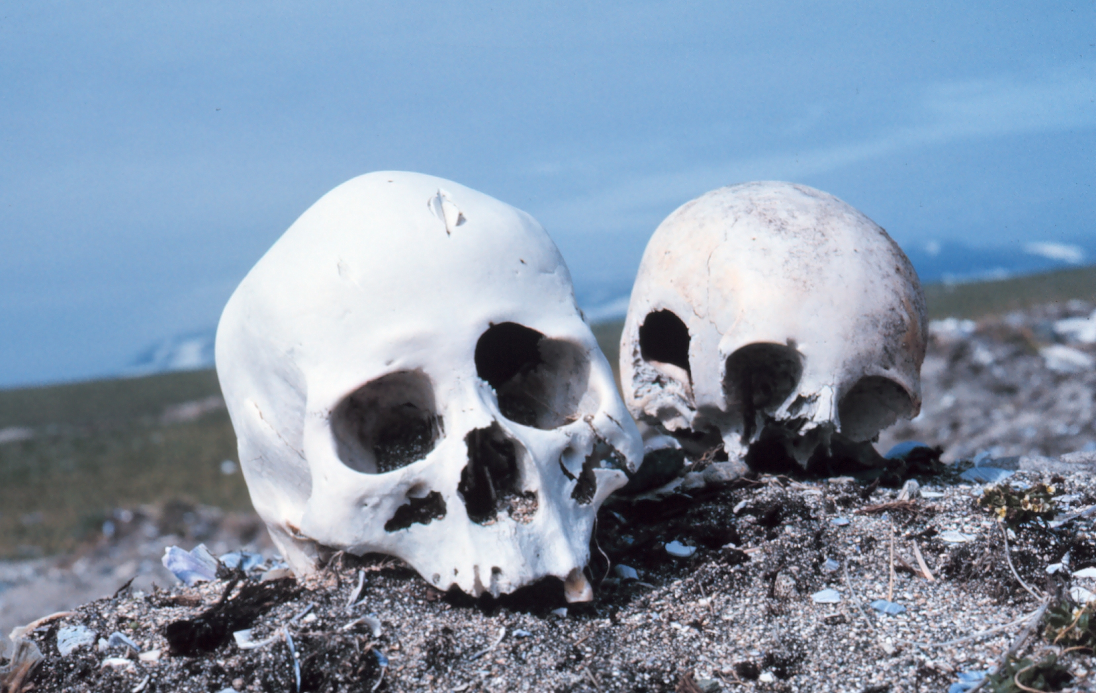
Forensic Anthropology
Let the bones tell the story!
Image: http://upload.wikimedia.org/wikipedia/commons/4/4c/Punuk.Alaska.skulls.jpg
Presentation developed by T. Tomm 2010 Updated 2024 https://sciencespot.net

Slide 2

Video #1 - Anthropologists & Crime Solving
Watch the video and then answer the questions.
What does a physical anthropologist do?
What four things do we want to know about a skeleton? Which bones do we use?
FORENSIC ANTHROPOLOGISTS analyze skeletal remains to determine the identity of a victim as well as his/her life history, cause of death, or other clues about a crime.
 Sex - Determined by examining the skull, pelvis, humerus, & femur
Age and stature (height/build) – Determined by analyzing the development of the teeth, bone growth, cranial suture lines, & the length of specific bones, such as the femur.
 Race – Determined by analyzing the skull for characteristics that are common among people of different races.

Slide 3
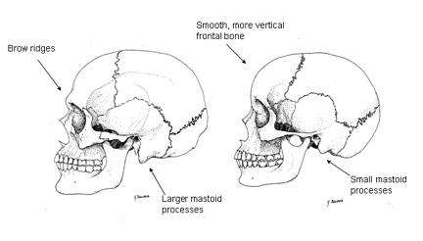
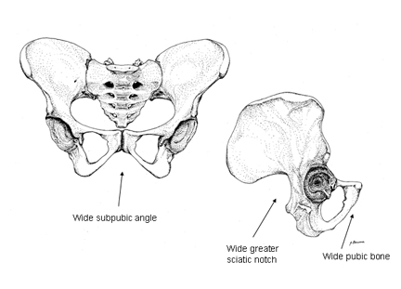
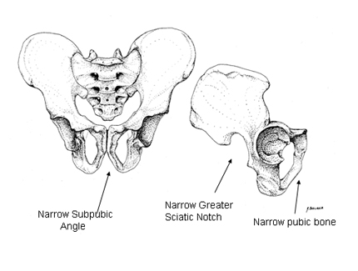

Which is which?
Which skull would belong to a female?
Which pelvis would belong to a female?
Think About It …
How could teeth provide clues about a skeleton?
Career Connection
What does a forensic anthropologist do?
Source: http://www.crime-scene-investigator.net/excavation.html
Images: http://www.wadsworth.com/anthropology_d/special_features/forensics/forensics_index/index.html

Slide 4
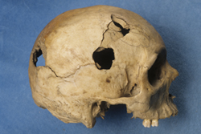
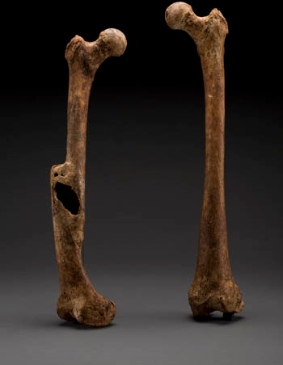
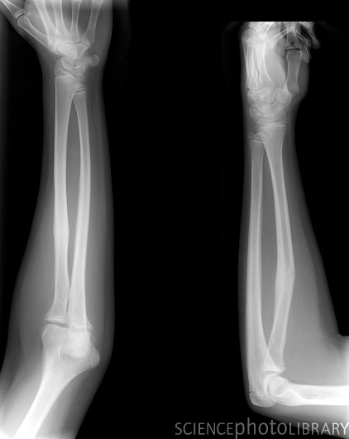
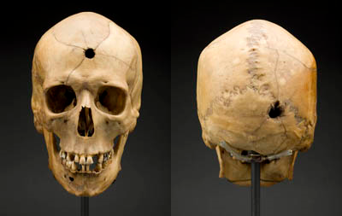
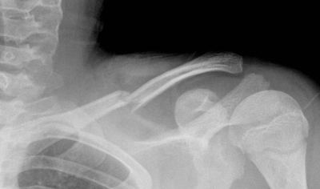
3. What else can we learn from bones?
DNA samples can be collected from bone, teeth, and hair to provide clues to a person’s identity.
Scientists may also be able to gain clues as to a person’s past, recent injuries, or the cause of death based on bone fractures and other signs of trauma.
Damage from a hammer
Healed Fractures
Gunshot Wounds
Images: http://www.legacyhealth.org/images/Housecalls/claviclefx.jpg, http://www.sciencephoto.com/images/download_lo_res.html?id=773301768, http://anthropology.si.edu/writteninbone/calvert_femur.html, http://anthropology.si.edu/writteninbone/trauma.html

Slide 5
Video #2 - Forensic Tools & Techniques
Watch the video and then answer the questions.
What techniques or tools did the scientists use to find the body?
What is “disturbed soil”? What might it indicate?
How did they narrow down the areas to investigate?
Did they find a body?
Canines, ground penetrating radar, and magnetic resonance
Disturbed soil is topsoil and subsoil mixed together.
It might indicate a burial site.
They used probes to find areas with disturbed soil and then used coring tools to gather core samples.
No

Slide 6
Video #3 - Identifying Human Remains
How do scientists get clues from skeletal remains?
List examples mentioned in the video.
Bones - Marks on the bones may indicate trauma (wounds) or animal activity; past injuries
Pelvis – Shape and openings can tell them if it was a male or female; tailbone can help age a skeleton
Ribs & Clavicle – Signs of aging to tell if the person was over or under 30 years of age
Cranium – Forehead shape, brow ridge, mastoid processes, chin, facial features, ancestry
Teeth – Absence or presence of wisdom teeth for age, condition of teeth for diet/nutrition, dental work, ancestry

Slide 7
Video #4 - What Bones Tell Us
Watch the video and then answer the questions.
1. What does “talking bones” mean? List 3 examples of clues.
2. What is the database used to identify the origin and sex of a skull?
3. What clues did they learn about the skeleton examined? Explain.
The bones of a victim can “tell” us about the person’s life.
Sex, physical structure, diseases, type of climate, diet, DNA
3D-ID
Sex/Origin = Hispanic male from South America
Femur = 5 ½ feet tall
Chemical composition = Man moved to US in last five years
Diseases – Poor natal health due to no folic acid

Slide 8
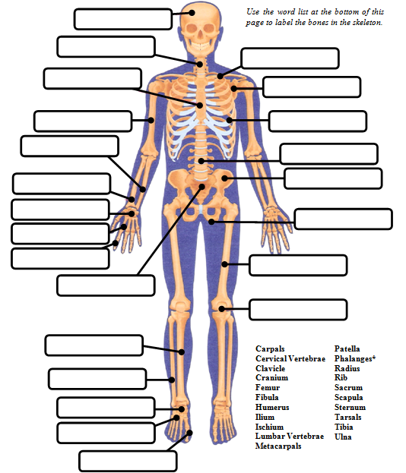

Cranium
Directions:
Identify the bones in the skeleton. One label will be used twice!
Cervical Vertebrae
Clavicle
Sternum
Scapula
Humerus
Ribs
Ulna
Lumbar Vertebrae
Radius
Ilium
Carpals
Ishium
Metacarpals
Phalanges
Femur
Sacrum
Patella
Tibia
Fibula
The Bone Dance
Tarsals
Metatarsals
Phalanges

Slide 9
Quick Quiz – Give the common name for each bone.
I should have known it was going to be one of those days, when I had stepped out of bed and stubbed my (1) PHLANGE on the night stand. While hopping up and down on one (2) METATARSAL and grasping the other, I slipped and fell onto my right shoulder breaking my (3) CLAVICLE. As I crawled on my
(4) METACARPALS and (5) PATELLAS to my bed, I felt my (6) CRANIUM begin to ache. I found my phone and let my (7) PHLANGES do the walking as I called my friend to come help me out. My friend answered the phone with a loud scream; my (8) MANDIBLE dropped, I asked what had happened, and he replied that he had been startled by the ringing phone, fell out of bed landed on his (9) COCCYX. Following that while racing to the phone he hit his (10) TIBIA on a stool. I should have known it was going to be one of those days.
TOES
2. FOOT
3. COLLAR BONE
4. HANDS
5. KNEES
6. SKULL or HEAD
7. FINGERS
8. LOWER JAW
9. TAIL BONE
10. SHIN
Source: http://www.homepage.montana.edu/~mtpbs/Education/NTTILessonPlans2/LegBoneConnectedToThe/NTTILegBoneConnectedToThe.pdf

Slide 10
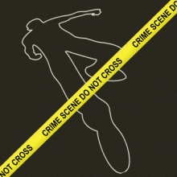
Bag O’ Bones Activity
Get Ready …
Get a long piece of butcher paper from your teacher.
Place it on the floor and have one of your classmates lay on it (back on the floor). Use a marker to make an outline of your classmate’s body.
Make a Skeleton …
Take the bones out of the bag and place them on the body outline in the approximate location where they would be found. You may refer to the skeleton model if you need help identifying a bone or its location.
Are you ready for a challenge?

Slide 11
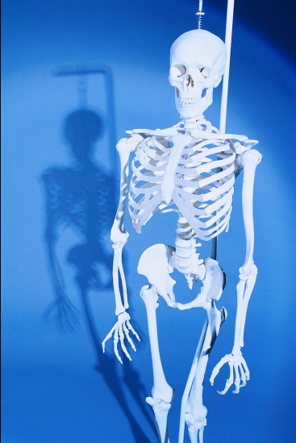
Bone Challenge
The Challenge … How fast can you put together a skeleton?
Directions:
1 - Find a partner and get a set of bones, blindfold, and timer from your teacher.
2 – Put on a blindfold and then have your partner spread out the “bones” on the table in front of you.
3 – When your partner starts the timer and says “go”, follow his/her directions to put the skeleton back together.
4 – Record your time on your worksheet.
Who had the best time? _____________________

