Slide 1
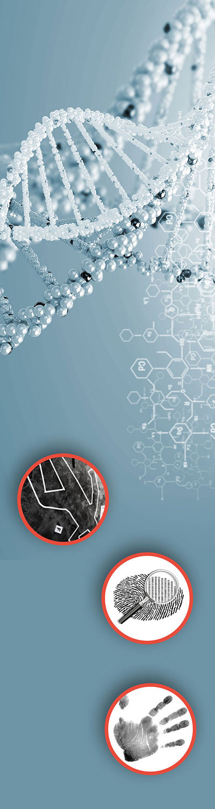
This lesson is often used after we complete the Microscope Basics lesson earlier in the school year. It can also be used during any forensic science unit. The Microscope Basics lesson can be found on the Biology page of the Science Classroom at https://sciencespot.net/Pages/classbio.html#micro
Teacher Notes:
The student digital slides for this unit are available at https://docs.google.com/presentation/d/1KuMm-xELGc85RP4hU3lRl0_7-JYD9sNH5CwFFqYKbbA/edit?usp=sharing
IMPORTANT: Make a copy of the student notebook before you assign it on your LMS. It is view-only and I am not able to approve access for your students.
The digital notebook (with all the slides for the digital lessons and activities) is available at https://docs.google.com/presentation/d/14eIEiGacRXMsDyuUxiEsSM2m4YOAtIlfmD4O4YsLdPI/edit?usp=sharing. It is set up for standard paper (8.5x11) in landscape mode for easier printing when needed. Paper versions are available for this unit on my Forensic Science page at https://sciencespot.net/Pages/classforsci.html
A DRAFT of the general outline of the digital lessons (with corresponding slide #s for the student notebook) is available at https://docs.google.com/document/d/15wxjmL-uHQPXDKOxmZXtU_gxy9dphEuyC1P4jzP-9mA/edit?usp=sharing . It is based on 44-minute class periods with 7th & 8th grade students.
Preview presentations before using with your classes as many slides have animations and links you will need to use.
I do Science Starters at the beginning of each class period. A collection of starters for Forensics is available on my lessons plans page at https://sciencespot.net/Pages/classforsci.html .
CSI Unit Training Materials
Trace Evidence
Quick Links
Part A: Microscopic Evidence
Part B: Hair Evidence
Part C: Fiber Evidence
Part D: Case Study - Purrfect Match
T. Tomm Updated 2023
https://sciencespot.net
This Photo by Unknown Author is licensed under CC BY

Slide 2
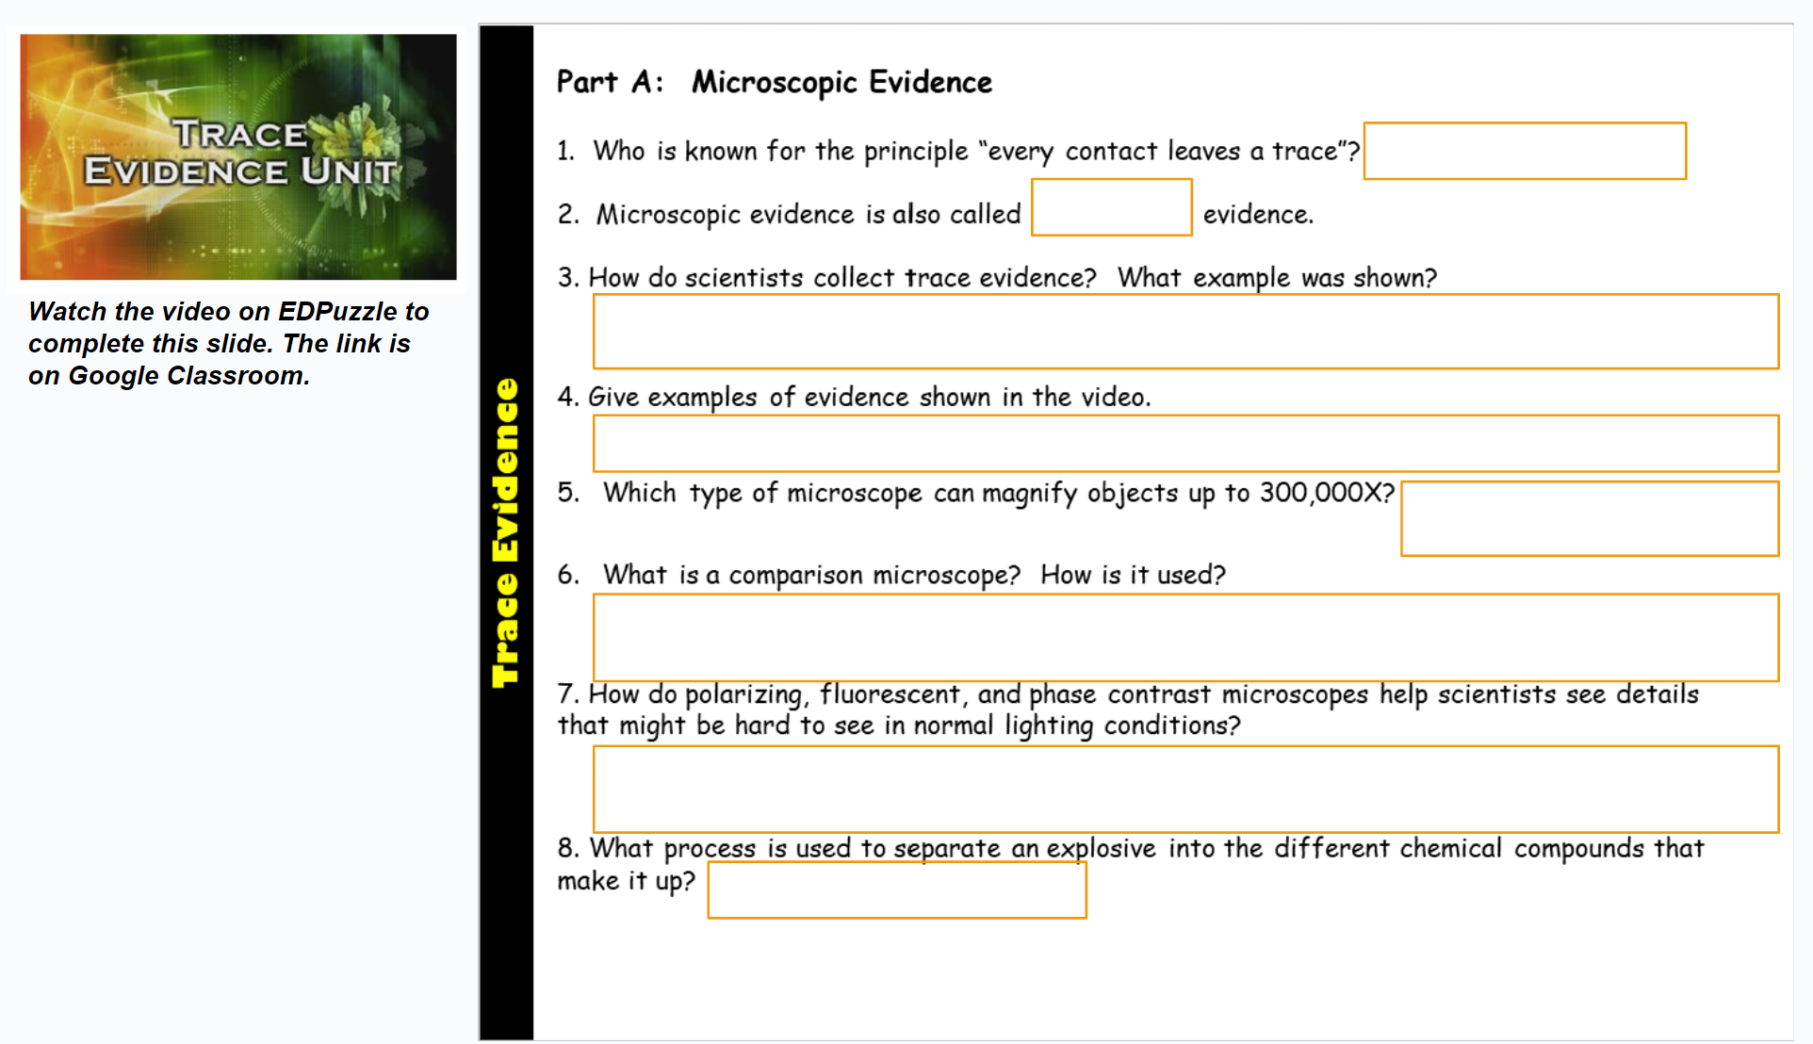
Note: Review the next slide. You will want to create the student sample “slides” for examination as they work on the video assignment. I use my thermal laminator and have them place their own hair samples inside. They use permanent markers to add their names and then turn them in.
Assignment: Complete this slide before class tomorrow.

Slide 3
Time to pull some hair ...
1- Use a permanent marker to write your name on the plastic sheet from your teacher.
2 – Pull out a strand (or 2) of hair and place it inside the plastic sheet. Make sure it fits all the way inside the plastic. Use scissors to trim if needed.
3 – Listen for your table group to have it laminated.
Get a start on the video assignment as I laminate the hair samples. We’ll examine them tomorrow!

Slide 4
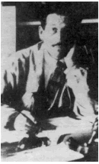
Part A: Microscopic Evidence
"Every Contact Leaves a Trace"
of evidence
The value of trace evidence was first recognized by Edmund Locard in 1910. He was the director of the very first crime laboratory in existence, located in Lyon, France.
Edmund Locard
Example: Burglars will may leave hairs from their body or fibers from their clothing behind and they may take carpet fibers away with them.
#1
TRACE
#2 - Microscopic evidence is also called _______ evidence.
Source: http://www.virtualsciencefair.org/2004/fren4j0/public_html/trace_evidence.htm

Slide 5
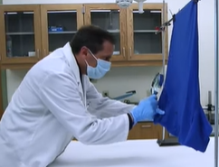
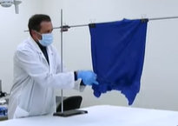
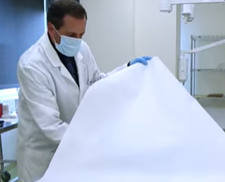

#3 - Collecting Trace Evidence
Visually examine the item with magnifying glasses, lights, and cameras (photos).
Scrape clothing/items, use tape to lift hairs and fibers, or other methods.
Gather evidence in paper folds, envelopes, and other accepted containers.

Slide 6
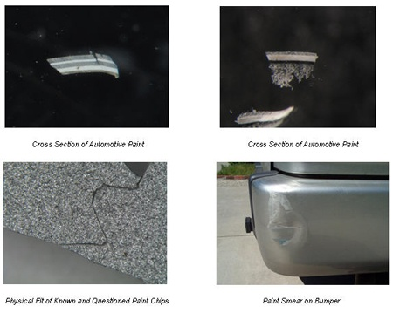
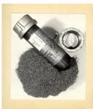
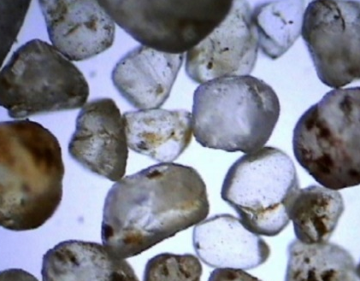
#4 - Trace Evidence Examples
Paint
Paint is examined with microscopes and several analytic instruments to determine its layer chemical composition. There are forty thousand different types of paint classified in a database available to police. It can be transferred from one vehicle to another in an accident, a paint chip left at the crime scene can be used to determine the make and model of the vehicle it came from, or paint transferred from a window to a suspect’s tool in a break and entry can place that tool at the crime scene.
Explosives
Sample of the explosive, the device, or other debris are submitted to the Trace Unit. These items are then analyzed with chemical spot tests and analytical instrumentation to determine their chemical make-up to help identify which type of explosive was used. These results can then be compared to any evidence found in the suspect’s possession.
Dust & Dirt
Soil evidence can reveal where a person has been, where they live, where they work, and if they have pets. Other debris in the sample and pollen can reveal where a person has been (outside).
Source: http://www.virtualsciencefair.org/2004/fren4j0/public_html/trace_evidence.htm

Slide 7
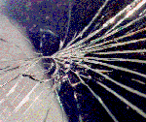
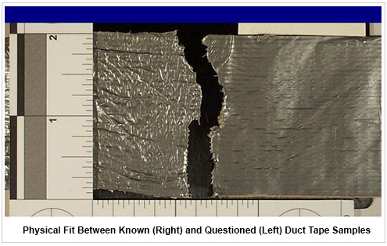
Glass
In car accidents, fragments of glass can be embedded in a victims’ hair or clothing. In break and entries, suspects often get glass fragments on their clothing. Glass particles can be compared to particles collected from the crime scene to determine if they have a common origin. Glass tint, thickness, UV fluorescence, density, and refractive index can all be used to match glass samples to glass found at a crime scene. Reconstructing a pane of glass may help determine the direction of the impact or sequence of impacts may be determined.
The pattern of cracks in a windshield fracture can reveal information about speed, occupant position, and angle of impact.
http://www.mtcforensics.com/investigation.html
Physical (Fracture) Matches
When an object breaks, tape is torn, or something is cut, two unique edges are formed. These edges can be compared by the naked eye, and under high magnification to see if they fit together like puzzle pieces and were part of the same object. If the edges fit together, they are said to physically match one another, and investigators know that the two objects were at one time a single object.
Source: http://www.virtualsciencefair.org/2004/fren4j0/public_html/trace_evidence.htm

Slide 8
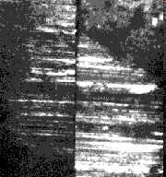
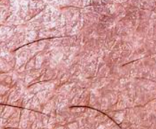
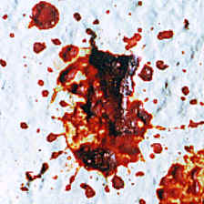
Firearms
Characteristics of ammunition, components and residue are examined to find matches. Bullets are never removed from their holes. The whole surrounding surface is cut out. Gunshot residue (GSR) from the hand or face needs to be done within six hours, and a lab can compare it with target residue.
Wounds
Wounds can often be matched to weapons, tool marks on the weapon, or at least the weapon's size, shape, and length. Wound pattern analysis is a special technique that often provides clues to how a crime was committed or characteristics of the suspect (left-handed, right-handed, height, etc.)
Biological Materials
Semen, saliva, sweat, and blood can usually be found in spatters, drops or stains and can be fresh, coagulated or in dried form. Bodily fluids, such as vomit, can be found at scenes and used to test for alcohol, drugs, and poisons. Cigarette butts may contain dried saliva. Semen containing sperm is particularly valuable for DNA analysis
Source: http://www.virtualsciencefair.org/2004/fren4j0/public_html/trace_evidence.htm

Slide 9
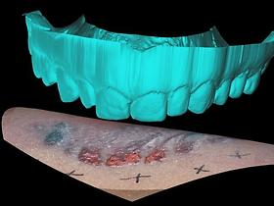
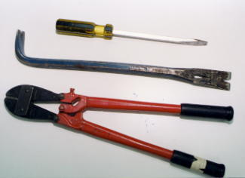
Bite Marks
Each of the thirty-two teeth in humans is unique due to age and wear. Bites can tell how quickly the offender subdued the victim and can often be matched to dental records. Microscopic examination can reveal tiny details to help match a bite mark to a suspect.
Tool Marks
When a tool is made and used, tiny nicks and chips begin to form, which adds unique characteristics to its blade and edges. Tools may also pick up traces of substances it came in contact with. Tool marks can be found at break and enters, robberies and other crime scenes where tools where used.
Shoeprints & Tire prints
Impressions from crime scenes can be photographed, lifted, or cast with dental stone to compare to suspect shoes or tires. Impressions can be three-dimensional when left in snow or soft soil, or they can be two-dimensional when a dirty, bloody, or other impression is left on a hard surface. Footwear impressions can lead to identification of a suspect because of the treads on the shoes that are worn down to each persons walking style. There may also be accidental scratches, nicks and cuts are left on the bottom of your shoe. Tires undergo the exact same changes making them unique as well.
Source: http://www.virtualsciencefair.org/2004/fren4j0/public_html/trace_evidence.htm

Slide 10
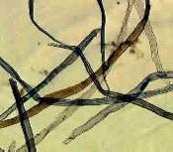
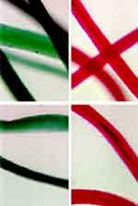
We will get a closer look at hair evidence later in this lesson!
Questioned Documents
Everyone has a unique style of handwriting allowing document examiners to establish similarities in handwriting. Most computers and printers also have a unique printing style, which a computer forensics specialists can use to determine the make printer used to type a document.
Hairs & Fibers
Hairs and fibers may be transferred from the suspect or the suspect’s clothes to the victims’ and vice versa, such as a pedestrian struck by a vehicle may leave hairs and fibers on the suspect’s vehicle bumper or windshield or carpet fibers attaching to a suspect’s shoes.
Hair with roots may provide individual DNA evidence. Hair also has characteristics. There are 14 different elements that can be identified in a hair sample.
Fibers are usually collected from clothing, carpeting, furniture, beds, and blankets. There are over a thousand known fibers, and several thousand known dye formulas.
Source: http://www.virtualsciencefair.org/2004/fren4j0/public_html/trace_evidence.htm
Image: http://www.nlm.nih.gov/visibleproofs/galleries/technologies/virtopsy.html

Slide 11
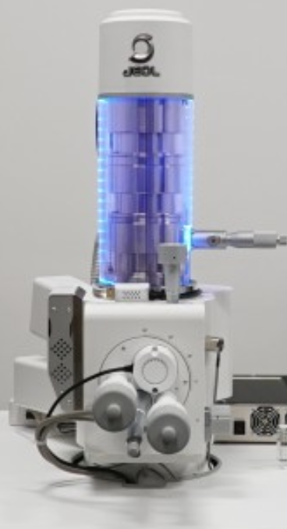
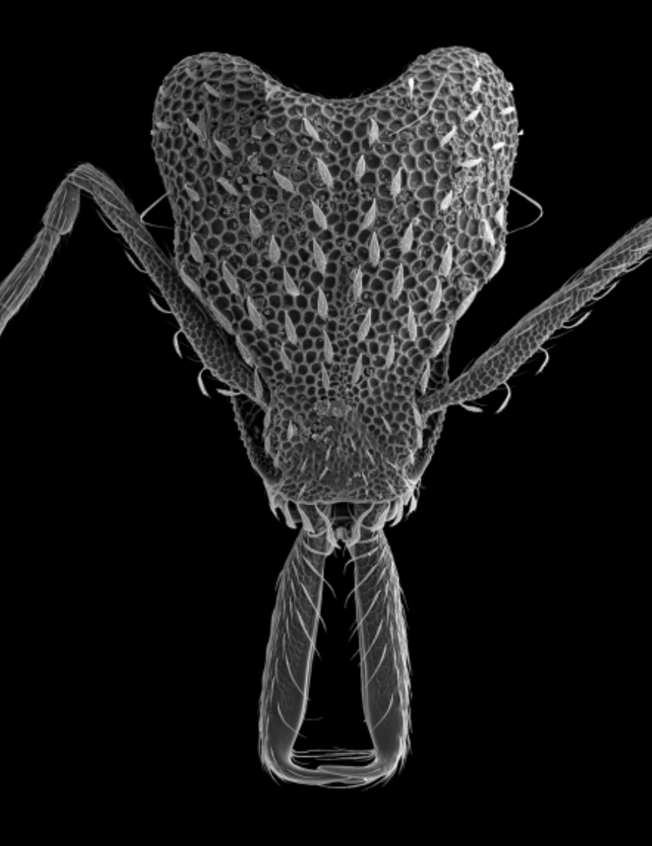
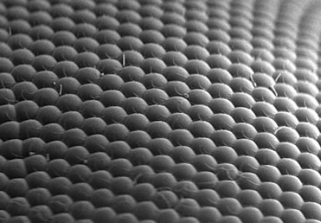
#5 - Which type of microscope can magnify objects up to 300,000X?
Scanning electron microscope (SEM)
What is this?
Ant
What is this?
Fly’s eye
NHM’s SEM has a resolution 13,000 times greater than the human eye and can magnify an object 830,000 times larger than its normal size.
Source: https://nhm.org/scanning-electron-microscope-lab

Slide 12
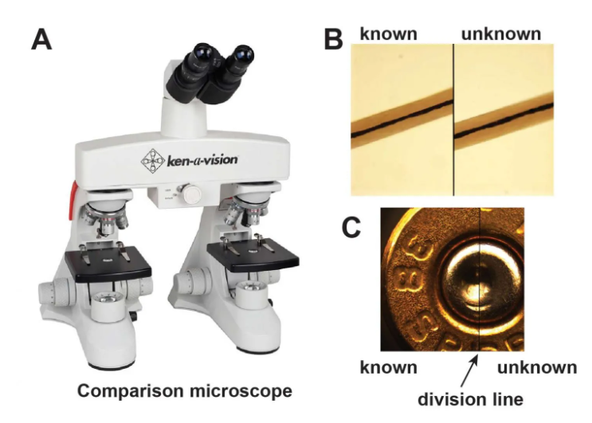
#6 – Comparison Microscope
Two compound microscopes connected to an optical bridge allowing scientists to view two things side by side.
Optical Bridge
Evidence from a crime scene compared to known samples.
Source: https://rsscience.com/hair-under-a-microscope/

Slide 13
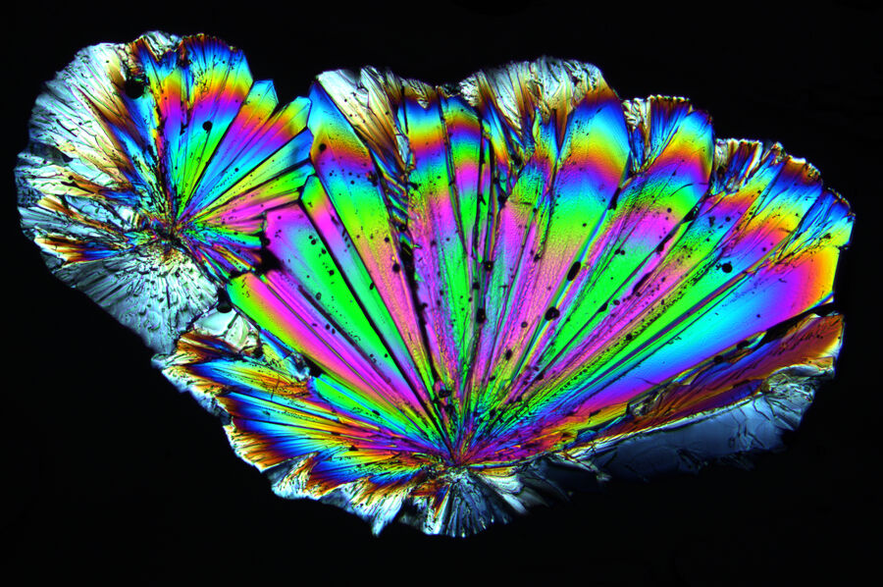
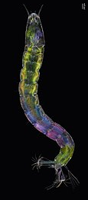
#7 - How do polarizing, fluorescent, and phase contrast microscopes help scientists see details that might be hard to see in normal lighting conditions?
They have different lenses and light sources to make details that are “invisible” under normal light appear for analysis.
Midge larva
Polarizing
Sugar crystal

Slide 14
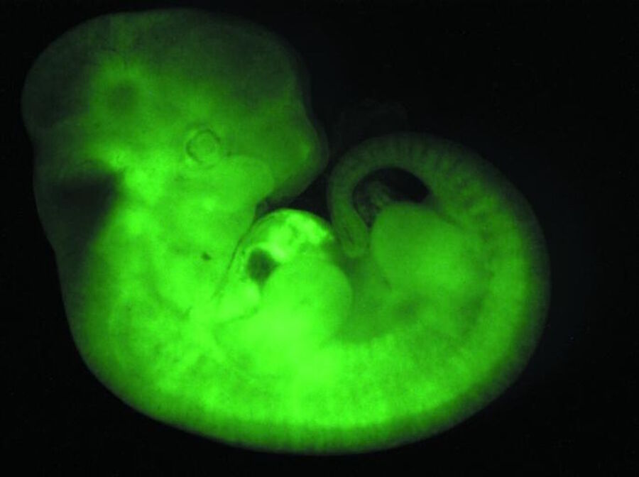
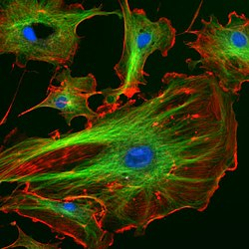
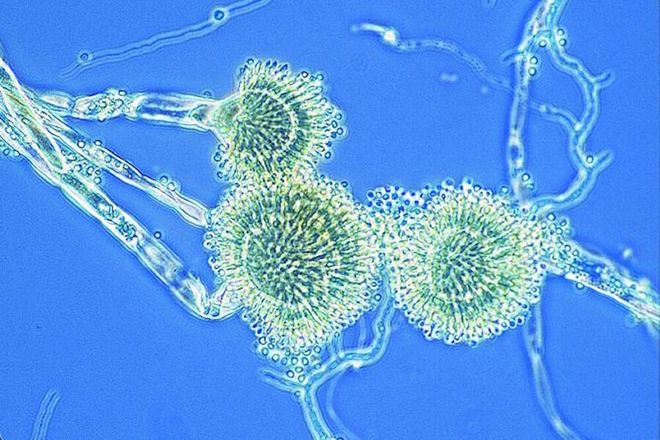
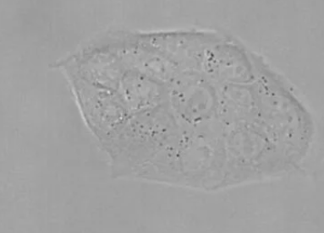
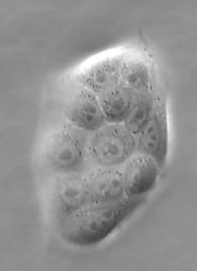
Mouse Embryo
Endothelial Cells
Sugar crystal
Fluorescent
Bright Field
Contrast
Mold
Phase contrast

Slide 15
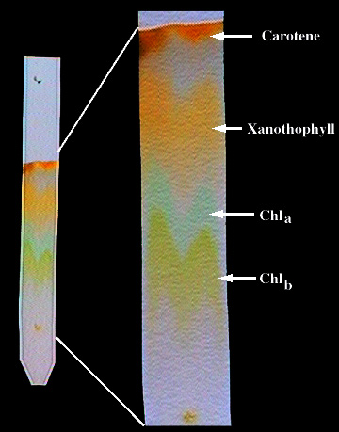
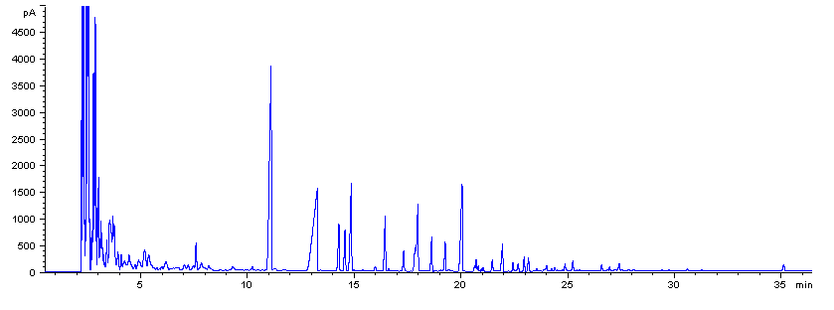
#8 – CHROMATOGRAPHY is the process is used to separate a mixture its different components.
Paper Chromatography
Can be used to separate the components of inks, dyes, plant compounds, make-up, candy coating, & many other substances
https://www.youtube.com/watch?v=2QVCxK0QPeg
Gas Chromatography
Used to determine the chemical composition of unknown substances, such as the compounds in gasoline by the peaks in the graph below.

Slide 16
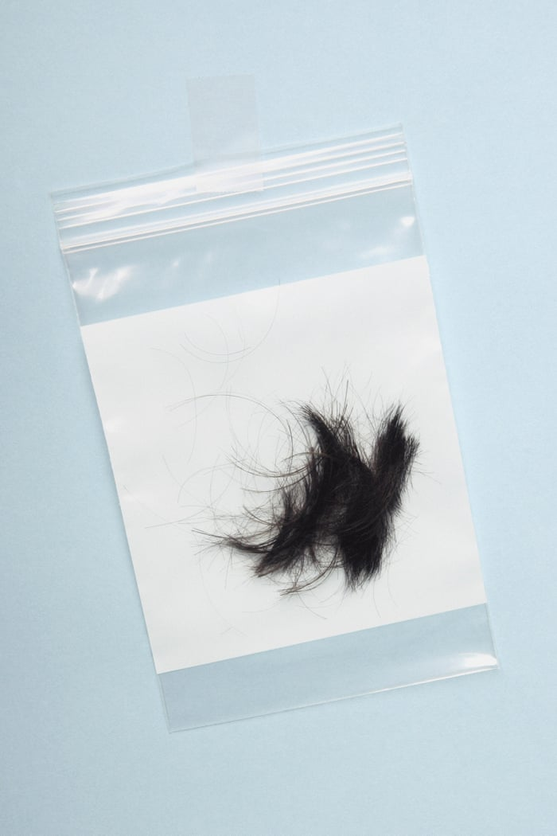
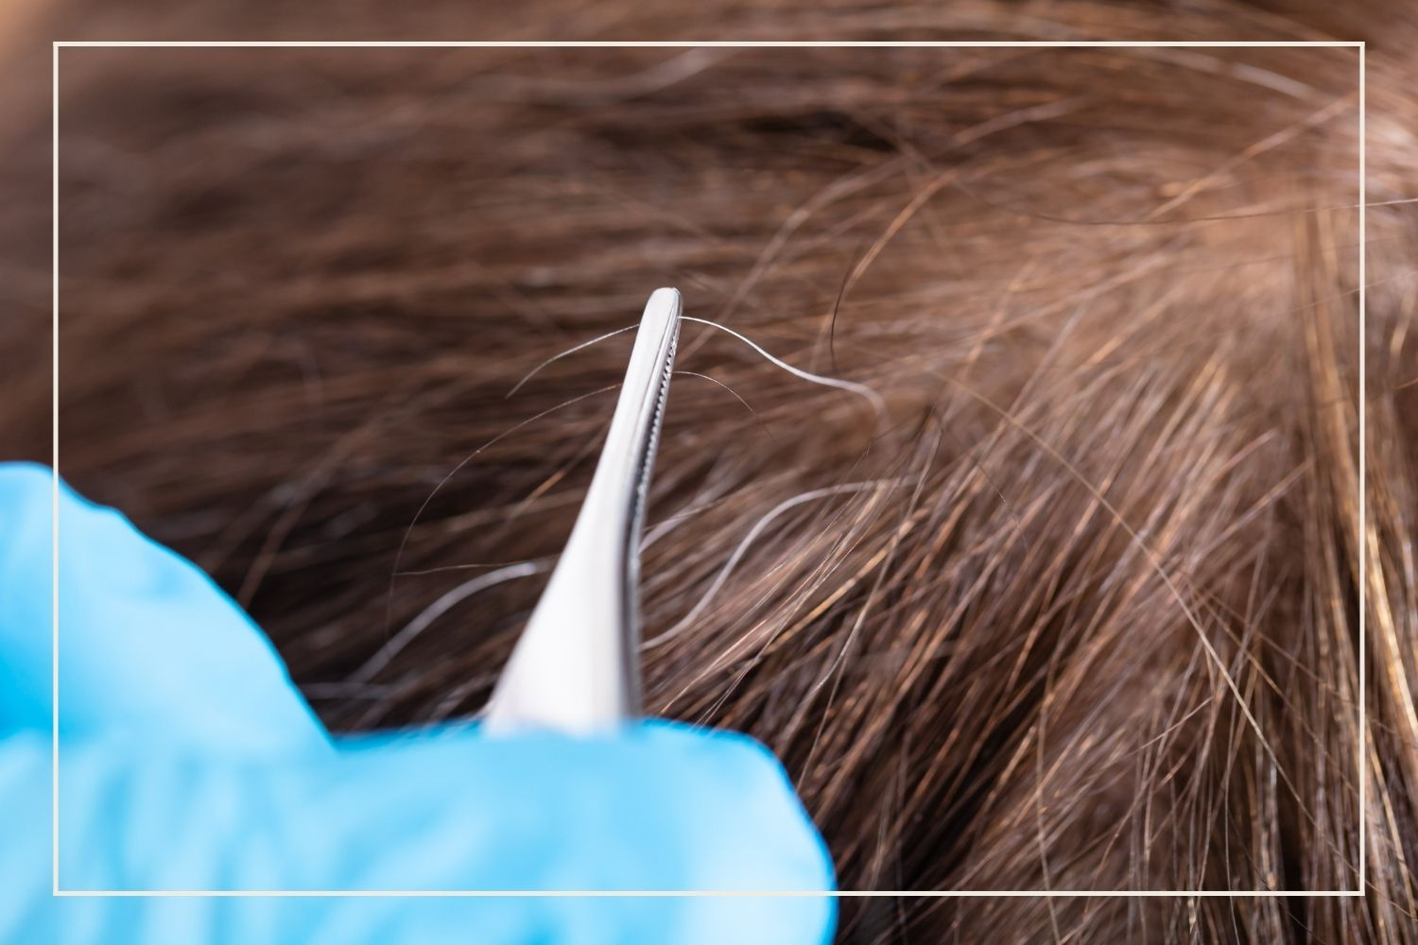
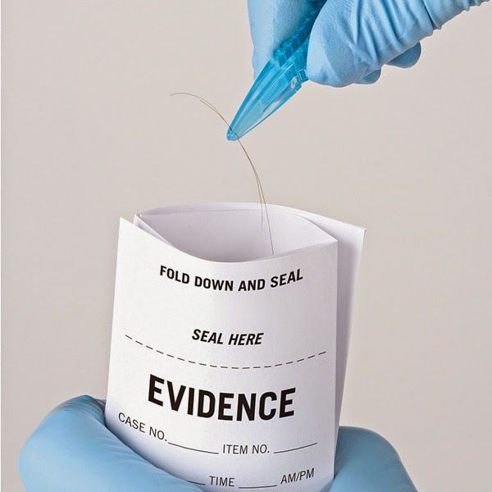
Part B: Hair Evidence

Slide 17
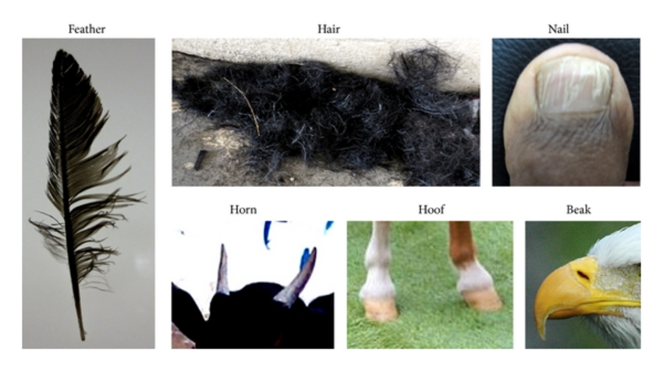
#1
Hair is composed of the protein KERATIN which is also the primary component of our FINGERNAILS and TOENAILS.
Keratin can also be found in other animals, such as bird feathers, horns, hooves, beaks, and fur.
Image Source: https://www.researchgate.net/figure/Sources-of-keratin-Different-sources-such-as-feathers-hair-nails-horns-hooves-and_fig3_272827545

Slide 18
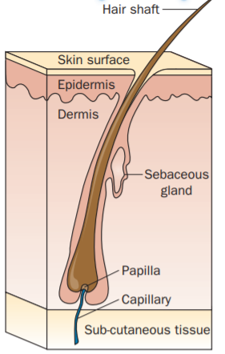
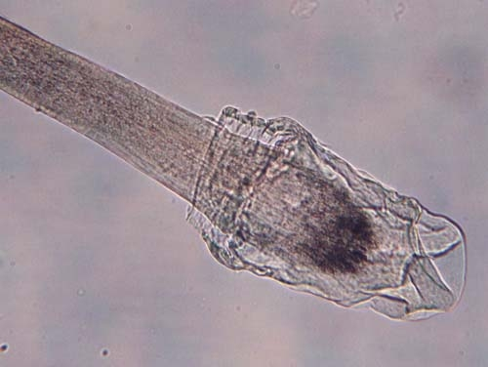
Hair is produced from a structure called the hair follicle (or root.)
Humans develop hair follicles during fetal development, and NO NEW FOLLICLES are produced after birth.
#2 → FALSE
In order to test hair evidence for nuclear DNA, the ROOT (or follicular tag) must be present.
Hair may also be tested for mitochondrial DNA, which is the DNA that is found in the mitochondria of our cells.
ROOT
#3
Image 1: https://ngl.cengage.com/assets/downloads/forsci_pro0000000541/4827_fun_ch3.pdf
Image 2: https://dps.mn.gov/divisions/bca/bca-divisions/forensic-science/Pages/trace-hair.aspx
NOTE: Hair that normally falls out does not have a root attached, while hair that is pulled out by force does.

Slide 19
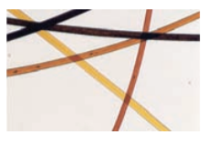
#4
What can we learn from hair evidence?
Genetic Background - Differences in the structure of hair, shape of the strand itself, and hair texture can be determined by the characteristics of a strand of hair.
Hair color – Pigments, are chemical compounds that reflect certain wavelengths of visible light, which we see as color. Hair that has been dyed can also be helpful to connect an individual to a hair from a crime scene.
Dyed hair samples
https://ngl.cengage.com/assets/downloads/forsci_pro0000000541/4827_fun_ch3.pdf

Slide 20
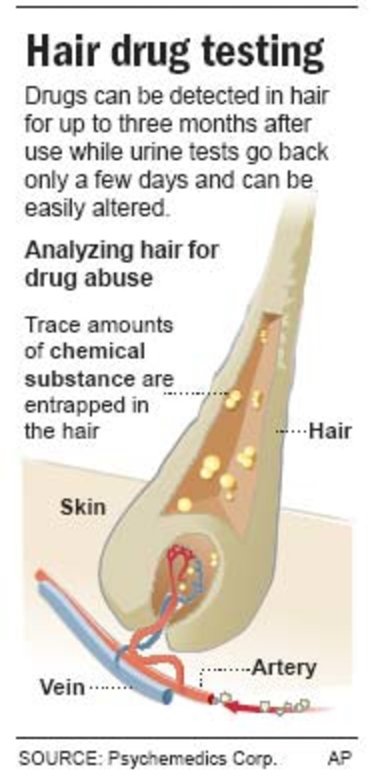
#4
More answers …
Diet/nutrition– Condition of the hair samples may give clues to an individual’s diet or nutritional history (especially if lacking in specific vitamins & minerals.)
Drug Use/Medications – Chemical tests and analysis can provide evidence of drug use to provide clues about a suspect or victim.
Intentional alteration - from the use of heat curling, perms, straightening, etc.) may mask natural hair color/type making identification more challenging.

Slide 21
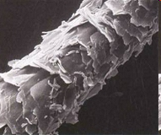
Part C: Hair Structure
CUTICLE
Outer coating composed of
overlapping scales
The cuticle varies in:
  Its scales,
  How many there are per centimeter,
  How much they overlap,
  Their overall shape, and
  How much they protrude from the surface
  Its thickness, and
  Whether or not it contains pigment.
Characteristics of the cuticle may be important in distinguishing between hairs of different species but are often not useful in distinguishing between different people.
Info: http://library.thinkquest.org/04oct/00206/lesson.htm#t_hair Image: http://www.hairdressersus.com/micro/Image5b.jpg

Slide 22
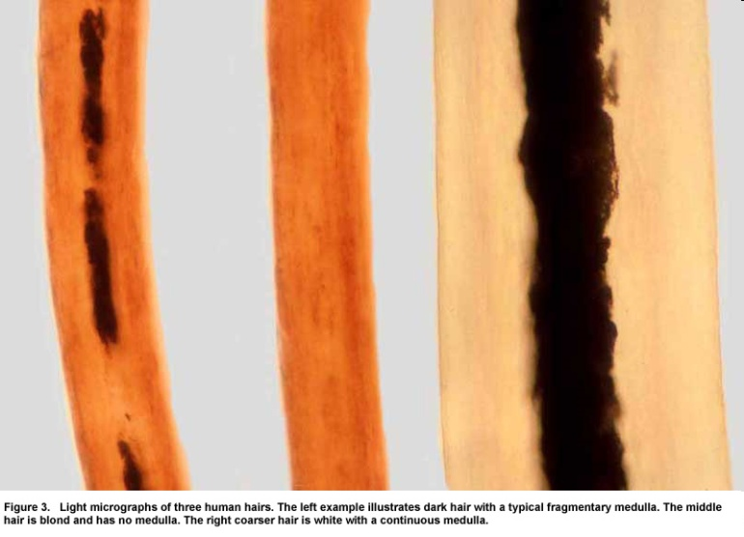

MEDULLA
Central core (may not be
present in all hair samples)
The medulla may vary in:
  Thickness
  Continuity - one continuous structure
  or broken into pieces
  Opacity - how much light is able to
  pass through it
It may also be absent in some species.
Like the cuticle, the medulla can be important for distinguishing between hairs of different species, but often does not lend much important information to the differentiation between hairs from different people.
http://library.thinkquest.org/04oct/00206/lesson.htm#t_hair
http://www.bfro.net/images/whatis/figures/Fig.%203%20with%20caption.jpg

Slide 23
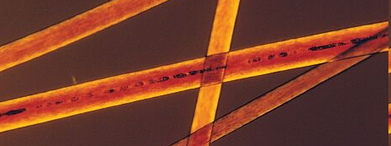
CORTEX
Protein-rich structure
around the medulla that
contains pigment
The cortex varies in:
  Thickness
  Texture
  Color
Distribution of the cortex is perhaps the most important component in determining from which individual a human hair may have come.
Microscopic examination can also reveal the condition and shape of the root and tip.
Info: http://library.thinkquest.org/04oct/00206/lesson.htm#t_hair Image: http://www.extrapersonality.com/hair.html

Slide 24
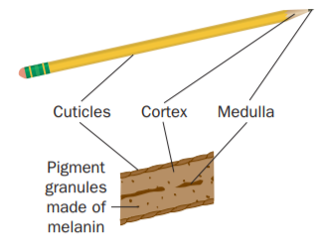
How is a hair like a pencil?
?
?
?
Cuticle = Paint
Cortex = Wood
Medulla = Lead
https://ngl.cengage.com/assets/downloads/forsci_pro0000000541/4827_fun_ch3.pdf

Slide 25
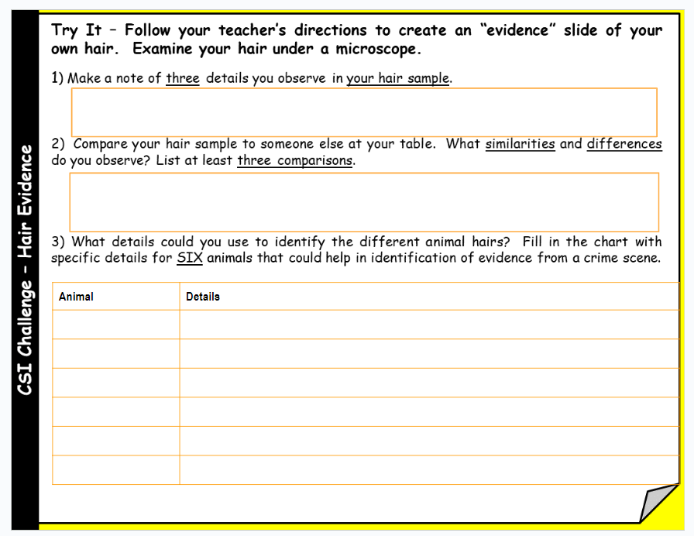
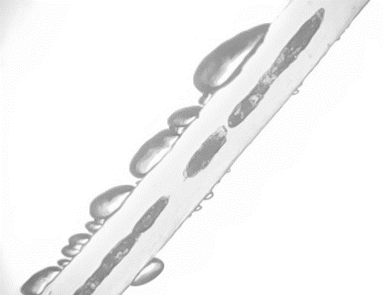
Try It - Let’s take a closer look …
#1 - Examine YOUR hair sample using low, medium, & high power. Use the fine focus to observe the different layers of hair and the root.
#2 - Examine hair samples from other students at your table and then answer question 2 on your notes.
THINGS TO NOTE …
Color(s) of the hair
Cuticle pattern
Root & description
Medulla pattern
Ends (smooth or split)
Oil or Gel
Medulla
NOTE: You will also see space around the hair that was trapped inside during lamination.

Slide 26
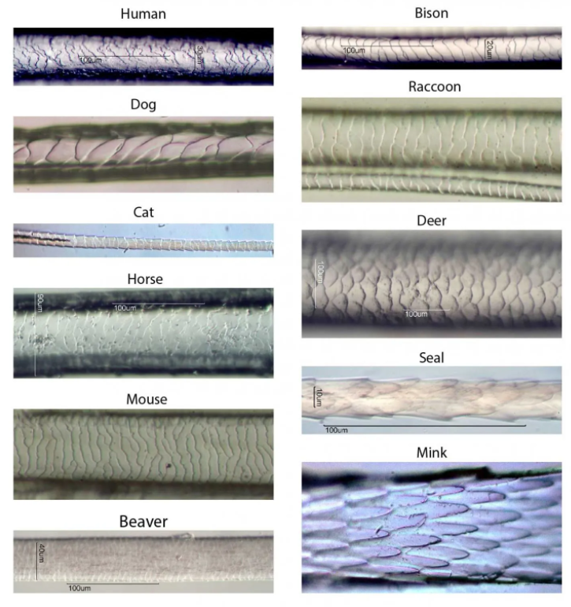
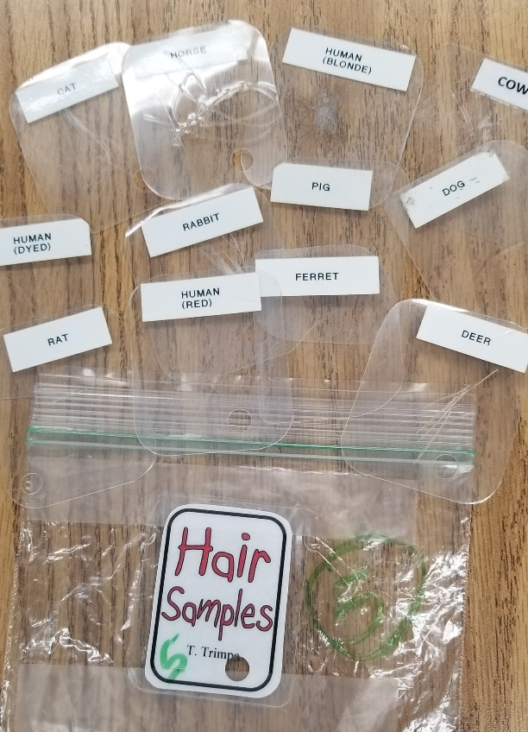
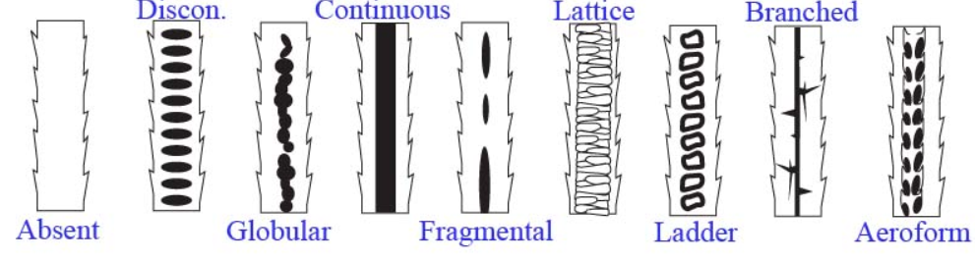
Note: I obtained hair samples from my students’ pets as well as my own animals. I created slide sets by laminating the samples with smaller thermal laminating pouches. I set up at least 7 sets for my classes along with a bag of extra slides just in case any samples go missing. You may also purchase slides from many science supply companies.
What animal is it?
Microscopic examination of animal hairs can reveal minute details to help scientists identify them. The cuticle and medulla can be helpful in identifying a specific animal species.
Cuticles - Use a microscope to examine the cuticle in the animal hairs provided by your teacher. Can you find any that match the patterns shown in this image?
Medulla – Examine the center of each strand to find the patterns shown in this image. Did you find other patterns?
Images: https://rsscience.com/hair-under-a-microscope (top) and http://www.microlabgallery.com/gallery/images/medulla%20draw%202.jpg (bottom)

Slide 27
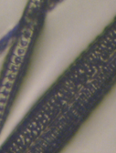
Time to examine some animal hairs …
Rabbit “Pods” make up its medulla
Choose samples to fill in your chart. Make a note of specific details that would help you identify it later.
Each table group will receive ONE set of animal hairs to examine. Do not share slides with other groups!
Image: https://www.mccrone.com/mm/untangling-hairy-science/

Slide 28
What animal is it?
Microscopic examination of animal hairs can reveal minute details to help scientists identify them. The cuticle and medulla can be helpful in identifying a specific animal species.
Cuticles - Use a microscope to examine the cuticle in the animal hairs provided by your teacher. Can you find any that match the patterns shown in this image?
Medulla – Examine the center of each strand to find the patterns shown in this image. Did you find other patterns?
Images: https://rsscience.com/hair-under-a-microscope (top) and http://www.microlabgallery.com/gallery/images/medulla%20draw%202.jpg (bottom)

Slide 29
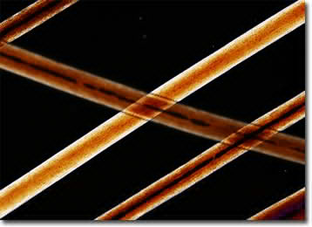
Animal Hair Challenge
Work with your table mates to examine the hair slides to identify the mystery hairs.
TOC
http://micro.magnet.fsu.edu/primer/techniques/polarized/gallery/images/humansmall.jpg

Slide 30
Note: I have 3 different versions to reduce the “sharing” of information between the six different classes I have in a day. I also keep their answer sheets as a record, which means they cannot pass it along to anyone else!
Challenge Rules
Your investigative team (table group) must examine the hair samples to identify the SEVEN mystery hairs show on the next slide.
Your team may use only TWO microscopes.
Your team must make a guess on all the samples before getting it checked by the teacher.
ONE person in your group will need to take the answer slip to the teacher to get checked. After it is checked, return to your spot and fix the ones you missed. Keep checking the answers until you have it all correct.
Set 1 Set 2 Set 3
Don’t give away answers!

Slide 31







Can you identify the animal hairs shown?
Set 1
Human
Deer
Horse
Cat
Dog
Rat
Rabbit
A
B
C
D
E
F
G
Set #1
Set 1 Key
Notes:
Teacher Note: I challenge students to identify each hair sample pictured on this slide as they examine the sets of animal hairs I have prepared for them. An observation worksheet is available on my website which requires students to draw an image of what they see and add a description that highlights unique characteristics of each specimen. A key for the animal hairs is available on the next to last slide of this presentation!

Slide 32
Can you identify the animal hairs shown?
Cat
Deer
Horse
Human
Rat
Rabbit
Dog
A
B
C
D
E
F
G
Set #2
Set 2 Key
Notes:
Teacher Note: I challenge students to identify each hair sample pictured on this slide as they examine the sets of animal hairs I have prepared for them. An observation worksheet is available on my website which requires students to draw an image of what they see and add a description that highlights unique characteristics of each specimen. A key for the animal hairs is available on the next to last slide of this presentation!

Slide 33
Can you identify the animal hairs shown?
Cat
Human
Deer
Horse
Rat
Dog
Rabbit
A
B
C
D
E
F
G
Set #3
Set 3 Key
Notes:
Teacher Note: I challenge students to identify each hair sample pictured on this slide as they examine the sets of animal hairs I have prepared for them. An observation worksheet is available on my website which requires students to draw an image of what they see and add a description that highlights unique characteristics of each specimen. A key for the animal hairs is available on the next to last slide of this presentation!

Slide 34
Answer Keys
Set 1 Key Set 2 Key Set 3 Key
http://micro.magnet.fsu.edu/primer/techniques/polarized/gallery/images/humansmall.jpg

Slide 35
Can you identify the animal hairs shown?
Set 1
Human
Deer
Horse
Cat
Dog
Rat
Rabbit
Human
Deer
Horse
Cat
A
B
C
D
E
F
G
Set #1
Dog
Rat
Rabbit
Notes:
Teacher Note: I challenge students to identify each hair sample pictured on this slide as they examine the sets of animal hairs I have prepared for them. An observation worksheet is available on my website which requires students to draw an image of what they see and add a description that highlights unique characteristics of each specimen. A key for the animal hairs is available on the next to last slide of this presentation!

Slide 36
Can you identify the animal hairs shown?
Cat
Deer
Horse
Human
Rat
Rabbit
Dog
Cat
Deer
Horse
Human
A
B
C
D
E
F
G
Set #2
Rat
Rabbit
Dog
Notes:
Teacher Note: I challenge students to identify each hair sample pictured on this slide as they examine the sets of animal hairs I have prepared for them. An observation worksheet is available on my website which requires students to draw an image of what they see and add a description that highlights unique characteristics of each specimen. A key for the animal hairs is available on the next to last slide of this presentation!

Slide 37
Can you identify the animal hairs shown?
Cat
Human
Deer
Horse
Rat
Dog
Rabbit
Cat
Human
Deer
Horse
A
B
C
D
E
F
G
Set #3
Rat
Dog
Rabbit
Notes:
Teacher Note: I challenge students to identify each hair sample pictured on this slide as they examine the sets of animal hairs I have prepared for them. An observation worksheet is available on my website which requires students to draw an image of what they see and add a description that highlights unique characteristics of each specimen. A key for the animal hairs is available on the next to last slide of this presentation!

Slide 38


Part C: Fiber Evidence
A fiber is the smallest unit of a textile material that has
a length many times greater than its diameter.
Cross-section of a man-made fiber
The discovery of cross transfers or multiple fiber transfers between a suspect's clothing and a victim's clothing dramatically increases the likelihood that the two individuals had physical contact.
Fibers from plants and animals are called natural fibers, but they can also be synthetic, or man-made.
http://www.fbi.gov/hq/lab/fsc/backissu/july2000/deedric3.htm#Fiber%20Evidence

Slide 39


Types of Fibers
Natural Fibers
Cotton fibers are the most commonly plant fibers used in textile materials.
Wool is the most common animal fiber used in the production of textile materials with the majority coming from sheep.
Synthetic Fibers
These are man-made fibers created using polymers made from petroleum products. Some man-made fibers may contain plant materials that have been combined with other chemicals.
http://www.fbi.gov/hq/lab/fsc/backissu/july2000/deedric3.htm#Fiber%20Evidence
https://edurev.gumlet.io/ApplicationImages/Temp/500346_83600c57-6504-4fae-9dc7-7407e301f532_lg.png?w=360&dpr=2.6

Slide 40



Characteristics to examine on fiber evidence:
Type, length, & shape of fiber used
Spinning method
Fabric construction
Dye composition (if colored)
Images: https://www.mshp.dps.missouri.gov/MSHPWeb/PatrolDivisions/CLD/TraceEvidence/fibers.html
Information: http://www.fbi.gov/hq/lab/fsc/backissu/july2000/deedric3.htm#Fiber%20Evidence

Slide 41






Try It: Can you identify the types of fibers shown?
A
B
C
D
E
F
A. Which samples are natural fibers? Which samples are synthetic fibers?
B. What characteristics can be used to identify unknown fiber samples?
Notes:
Teacher Note: I challenge students to identify each fiber sample pictured on this slide as they examine the sets of fibers I have prepared for them. An observation worksheet is available on my website which requires students to draw an image of what they see and add a description that highlights unique characteristics. A key for the fibers is available on the last slide of this presentation!

Slide 42
Types of Fibers – Answer Key
A
Acrylic Yarn
B
Cotton Yarn
C
Nylon Rope
D
E
F
Polyester Yarn
Rayon Rope
Wool Yarn
A. Which samples are natural fibers?
Which samples are synthetic fibers?
B. What characteristics can be used to identify unknown fiber samples?
Cotton, Wool
Acrylic, nylon, polyester, rayon
What did you say?

