Slide 1


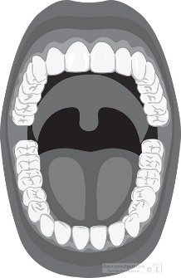
Teacher Notes:
The student digital slides for this unit are available at https://docs.google.com/presentation/d/1Ray7CFPod01UyuQp2Rx2B4rqWOKOhk4m9SwZ0MVWmYw/edit?usp=sharing
IMPORTANT: Make a copy of the student notebook before you assign it on your LMS. It is view-only and I am not able to approve access for your students.
The FULL digital notebook (with all the slides for the digital lessons and activities) is available at https://docs.google.com/presentation/d/14eIEiGacRXMsDyuUxiEsSM2m4YOAtIlfmD4O4YsLdPI/edit?usp=sharing. It is set up for standard paper (8.5x11) in landscape mode for easier printing when needed. Paper versions are available for this unit on my Forensic Science page at https://sciencespot.net/Pages/classforsci.html
A DRAFT of the general outline of the digital lessons (with corresponding slide #s for the student notebook) is available at https://docs.google.com/document/d/15wxjmL-uHQPXDKOxmZXtU_gxy9dphEuyC1P4jzP-9mA/edit?usp=sharing . It is based on 44-minute class periods with 7th & 8th grade students.
Preview presentations before using with your classes as many slides have animations and links you will need to use.
I do Science Starters at the beginning of each class period. A collection of starters for Forensics is available on my lessons plans page at https://sciencespot.net/Pages/classforsci.html .
CSI Unit Training Materials
Teacher Note: You may want to complete the Case Study: Tourist Trap prior to this lesson and the bite mark activity.
“Impressive”
Evidence
Complete the slide as we watch the video. You will use the information to determine which view (investigators or detectives) you believe to be the most reliable.
T. Tomm Updated 2023
https://sciencespot.net
This Photo by Unknown Author is licensed under CC BY

Slide 2
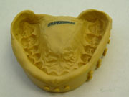
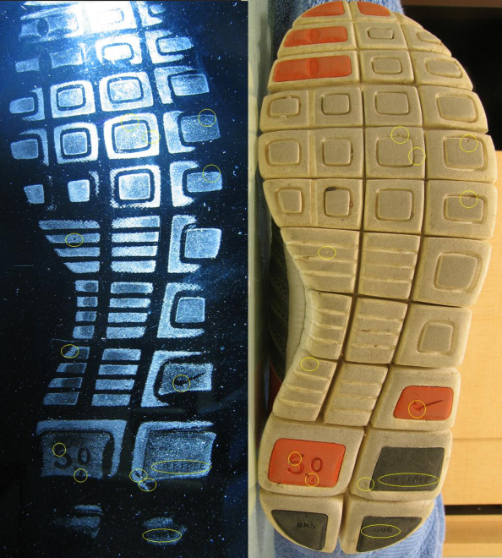
What is impression evidence?
IMPRESSION EVIDENCE can be defined as OBJECTS or MATERIALS that have retained the characteristics of other objects through direct CONTACT.
SHOEPRINTS, TOOL MARKS, TIRE TRACKS, BITE MARKS, and RIFFLING marks on a bullet are several examples of impression evidence.
The QUALITY of the impression depends on:
⧫ The OBJECT making the impression
The HARDNESS of the surface conditions, and
What type of MATERIAL makes up the surface (soil, mud, dust, concrete, grass, skin, etc.)
Images: http://upload.wikimedia.org/wikipedia/commons/archive/6/61/20070917141644!Shoeprint(forensic).jpg and
http://www.topmark.co.nz/images/content/tmpics01/gallery-s/SilipressionTeethMold.jpg

Slide 3
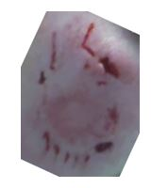
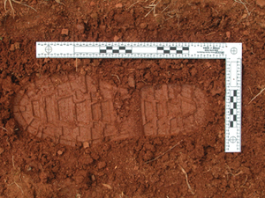
How is impression evidence collected?
2-Dimensional (2D):
Documented using photography to show TWO dimensions (length & width or width & height)
Rulers may also be used to document exact dimensions.
Impressions may be dusted with powder to be photographed or lifted with tape. They may also be collected using an electrostatic dust lifting process.
Shoeprint: http://www.forensicsciencesimplified.org/fwtt/how.html

Slide 4
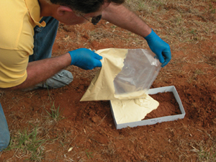
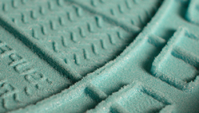
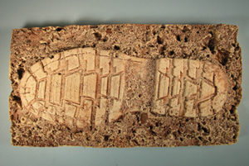
3-Dimensional (3D):
Documents THREE dimensions (length, width, & height/depth) of a piece of evidence
Casts are made to show depth, which involves using dental cement (or a similar substance) to preserve the dimensional characteristics of the print.
Evidence may also be photographed with rulers or other objects to document dimensions
Tire Track: https://www.youtube.com/watch?v=dhkSlJadfPs
Shoeprint: http://www.forensicsciencesimplified.org/fwtt/how.html
Images: http://www.evidentcrimescene.com/cata/cast/dscasting.html

Slide 5
Class vs. Individual Characteristics
CLASS → Characteristic that shows the class or group a material belongs.
Examples:
Tire tread pattern matches to a brand/type of tire
Teeth or bite marks matches to a specific species of animal
Paint chip from a tool may help us identify the manufacturer of the tool
INDIVIDUAL → Characteristics that match of evidence to ONE specific item or person.
Examples:
Wear pattern on a shoe print matches a suspect’s shoe.
Bite mark shows specific locations of teeth that can be matched to a suspect’s dental profile
Break in the end of a screwdriver matches a spot in the wood where it was used to pry open a door
Footprint Evidence

Slide 6
Directions: Use what you learned from the previous slide to identify each example as either C (class) or I (individual).
?
____ Wear pattern on a shoe print matches a suspect’s shoe (& his/her walking pattern)
____ Paint chip from a tool matches the type of red paint used on Tools R Us tools.
____ Tire tread pattern matches patterns used on a Hoosier 4-Ply Super Turf tire.
____ Broken corner on a screwdriver matches a mark left on a wooden doorway at a crime scene
____ Teeth or bite marks matches to a specific breed of dog.
____ Bite mark shows specific locations of teeth that can be matched to a suspect’s dental profile.
?
?
?
?
?

Slide 7
Identify each example as either C (class) or I (individual).
____ Wear pattern on a shoe print matches a suspect’s shoe (& his/her walking pattern)
____ Paint chip from a tool matches the type of red paint used on Tools R Us tools.
____ Tire tread pattern matches patterns used on a Hoosier 4-Ply Super Turf tire.
____ Broken corner on a screwdriver matches a mark left on a wooden doorway at a crime scene
____ Teeth or bite marks matches to a specific breed of dog.
____ Bite mark shows specific locations of teeth that can be matched to a suspect’s dental profile.
ANSWER KEY
I
C
C
I
C
I

Slide 8
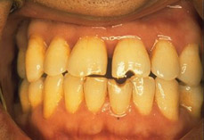
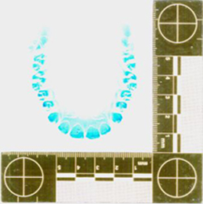
Part B: Bite Mark Evidence
WHAT CLUES CAN WE GET FROM A BITE MARK?
TYPE of bite mark (human or animal)
TEETH characteristics (position, dental work ,
wear patterns, etc.)
TIME SINCE BITE – The color of the area helps to estimate how long ago the bite occurred (old or recent bite)
DNA - Swab for saliva or blood for
DNA testing.
LOCATION - Marks can be left on a
victim’s skin or other objects, such as
Styrofoam cups, gum, or foods.
Bite Mark Evidence Video
Images: http://www.forensicdentistryonline.org/Forensic_pages_1/currentopic1.htm, http://www.trestonedental.co.uk/images/0303.jpg

Slide 9
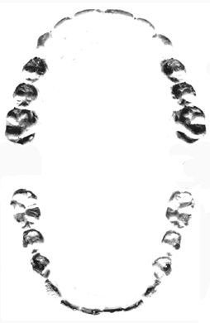
A closer look at bite mark evidence …
Make an Impression
1 – Label one side MAXILLA (top jaw) and the other MANDIBLE (lower jaw).
2 - Fold the Styrofoam plate in half.
3 – Gently bite down on the plate to leave your bite mark impression.
4 - Place a sheet of plastic film over the impression and use a permanent marker to recreate the pattern to match that of your bite mark.
Maxilla
Width
Depth
Mandible
Time to create some evidence …
http://forensicfact.files.wordpress.com/2008/05/cast_negative_resized_copy.jpg

Slide 10
Maxilla
Analyze your bite mark and compare with your group.
How does the width of your bite mark compare to the depth?
Do you have the same number of individual tooth impressions as your group mates?
What other details do you observe that would make it easy to identify as your bite mark?
Width
Depth
Mandible
http://forensicfact.files.wordpress.com/2008/05/cast_negative_resized_copy.jpg

Slide 11
Answer the questions on your notes.
What CLASS characteristics do you see in your bite mark?
What INDIVIDUAL characteristics do you see in your bite mark? List 3 characteristics.
Possible answers would include the different types of human teeth (incisors, canines, molars) and approximate age (if molar impressions are present).
Possible answers would include missing teeth (baby teeth or other reasons), angles/slanted impressions, marks from braces, width & depth of bite mark, and tooth damage (chips, broken teeth, etc.)
Click to reveal possible answers
http://forensicfact.files.wordpress.com/2008/05/cast_negative_resized_copy.jpg

Slide 12
#2 - Bite Mark Challenge - Follow your teacher’s directions to test each material. Complete the chart with your quality rating and observations.
Quality → 1 = Poor to 5 = Excellent
Candy | Quality | Observations
Orange Slice
Tootsie Roll
Airhead
Swedish Fish
Circus Peanut
You may substitute other candy for these items, but I recommend keeping the circus peanut. It usually ends up with the best rating!
What materials worked the best? Why?
What else could we use?
NOTE: As with any lab involving food, be aware of any food allergies that may be a concern with your students.

Slide 13
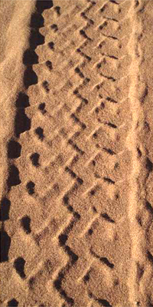
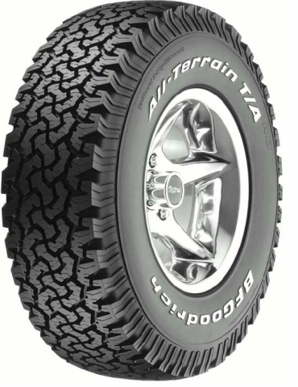
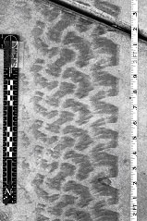
Part C: Tire Track Evidence
Tire tracks are important in forensic investigations and are usually found in road accident scenes or may provide clues at crime scenes.
Investigators may make ink prints of a tire or plaster casts of a track. They will also take photographs that can later be used to prove a match.
Features to analyze:
Tread pattern and size (width & depth) can help investigators identify the type of vehicle that left them
Use tire databases to determine the brand and model of the tire that left the impression.
Unique characteristics due to the wear pattern, damage, or material defects to help match it to a specific vehicle
Images: http://www.suite101.com/view_image.cfm/454216, http://www.ronsmithandassociates.com/FWTTS.htm.

Slide 14

Directions: Complete the notes as you watch the video.
Video Link: https://edpuzzle.com/media/5ae084f8cf5572411ed5ca8d

Slide 15
United Streaming: The Value of Evidence
Part A: Complete this worksheet as you watch the video.
1. The job of the Forensic Science Unit is to collect ____________ evidence.
2. To document a tire track, it is first ______________________ and then ___________ are made using dental cement that is poured into a metal form.
3. Investigators use a high-powered _____________ to trace the path to the victim. The light shines at ____________________ that cause materials to fluoresce and ________________ goggles help make evidence stand out sharply.
4. Evidence that is collected at a crime scene is analyzed by a ___________, who goes through the debris that is collected at a crime scene.
5. ____________ fibers are valuable clues because they can link suspects to a specific location.
Click to reveal answers
PHYSICAL
PHOTOGRAPHED
CASTS
LIGHT
WAVELENGTHS
ORANGE
CHEMIST
(Or other
specialists)
CARPET

Slide 16
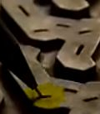
6. The tire track expert studies the photographs taken at the crime scene to examine the tread _____________ to determine what kind of vehicle uses that kind of a tire.
8. The final pieces of _______________ needed for an airtight case was obtained by investigators offering a dog bathing service. During the bath, investigators gathered some dog _________ and also got carpet _________ from the living room, which matched those found at the crime scenes.
PATTERNS
7. Tire treads are made up of geometric shapes called __________. The key to tire identification is to match _________________ in pitches. They also examine tiny cuts on the surface called _______ that were molded into the tire by small metal teeth.
PITCHES
DIFFERENCES
SIPES
EVIDENCE
HAIRS
FIBERS

Slide 17
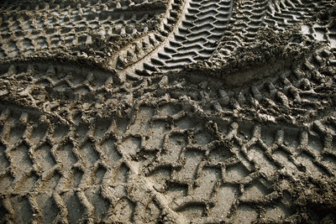
Tire Track Challenge
Forensic Science Activity
http://pro.corbis.com/images/CB001940.jpg?size=572&uid={D27A89DF-00BB-4028-AA57-7A908AF0511D}
T. Trimpe 2007 http://sciencespot.net

Slide 18
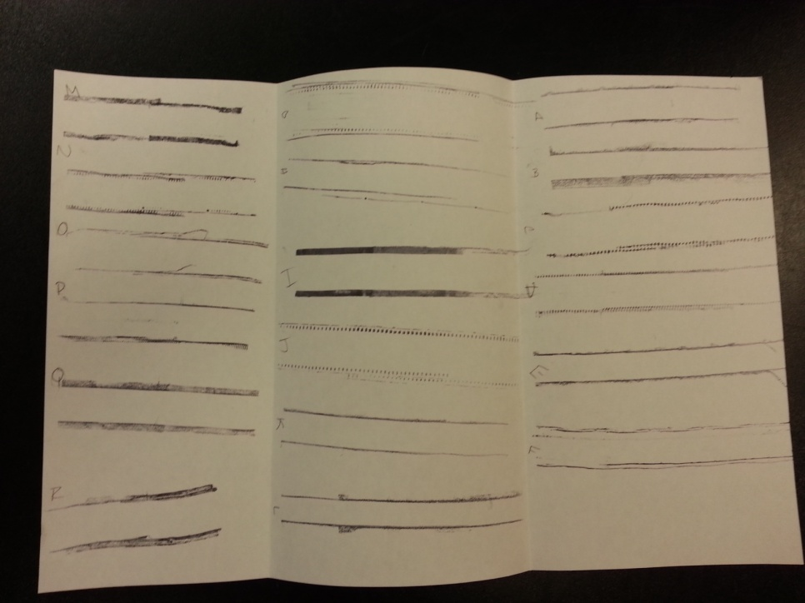
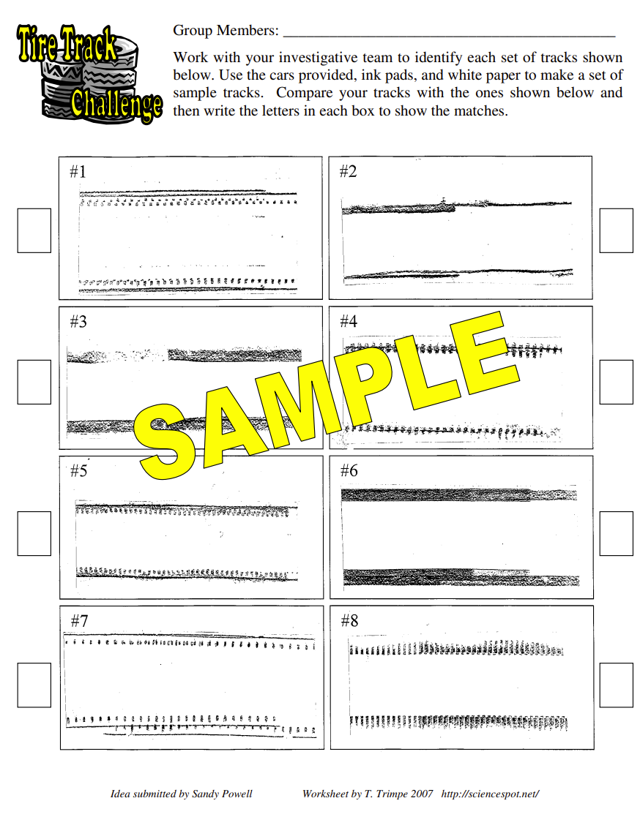
Teacher Note: For this activity I raided my son’s Hot Wheels box to find 18 different types of vehicles. I labeled them with letters using a label maker. I used ink pads (harder ink instead of those with a sponge) to make “evidence” samples.
I selected 8 of the best samples to use for the challenge activity. I organized digital pictures of them on a page, which was laminated to use in the class activity.
Go to https://sciencespot.net/Media/FrnsScience/ImpEvi_Tiretracksinfo.pdf for more information.
Tire Track Lab
Your group will need to document the tread patterns for each vehicle.
Step 1: Get a large piece of white paper from your teacher. You will also need a pen or pencil.
Step 2: Fold the paper into thirds as demonstrated by your teacher.
Step 3: Divide each column into 6 spaces for a total of 18 spaces.
Step 4: At each station, gently roll each car over the ink pad several times to cover all the sides of the tires.
Step 5: Gently roll each car on the white paper for a length of 5-6” and label the tracks with the correct letter.
Caution: You will want to apply enough pressure to get a good impression, but not too hard that you cause damage to the vehicle, its tires, or the ink pad.
Step 6: Roll each car on a piece of paper towel to remove excess ink and then wait quietly for the teacher to say to “rotate” before you go to the next station.

Slide 19
Step 7: Cut apart the tread samples so you have 18 strips. Organize into at least 3 different groups.
Step 8: Analyze the tire tracks to identify unique characteristics and use a highlighter to mark each characteristic you find.
Features to analyze:
Tread pattern
Width & depth of the tread pattern
Unique characteristics due to the wear pattern, damage, or defects
Answer the question on your notes based on the types of features you observed highlighted.

Slide 20
Go to https://sciencespot.net/Media/FrnsScience/ImpEvi_Tiretracksinfo.pdf for more information.
Tire Track Challenge
Work with your partner to identify the 8 tracks shown on the challenge worksheet.
Compare the tracks you made earlier and match them to the suspect tracks on the worksheet.
Once you have identified all the cars, have your answers checked by your teacher. Keep trying until you have them all correct!
Ready?
Set?
GO!

Slide 21
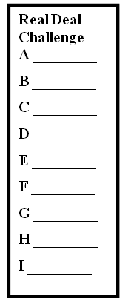
Go to https://sciencespot.net/Media/FrnsScience/tiretracksinfo.pdf for more information.
REAL DEAL CHALLENGE
How many of the real tire tracks can you identify?
Examine the samples located around the room.
NOTE: You are not allowed to move them!
Examine the ink prints on the back cabinets.
Write down the numbers that match each ink print
in the box on your worksheet.
You will have 10 minutes to match as many as you can before we go over the answers!
Teacher Note: I obtained samples of real tire treads from a local tire shop. They labeled the back with the brand of tire. I used a paint roller and ink to make prints. The prints were laminated and displayed around the classroom. Students had time to examine the real tires and try to match it to a print.

