Slide 1

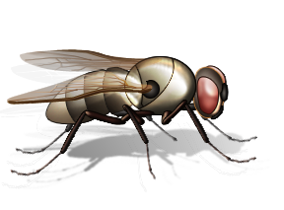
Teacher Notes:
The student digital slides for this unit are available at https://docs.google.com/presentation/d/1kxLyg_FGisErEb48PhBpV1bAOslyKG3gaoNxLtWR6II/edit?usp=sharing
IMPORTANT: Make a copy of the student notebook before you assign it on your LMS. It is view-only and I am not able to approve access for your students.
The FULL digital notebook (with all the slides for the digital lessons and activities) is available at https://docs.google.com/presentation/d/14eIEiGacRXMsDyuUxiEsSM2m4YOAtIlfmD4O4YsLdPI/edit?usp=sharing. It is set up for standard paper (8.5x11) in landscape mode for easier printing when needed. Paper versions are available for this unit on my Forensic Science page at https://sciencespot.net/Pages/classforsci.html
A DRAFT of the general outline of the digital lessons (with corresponding slide #s for the student notebook) is available at https://docs.google.com/document/d/15wxjmL-uHQPXDKOxmZXtU_gxy9dphEuyC1P4jzP-9mA/edit?usp=sharing . It is based on 44-minute class periods with 7th & 8th grade students.
Preview presentations before using with your classes as many slides have animations and links you will need to use.
I do Science Starters at the beginning of each class period. A collection of starters for Forensics is available on my lessons plans page at https://sciencespot.net/Pages/classforsci.html .
CSI Unit Training Materials
Forensic Entomology
Insects as Evidence
Warning: Some material in this presentation and related videos may be too graphic for some people.
T. Tomm Updated 2023
https://sciencespot.net
This Photo by Unknown Author is licensed under CC BY

Slide 2
FORENSIC ENTOMOLOGISTS apply their knowledge of entomology to provide information for criminal investigations, which may include:
Identification of insects at various stages of their life cycle, such as eggs, larva, pupa, and adults.
Collection and preservation of insects used as evidence.
Estimating the postmortem interval or PMI, which is the time between death and the discovery of the body.
Testifying in court to explain insect-related evidence found at a crime scene.
Forensic Entomology
Did you know? Maggots can be used to test a corpse for the presence of poisons or drugs. Some drugs can speed up or slow down the insect’s development.
Cool Jobs: Forensic Entomology
Discovery Video

Slide 3
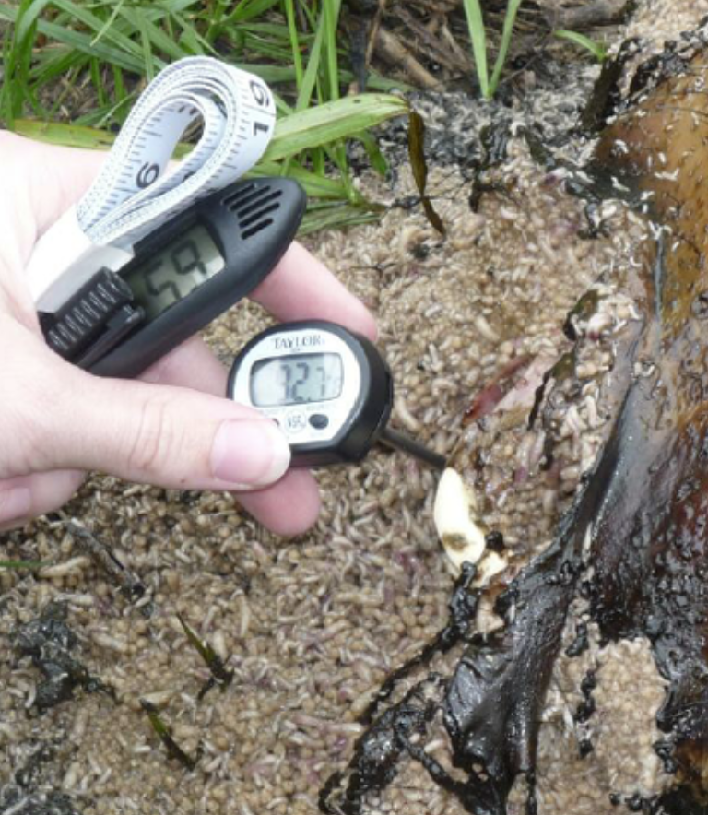
Estimating the POSTMORTEM INTERVAL, or the time between death and discovery of the corpse, is based on several factors including insect evidence.
WEATHER data, such as the daily TEMPERATURE (highs/lows), HUMIDITY, and PRECIPITATION for a period of time before the body was discovered to the time the insect evidence was collected can be helpful in determining the rate at which decomposition occurs in a corpse.
PMI: Weather Data
Investigators will also note:
The air temperature,
Ground surface temperature,
Temperature of the area between the body and the ground,
Temperature of the soil under the body, and
The temperature inside any maggot masses, such as the one shown in the image.
Image: https://www.researchgate.net/figure/Measuring-maggot-mass-temperature_fig2_277330856

Slide 4
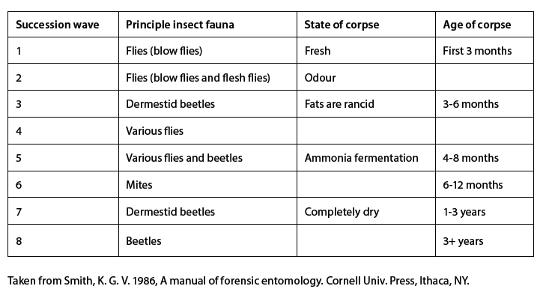
Species succession, or the progression of insect life found on a corpse, follows a pattern. The insect species found on a corpse will vary depending on its age, which may provide further clues about the PMI.
PMI: Species Succession
Based on the chart, which type of insects would you expect to find on a corpse with a PMI of 5 months?
Dermestid Beetles

Slide 5

Other factors may play be considered in estimating the POSTMORTEM INTERVAL, such as:
  The presence of drugs in a corpse may accelerate or slow down the time needed for an insect’s life cycle.
  Conditions of the corpse itself may change the time it takes insects to find it, such as if it was wrapped in a material, in a closed room, exposed to outside conditions, etc.
  Other insect species, such as predatory insects, may affect the development of the collected species or eaten some species as prey.
PMI: Other Factors
Did you know… The “Body Farm” in Knoxville, TN is a university research facility to investigate human decomposition under various conditions in order to understand the factors which affect its rate.
← Click the image to learn more

Slide 6
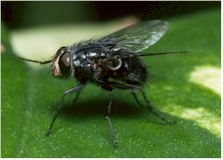
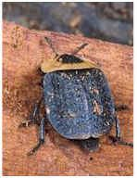
The developmental rates of many fly and beetle species are relatively predictable, which can be used as an “insect clock” to determine the age of a larva (maggot or grub) as well as estimates for eggs and pupas.
Because insects are ectothermic (“cold blooded”), the rate of their development is highly influenced by temperature. An insect’s internal body temperature must be warmed up to its critical level in order to become active.
Temperatures higher than 70º will accelerate or speed up the development process, while lower temperatures will cause it to slow down.
Blow Fly
PMI: Insect Evidence
Carrion Beetle
Images: http://www.insectinvestigations.com/aboutfe.htm

Slide 7
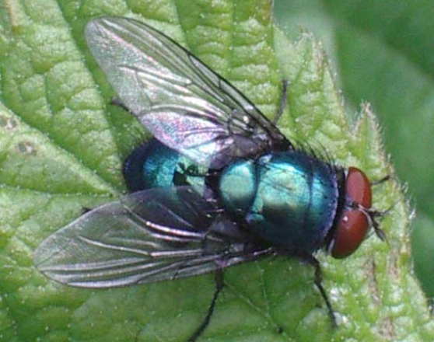
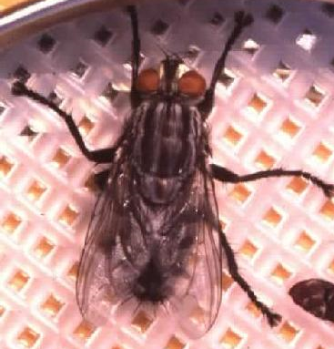
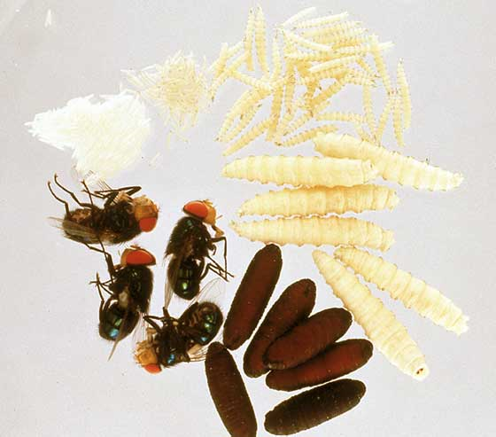
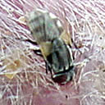
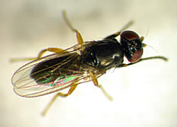
Examples of Diptera (Flies)
Early Stage Decomposition
Blow & Greenbottle Flies
(Calliphoridae)
Metallic thorax and abdomen
Flesh Fly
(Sarcophagidae)
Striped thorax
PMI: Insect Evidence
Life Cycle of a Calliphoridae Fly
Late Stage Decomposition
House Fly
(Muscidae)
Cheese Skipper
(Piophilidae)
Informational Source: http://naturalsciences.org/files/documents/csi_tg_overview.doc
Images: Top Left - http://www.scienceinschool.org/repository/images/issue2forensic3_large.jpg, Middle-Left: http://forensicfact.files.wordpress.com/2008/04/blowfly053.jpg,
Top Right - http://users.usachoice.net/~swb/forensics/P1.jpg, Bottom - http://www.deathonline.net/decomposition/corpse_fauna/flies/index.htm

Slide 8
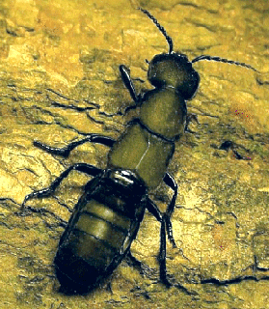
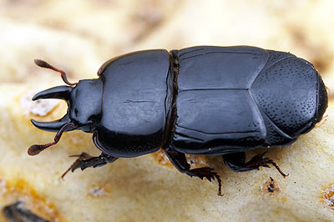
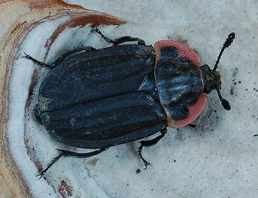
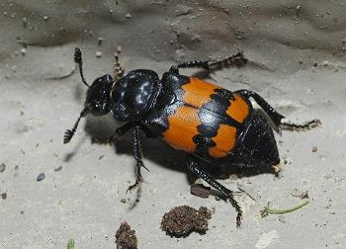
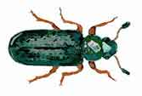
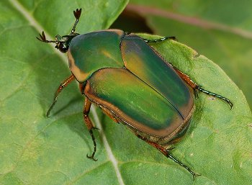
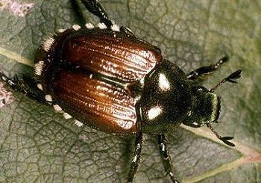
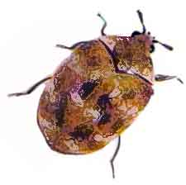
Examples of Coleoptera (Beetles)
Early Stage
Decomposition
Early to Late Stage Decomposition
Carrion Beetles (Silphidae)
Adults & larvae feed on fly larvae
Rove Beetles
(Staphylinidae)
Predator of fly eggs
Clown Beetles
(Histeridae)
Predator of fly eggs
PMI: Insect Evidence
Late Stage Decomposition
Ham & Checkered
Beetles (Cleridae)
Predator of flies & beetles;
also feed on dead tissue
Hide Beetles
(Scarabidae)
Usually the last to arrive
Skin Beetles
(Dermestidae)
Feed on dried skin & tissues
Informational Source: http://naturalsciences.org/files/documents/csi_tg_overview.doc
Images: http://www.cals.ncsu.edu/course/ent425/library/spotid/coleoptera/coleoptera.html & http://www.forensicflies.com/beetles.htm

Slide 9
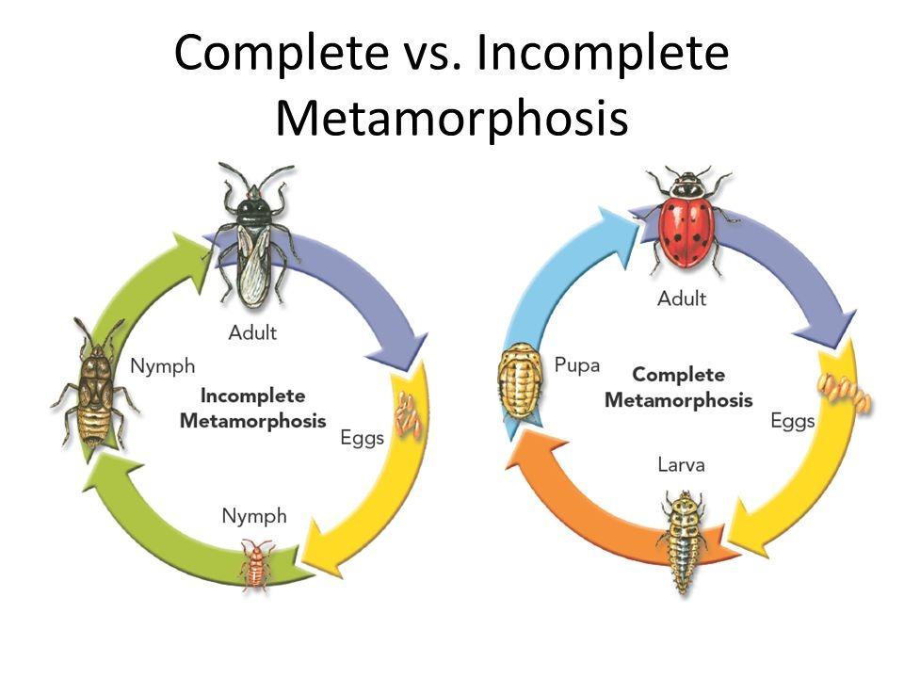

Insects with a COMPLETE life cycle have four stages: EGG, LARVA, PUPA, and ADULT.
Examples: Butterflies, bees, ants, flies, and beetles
Types of Metamorphosis
Insects with an INCOMPLETE life cycle with three stages: EGG, NYMPH, and ADULT.
Examples: Grasshoppers, true bugs, crickets, roaches, and cicadas.

Slide 10
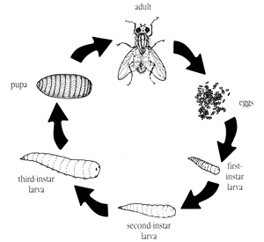
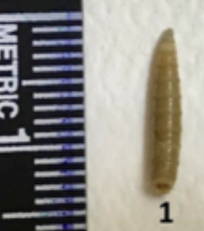
Blowfly Life Cycle
Adults lay eggs within minutes of an animal’s death. They find natural openings (nose, eyes, mouth, ears, etc.) or openings caused by wounds.
Adults emerge from pupa cases after 6-8 days.
Adult
Pupa
Eggs
Eggs hatch into larva in 12-24 hours.
3rd Instar
Larva
1st Instar
2nd Instar
Fly larva (called maggots) molt or shed their exoskeletons many times as they grow larger.
The length of a larva can
be helpful to determine the
age if the species is known.
Different fly species → Different timelines
(even with temperatures staying the same)
Images: http://www.umext.maine.edu/images/FlyLife.jpg , https://forensicbites.org/2020/03/06/identifying-forensic-sciences-first-responder-the-blow-fly/

Slide 11
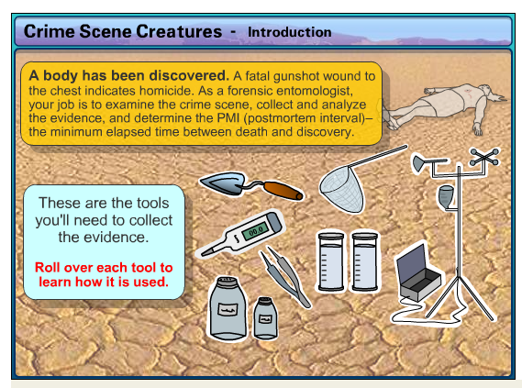
Let’s give it a try …
https://web.archive.org/web/20210224050005/https://www.pbs.org/wnet/nature/crime-scene-creatures-interactive-determine-the-time-of-death/4390/
Flash-Based Activity → May only be completed if your district allows access to the Ruffle extension for Chrome.

