Slide 1

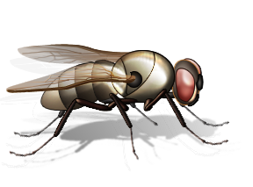
Teacher Notes:
The student digital slides for this unit are at https://docs.google.com/presentation/d/1Axxvop32Mco-kpLjAgEXGDl1O_LQuBd21H3ny4NVrrM/edit?usp=sharing
IMPORTANT: Make a copy of the student notebook before you assign it on your LMS. It is view-only and I am not able to approve access for your students.
The FULL digital notebook (with all the slides for the digital lessons and activities) is available at https://docs.google.com/presentation/d/14eIEiGacRXMsDyuUxiEsSM2m4YOAtIlfmD4O4YsLdPI/edit?usp=sharing. It is set up for standard paper (8.5x11) in landscape mode for easier printing when needed. Paper versions are available for this unit on my Forensic Science page at https://sciencespot.net/Pages/classforsci.html
A DRAFT of the general outline of the digital lessons (with corresponding slide #s for the student notebook) is available at https://docs.google.com/document/d/15wxjmL-uHQPXDKOxmZXtU_gxy9dphEuyC1P4jzP-9mA/edit?usp=sharing . It is based on 44-minute class periods with 7th & 8th grade students.
Preview presentations before using with your classes as many slides have animations and links you will need to use.
I do Science Starters at the beginning of each class period. A collection of starters for Forensics is available on my lessons plans page at https://sciencespot.net/Pages/classforsci.html .
CSI Unit Training Materials
CSI: Crime Solving Insects
Warning: Some material in this presentation and related videos may be too graphic for some people.
T. Tomm Updated 2023
https://sciencespot.net
Developed for use with the Crime Solving Insects activity available at https://fyi.extension.wisc.edu/wi4hstem/files/2015/02/CSIfinal.pdf
This Photo by Unknown Author is licensed under CC BY

Slide 2
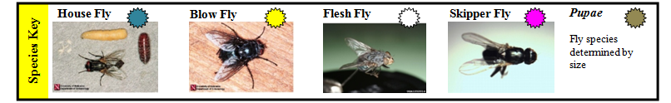
Crime Solving Insects: Case Studies
For each case:
1 – Review the police report and weather report.
2 – Examine & document the collected evidence.
  Measure the length of the maggots & pupae. Record your data in the chart.
  Consult the Species Key and the tables on your lab page to determine the various fly species that were found on the corpse and their ages.
3 – Use the information from the reports and your examination to answer the questions.
Part A: Color code your species key.
Developed for use with https://fyi.extension.wisc.edu/wi4hstem/files/2015/02/CSIfinal.pdf

Slide 3
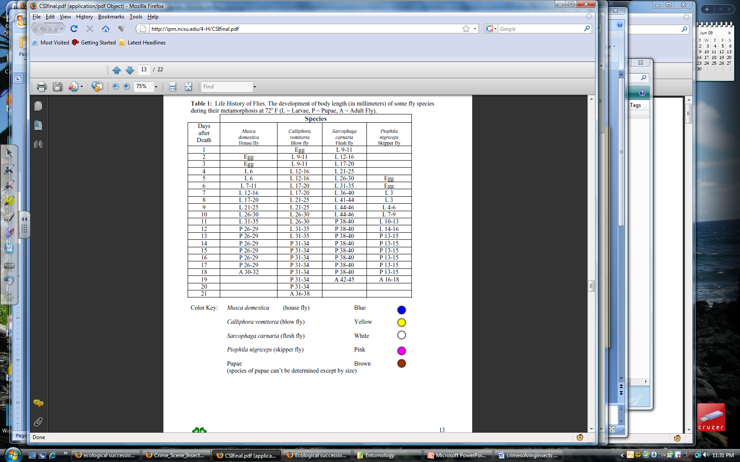
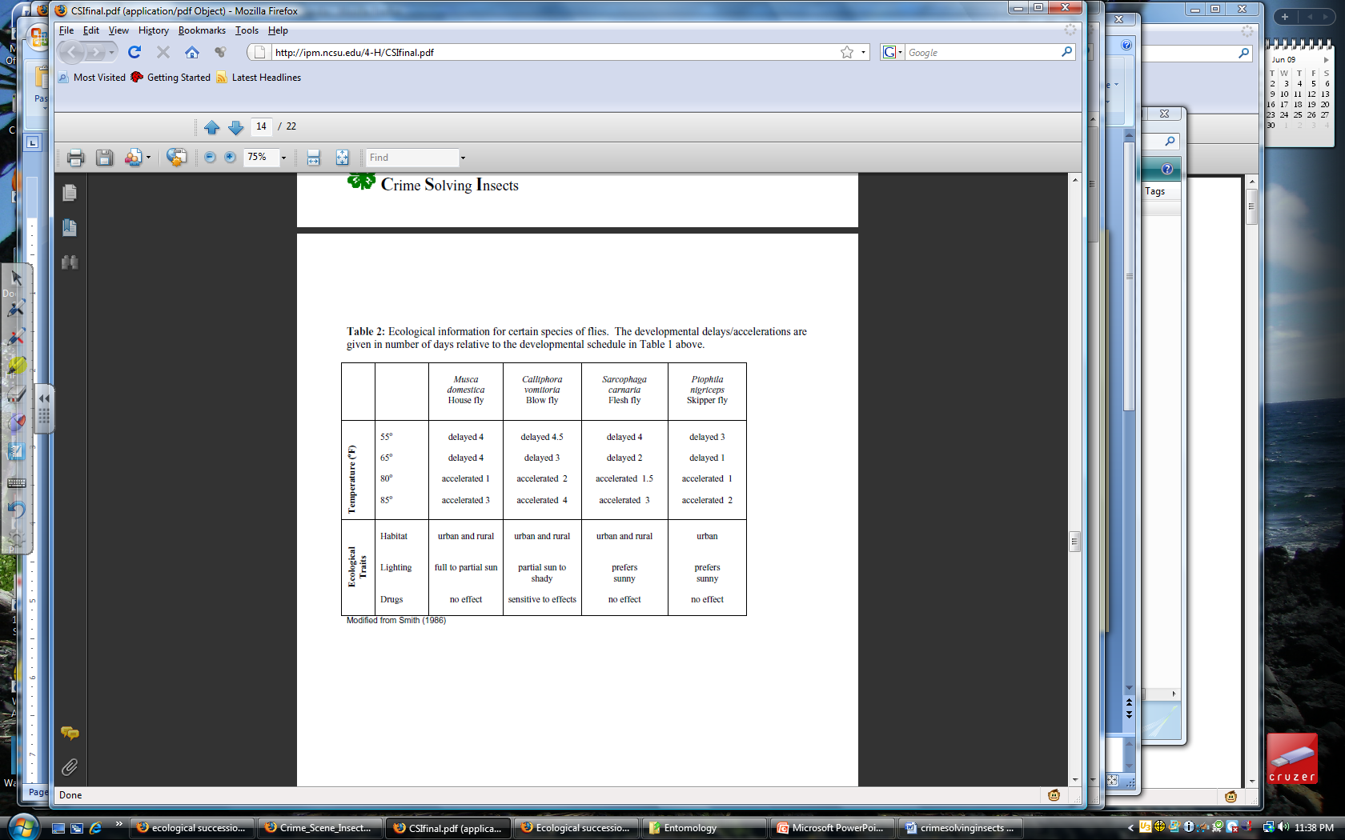
Part B: Fly Development Charts
Scientists use weather and ecological data along with larva size to estimate the age of a insects found on or near a corpse.
Table 1: Body Length of Flies at 72ºF
Table 2: Ecological Information
The delays/accelerations are given in number of days relative to the schedule in Table 1.
Use this information to help you determine the age for the following examples.
L = Larvae P = Pupae A = Adult Measurement Unit: Millimeter

Slide 4
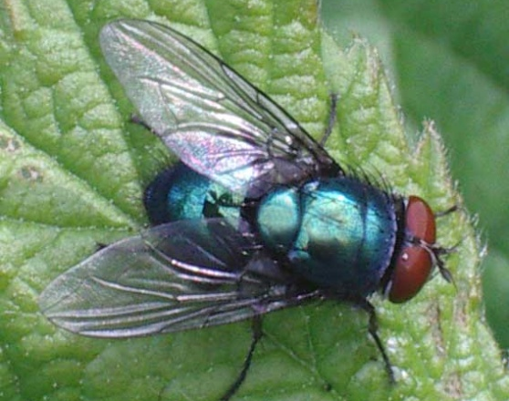
Example 1: Blow fly
Temperature has averaged 72º F
Larva measures at 32 mm
Estimated age
= ______
12-13 days
Table 1: Body Length of Flies at 72ºF
Table 2: Ecological Information
?
Temp = 72º
No delay or acceleration
The delays/accelerations are given in number of days relative to the schedule in Table 1.
L = Larvae P = Pupae A = Adult Measurement Unit: Millimeter

Slide 5
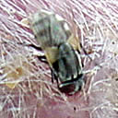
Example 2: House fly
Temperature has averaged 65º F
Larva measures at 32 mm
Estimated age
= ______
15 days
Table 1: Body Length of Flies at 72ºF
Table 2: Ecological Information
+4
The delays/accelerations are given in number of days relative to the schedule in Table 1.
L = Larvae P = Pupae A = Adult Measurement Unit: Millimeter

Slide 6
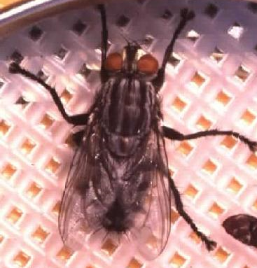
Example 3: Flesh Fly
Temperature has averaged 80º F
Larva measures at 32 mm
Other data: Sunny area, no drugs
Estimated age
= ______
7.5 days
Table 1: Body Length of Flies at 72ºF
Table 2: Ecological Information
+1.5
The delays/accelerations are given in number of days relative to the schedule in Table 1.
L = Larvae P = Pupae A = Adult Measurement Unit: Millimeter

Slide 7
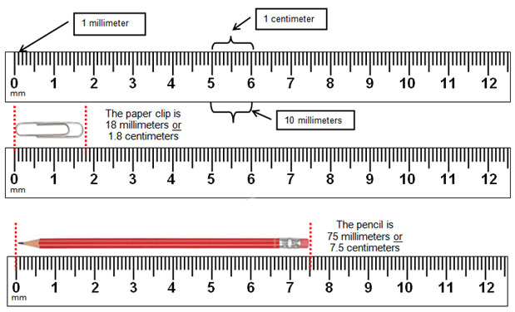
Measurement Practice

Slide 8
Things to consider …
Temperatures – How do temperatures above or below 72º F affect our estimates?
Ecological – Type of habitat, sun vs. shade
Drugs – What effect would stimulants or depressants found in a corpse’s system have on insect development?
Species Succession – Which species tend to find the body first? Second? Third?
Wounds – Do scientists observe areas with more maggots than expected? If so, that might indicate a wound area.

Slide 9
Case #1: Oh, Deer!
Police Report: The body of a female deer was found behind a fence along a busy two-lane road on the edge of the city limits of Manito. Animal Control was called and reported no apparent wounds on the body. It was not hunting season.
Weather Report: Daytime temperatures have been fairly consistent for the past three weeks, ranging from 70 to 74º F.
Questions:
1. Approximately how long has this animal been dead?
2. Why are maggots of different ages found in the body?
3. Other than temperature, what other conditions would you want to obtain from the weather station or area to help you to be more confident of your time of death estimation?
Species & Stage | Size (mm) | Age

Slide 10
Case #2: Canine Caper
Police Report: The body of a large pit bull terrier was found inside a walk-in basement at a home in Pekin. Maggots were found concentrated in the head and region behind the shoulder. The windows were closed, although the open curtains allowed sunlight to enter, and the air conditioner was set at 72º F.
Weather Report: Daytime temperatures have been variable over the past three weeks, ranging from 75 to 94º F. Skies have been sunny.
Questions:
1. Approximately how long has this animal been dead?
2. How does the air temperature and the fact that the windows were closed relate to the populations of flies you observed in and around the corpse?
Species & Stage | Size (mm) | Age
3. Do you suspect foul play? Explain.

Slide 11
Case #3: Dandy’s Death
Police Report: The body of a young male horse, Dandy, was found in a pasture in a small town near Petersburg. The autopsy from the vet school reveals that the cardiac glycoside, oleandrin (a powerful heart stimulant), was present in the body. Oleandrin is found in the oleander plant. Oleander is a common ornamental shrub in this area, but none grows within 200 feet of the pasture.
Weather Report: Daytime temperatures have been unusually warm over the past three weeks, ranging from 84 to 86º F.
Questions:
1. Approximately how long has this animal been dead?
2. What effect, if any, does oleandrin and temperature have on your estimation of time of death?
3. Do you suspect foul play? Explain.
Species & Stage | Size (mm) | Age

Slide 12
Case #4: Porky’s Peril
Police Report: The body of a large pot-bellied pig was found in a dense stand of evergreen trees far from any urban area in Fulton County. Hairs around the pig’s neck were worn away in a band pattern.
Weather Report: Daytime temperatures have been average over the past three weeks, ranging from 70 to 73º F. Temperatures in the woods would be approximately 5 degrees cooler due to the lack of sun in the shady environment.
Questions:
1. Approximately how long has this animal been dead?
2. What effect, if any, does temperature have on your estimation of time of death in this case?
3. Do you suspect foul play? Explain.
Species & Stage | Size (mm) | Age

