Slide 1
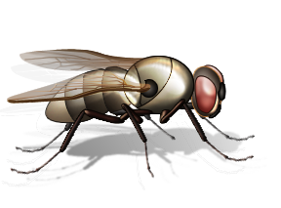
Crime Scene Creatures
Video available at https://www.pbs.org/video/crime-scene-creatures-kecgt7/
T. Tomm 2009 Updated 2024 https://sciencespot.net/

Slide 2
1. What animal was used as for the corpse? Why?
2. Why are flies good to use as evidence?
3. What do you need to know to use flies as evidence?
4. What factors affect the development of a fly? How?
PIG – most similar to humans in composition
Their life cycle has a set timetable that can be used to provide details regarding the time between death and discovery.
Fly species, temperature , humidity, & the way someone dies
Corpse covered in vegetation - Delays development up to 24 hours
Carbon Monoxide/Automobile – Speeds up process by acting as greenhouse
Buried corpse - Buried below 40 cm – No insect activity
Two Fly Species Together - Predator can cause prey fly species to leave corpse early
Corpse wrapped in blankets - Delays development up to 2 ½ to 3 days

Slide 3
5. What “evidence” might animals leave after visiting a corpse? Explain using at least 3 specific examples.
Gouges out eyes and makes it look like they were injured before death
Crows -
Buzzards –
Fox -
Hedgehogs -
Rats -
Raccoons –
Coyotes/Dogs -
Can leave marks that look like stab wounds or other damage
Can crush bones that could be interpreted as injuries
Eat the maggots (evidence)
Leave gnaw marks on bones and chew into the bones to get to the fat
Leave entry holes in the corpse and then come back to eat the maggots
Chew on body and leave marks that can be interpreted the wrong way

Slide 4
6. What could each type of evidence tell investigators?
Plant DNA
Diatoms
Accelerants
Pool cue
Bullet Wounds
The DNA from some fruits or seeds can be linked back to a specific plant that they came from.
Since diatoms grow in specific places, finding these on a victim or suspect can be linked to a specific body of water.
Chemical compounds often used to start fires can be detected by canines
The wood from the pool cue matched the wood in a splinter that was found in a murder victim.
As they eat the flesh around the bullet wound, the metals from the bullet become concentrated in their bodies and then tested to determine what kind of metals are present.

Slide 5
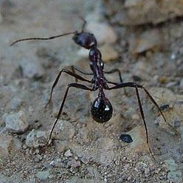
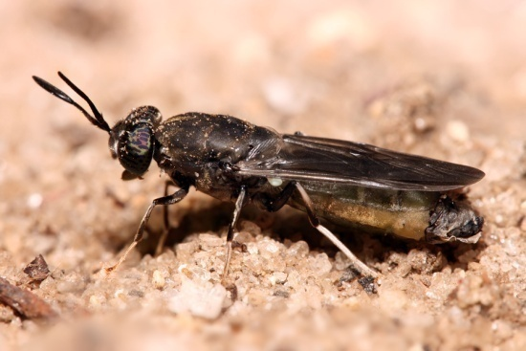
7. How was a toolbox used to solve a crime?
The toolbox contained a corpse, an ant nest, and a pupa case of a solider fly.
The life cycle of the long-legged ant is approximately 12 months.
The soldier fly’s life cycle in approximately 3 months.
Adding these 2 together gives us an estimate of approximately 15 months for the corpse inside.

Slide 6
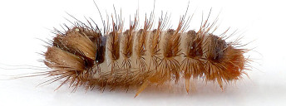
8. What "evidence" did the scientist leave behind? How was each one used to connect him to the crime?
FLIES
- used to determine the time of the killing.
- could have tied his car to the location.
- could have backed it up.
- could link him to the river.
- Could have found the murder weapon with the gasoline on it.
- from the weapon could be matched to other evidence.
FRUIT
POLLEN
DIATOMS
DOG
WOOD

