Slide 1


Teacher Notes:
The student digital slides for this unit are available at https://docs.google.com/presentation/d/1sgfLJWqEcyW3Xx8C6zd-W_p88LUaAtB0NWg5-op0up8/edit?usp=sharing
IMPORTANT: Make a copy of the student notebook before you assign it on your LMS. It is view-only and I am not able to approve access for your students.
The FULL digital notebook (with all the slides for the digital lessons and activities) is available at https://docs.google.com/presentation/d/14eIEiGacRXMsDyuUxiEsSM2m4YOAtIlfmD4O4YsLdPI/edit?usp=sharing. It is set up for standard paper (8.5x11) in landscape mode for easier printing when needed. Paper versions are available for this unit on my Forensic Science page at https://sciencespot.net/Pages/classforsci.html
A DRAFT of the general outline of the digital lessons (with corresponding slide #s for the student notebook) is available at https://docs.google.com/document/d/15wxjmL-uHQPXDKOxmZXtU_gxy9dphEuyC1P4jzP-9mA/edit?usp=sharing . It is based on 44-minute class periods with 7th & 8th grade students.
Preview presentations before using with your classes as many slides have animations and links you will need to use.
I do Science Starters at the beginning of each class period. A collection of starters for Forensics is available on my lessons plans page at https://sciencespot.net/Pages/classforsci.html .
CSI Unit Training Materials
NOTE: If you have already completed the Fingerprint Basics portions, you may need to edit the material presented in this section. Our 6th grade students complete the basic lessons & I use this as a review before we do the latent print lab.
Latent Print Analysis
T. Tomm Updated 2023
https://sciencespot.net
T. Tomm 2007 Updated 2023 https://sciencespot.net/
This Photo by Unknown Author is licensed under CC BY

Slide 2
Part A: Directions: Watch the video to answer these questions.
1 – How soon do fingerprints form in a fetus?
2 – True or False? Identical twins have identical fingerprints.
3 – What are the parts of a fingerprint?
4 – Why do we have fingerprints?
5- True or False? No two people have the same fingerprints.
6 – In which century were fingerprints first used as evidence?
https://www.youtube.com/watch?v=qX6hFXHDmk4

Slide 3
Part A Answer Key
1 – How soon do fingerprints form in a fetus?
2 – True or False? Identical twins have identical fingerprints.
3 – What are the parts of a fingerprint?
4 – Why do we have fingerprints?
5- True or False? No two people have the same fingerprints.
6 – In which century were fingerprints first used as evidence?
Click to reveal answers.
24 weeks
https://www.youtube.com/watch?v=qX6hFXHDmk4
FALSE
Ridges – lines Valleys – spaces between them
To grasp objects (also called friction ridges)
TRUE
People may have the same patterns, but not the exact same ridge features in the exact same places.
19th Century

Slide 4
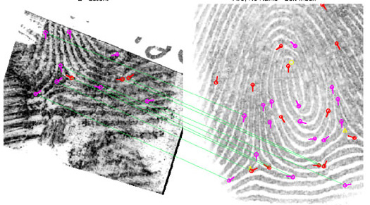
2. LATENT PRINTS are impressions left by friction ridge skin on a surface, such as a tool handle, glass, door, etc.
3. What is AFIS? How is it used?
AFIS = AUTOMATED FINGERPRINT IDENTIFICATION SYSTEM
https://www.youtube.com/watch?v=qX6hFXHDmk4
Used to match fingerprints to identify victims or suspects.
AFIS Video
http://www.fdle.state.fl.us/CrimeLab/images/fingerrint%20comparison%20for%20afis.jpg

Slide 5
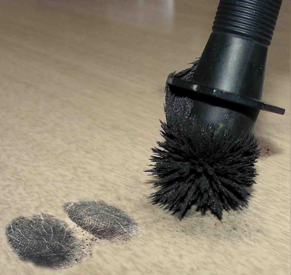
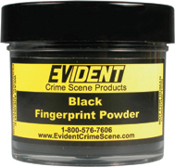
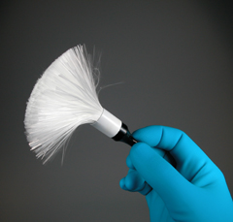

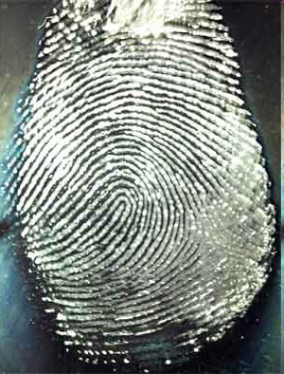
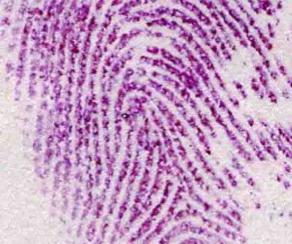
4. How can latent prints be collected?
a) BLACK or MAGNETIC powder can be used, which works better on shiny surfaces or plastic containers.
b) FLUORESCENT powder and UV lights can find latent prints on multi-colored or dark surfaces.
c) CYANOACRYLATE fuming method (often called the super glue method) is a procedure that is used to develop latent fingerprints on a variety of objects.
d) NINHYDRIN is a chemical that bonds with the amino acids in fingerprints and will produce a blue or purple color. It is used to lift prints from surfaces such as paper and cardboard.

Slide 6
LAB DIRECTIONS
Before we begin …
You need to clean up any spills immediately!
Dust everything on the paper!
Don’t dust anything without permission!
Materials
Each TABLE needs a LIFTING KIT → magnetic black powder, magnetic applicators, and clear tape.
Each PERSON needs a CD and INDEX CARD. Put your NAME on the card! You will turn it in at the end of class.
Goal - Lift at least 4 GOOD fingerprints.
(You will have more time on Monday to finish!)

Slide 7
DIRECTIONS:
Press the pad of your right thumb on a CD to make a print.
Place the CD on the paper.
Dip a brush lightly into the container of black powder and tap off the extra. You only need a very small amount of powder on the brush to dust the print.
Hold the brush over the print and gently swipe over the print you want to process.
Use the brush to remove any extra powder.
Use a small piece of clear tape to lift the print and place it on your card.
Goal - Lift at least 4 GOOD fingerprints.
(You will have more time during the next class period!)

Slide 8
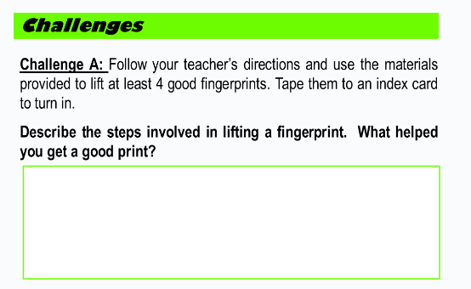
TURN IN YOUR CARD to the bins by the periodic table!
Clean Up
1 – Remove as much of the black powder as you can from the paper with your magnetic applicator and return it to the container.
2 – Put your materials back in the kit and place in the sanitizer.
3 – Fold the paper in half and leave your paper in the middle of the table.
4 – Get a towel and “dry” wash the table – especially the edges that weren’t covered with white paper.
5 – Wash your hands!
Complete Challenge A

Slide 9
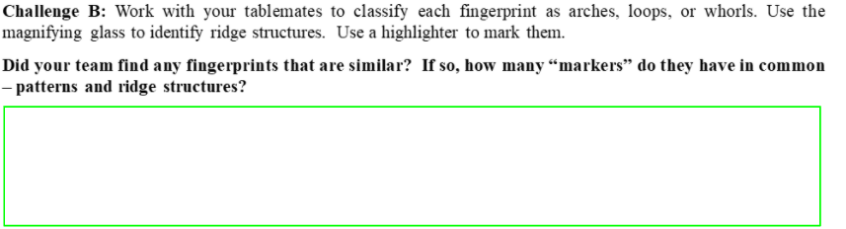
Fingerprinting Day 2
Finish your fingerprint card – need at least 4 good latent prints.
Complete Challenge A in your HDSN.
We will work on Part B today.

Slide 10
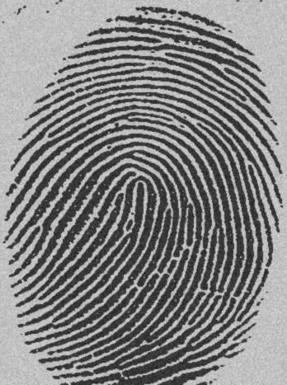

OPTIONAL – These practice activities have been included in the digital slides and the printable worksheet. You may choose to complete them as a whole-class activity instead of individually.
Challenge B PRACTICE #1
Use the tools provided to inspect your latent prints.
Identify the PATTERN (arch, loop, or whorl) and write it on the card next to the print.
Use a highlighter (or light colored permanent marker) to mark RIDGE STRUCTURES you see and LABEL the ones you can identify.
Label the image on your notes.
?
?
?
?
?
?
What pattern do you see?
What ridge structures do you see?

Slide 11
Challenge B PRACTICE #1 ANSWERS
?
DOT(or Island)
?
Ending Ridge
?
Fork
Short Ridge
?
What pattern do you see?
?
Loop
?
What ridge structures do you see?
Scar

Slide 12
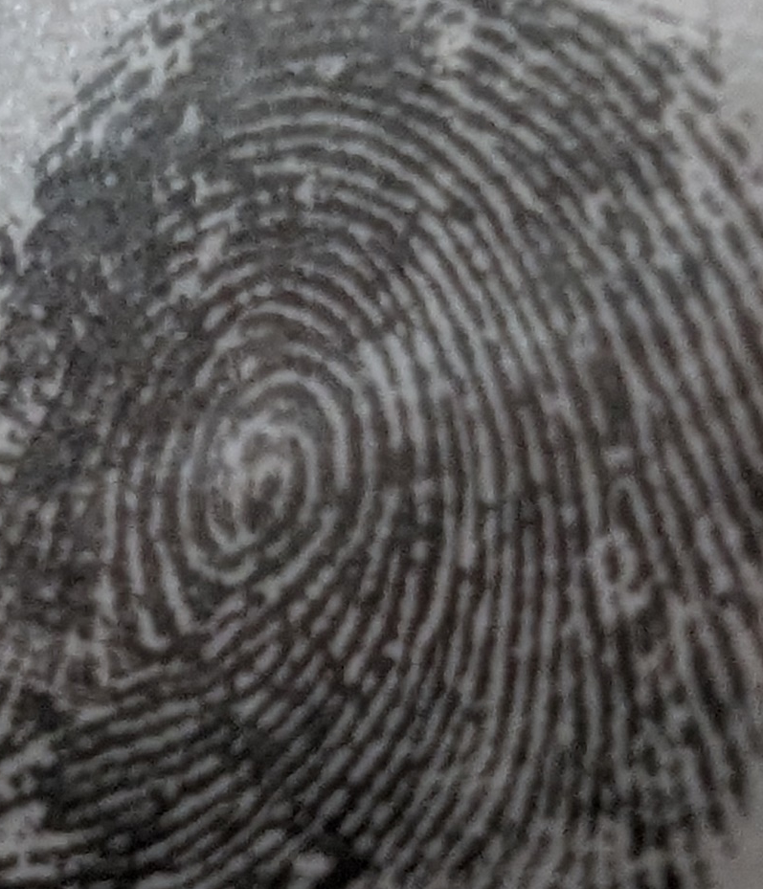
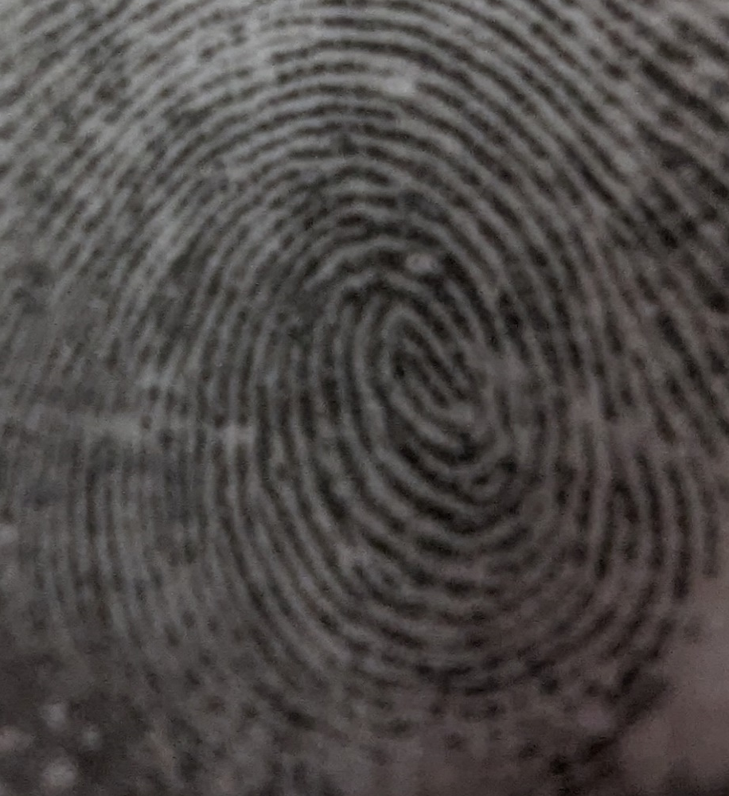
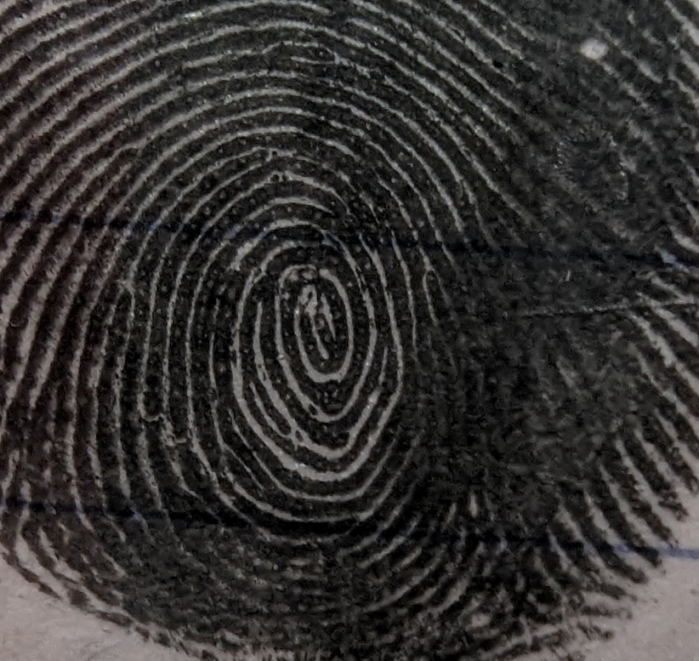
PRACTICE #2
B
Pattern =
A
Pattern =
What letters can you find?
Circle them.
Which ridge structures can you find?
Use circles to mark each one and label.
Which are
plain whorls?
Use a star to show your answer.
C
Pattern =

Slide 13
B
?
PRACTICE #2 ANSWERS
Whorl
?
Pattern =
A
Whorl
Pattern =
Bridges
What letters can you find?
Circle them.
?
?
?
Fork
?
Which ridge structures can you find?
Use circles to mark each one and label.
?
?
Which are
plain whorls?
Use a star to show your answer.
Specialty
?
C
Whorl
Pattern =

Slide 14
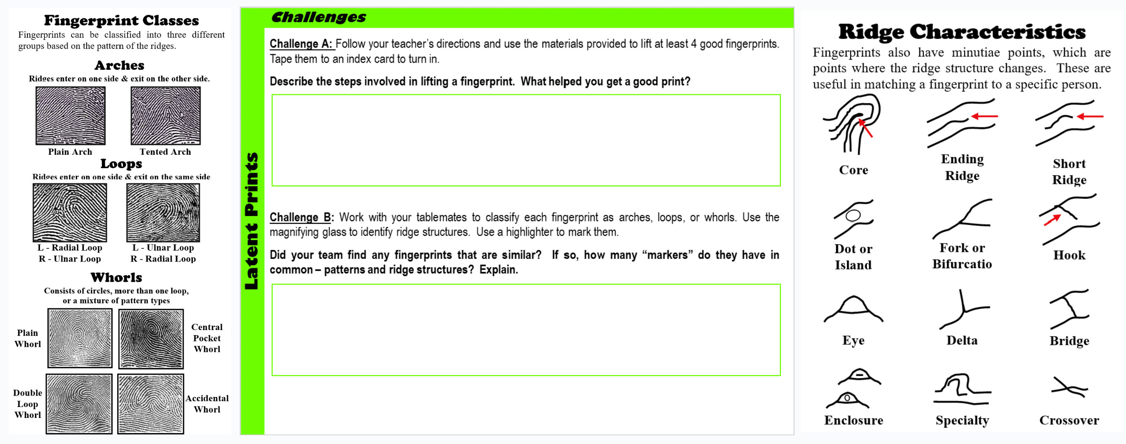
What patterns did your table have in common?
What ridge structures?
Latent Prints
Use the images to help you classify your patterns and ridge structures.

Slide 15
Clean Up
1 – Remove as much of the black powder as you can from the paper with your magnetic applicator and return it to the container. Fold the paper in half and leave your paper in the middle of the table.
2 – Put your materials back in the kit. Return to the front counter.
3 –Clean the CD and slide along with your table - return all material to the front counter.
4 - Wash your hands!
TURN IN YOUR CARD IF you are done. If not, finish your analysis and then turn in.
We will discuss the answers for both challenges tomorrow.
Latent Prints

Slide 16
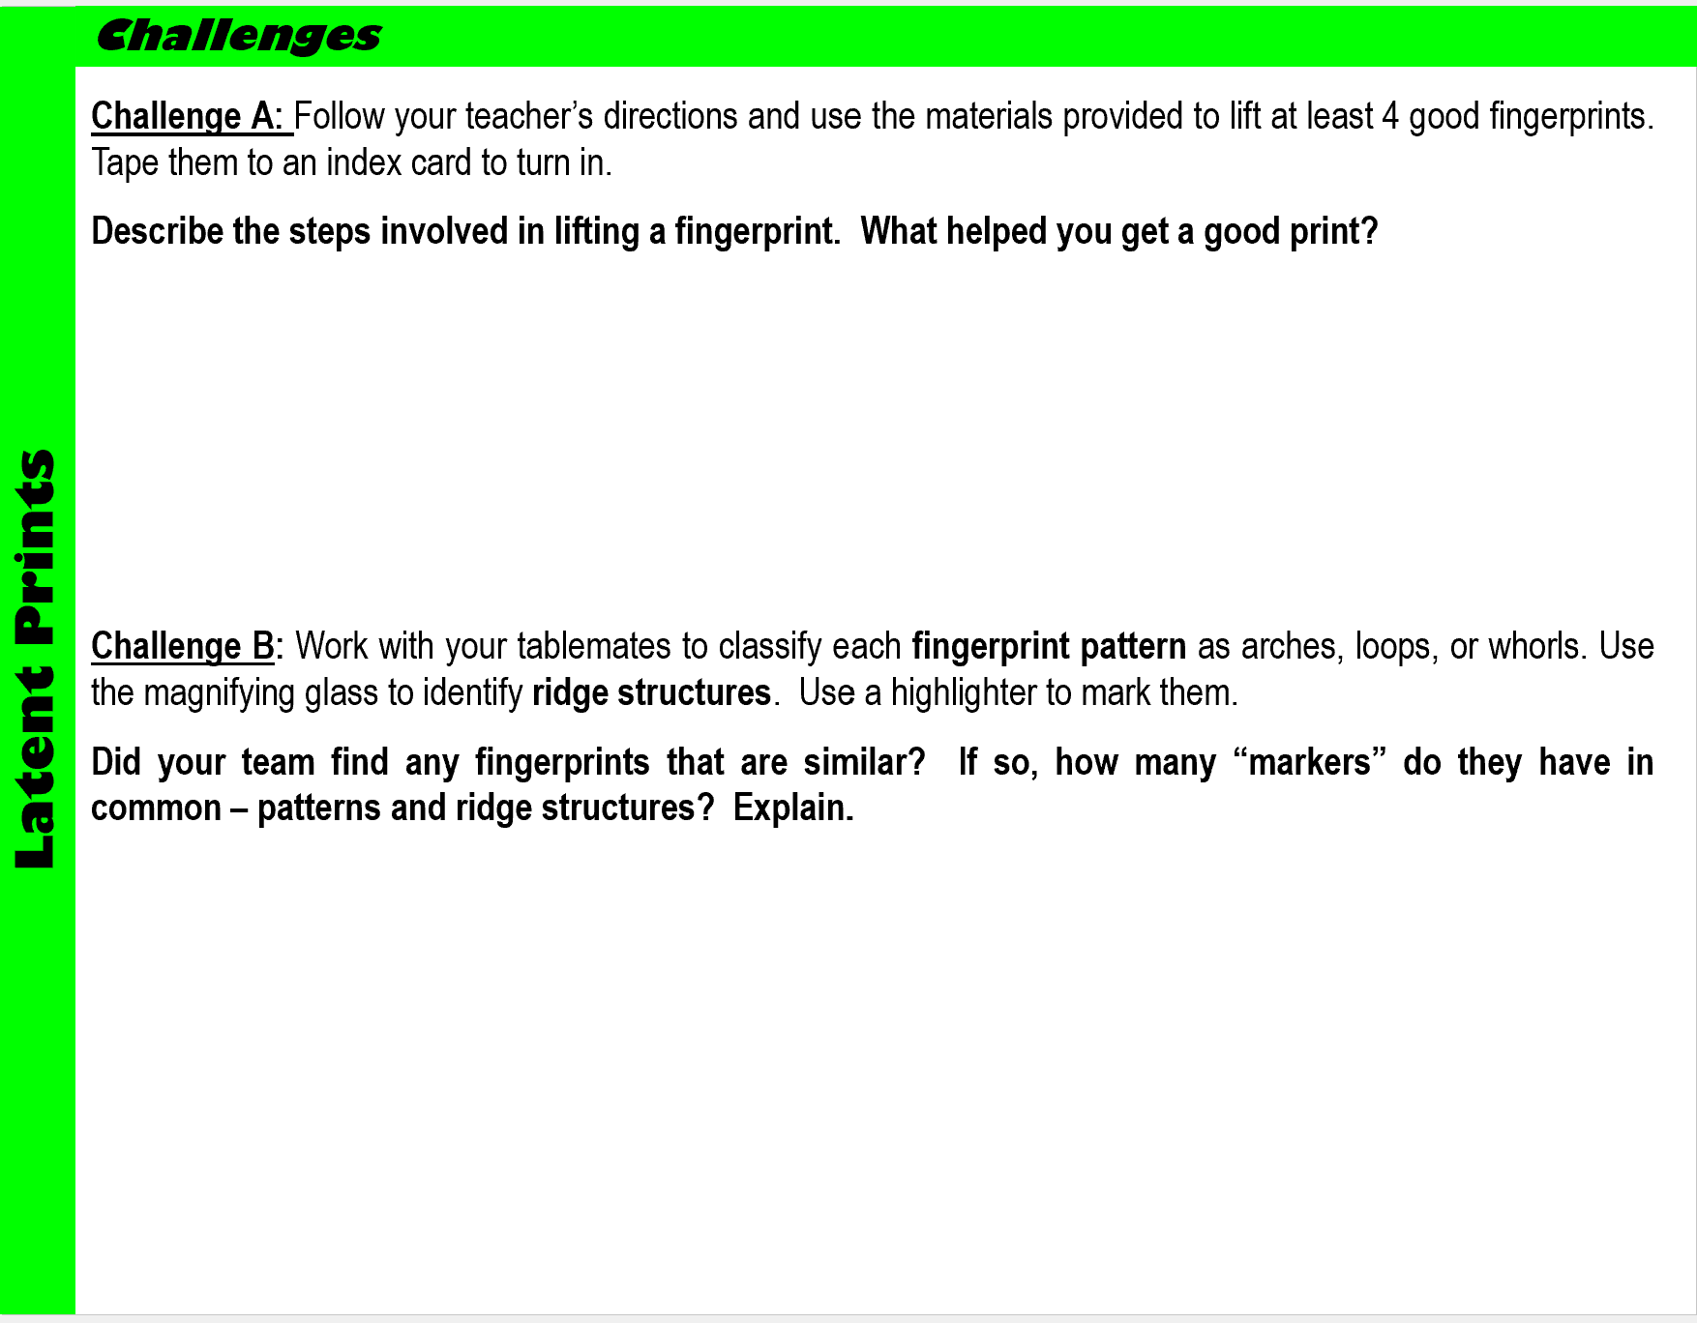
Create an impression on a CD or slide, dip the magnetic wand into the powder, lightly brush back and forth over the print to reveal it. Put a piece of tape over the print and slowly lift it to lift the print. Tape on an index card. Do not brush too hard or you will destroy the print!
Your team should have found that many people have the same pattern, such as a lot of people having loops (60%) more than the whorls (35%)
and arches (5%).
Some people may also have the same ridge structures, but they are not in the exact same locations, the exact same size, or the exact same distance from each other. This is why we say that no two prints are the same – they can be the same pattern but differ in the ridge structures.

