Slide 1

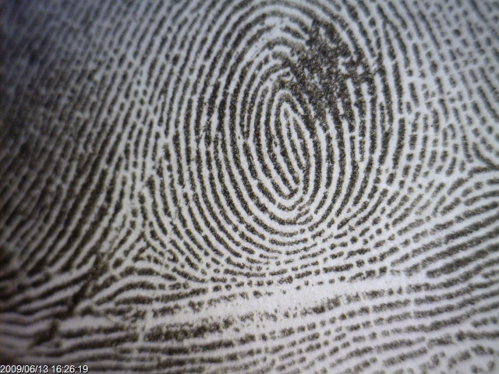
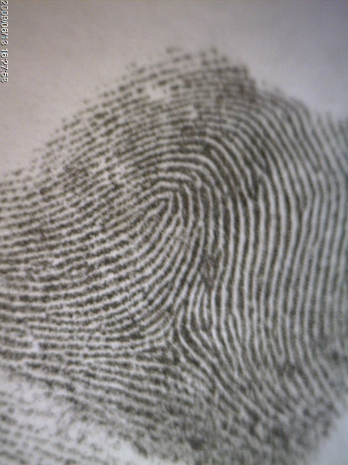
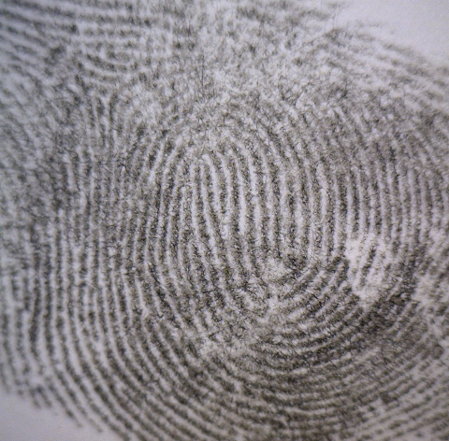
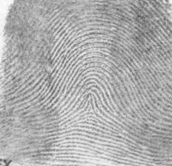
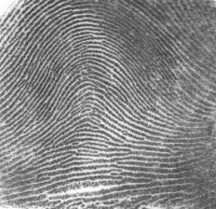
Teacher Notes:
The student digital slides for this unit are available at https://docs.google.com/presentation/d/1sgfLJWqEcyW3Xx8C6zd-W_p88LUaAtB0NWg5-op0up8/edit?usp=sharing
IMPORTANT: Make a copy of the student notebook before you assign it on your LMS. It is view-only and I am not able to approve access for your students.
The FULL digital notebook (with all the slides for the digital lessons and activities) is available at https://docs.google.com/presentation/d/14eIEiGacRXMsDyuUxiEsSM2m4YOAtIlfmD4O4YsLdPI/edit?usp=sharing. It is set up for standard paper (8.5x11) in landscape mode for easier printing when needed. Paper versions are available for this unit on my Forensic Science page at https://sciencespot.net/Pages/classforsci.html
A DRAFT of the general outline of the digital lessons (with corresponding slide #s for the student notebook) is available at https://docs.google.com/document/d/15wxjmL-uHQPXDKOxmZXtU_gxy9dphEuyC1P4jzP-9mA/edit?usp=sharing . It is based on 44-minute class periods with 7th & 8th grade students.
Preview presentations before using with your classes as many slides have animations and links you will need to use.
I do Science Starters at the beginning of each class period. A collection of starters for Forensics is available on my lessons plans page at https://sciencespot.net/Pages/classforsci.html .
CSI Unit Training Materials
Fingerprint Evidence
T. Tomm Updated 2023
https://sciencespot.net
T. Tomm 2007 Updated 2023 https://sciencespot.net/
This Photo by Unknown Author is licensed under CC BY

Slide 2
Part A: Fingerprint Basics
According to criminal investigators, fingerprints follow 3 fundamental principles:
A fingerprint is an individual characteristic; no two people have been found with the exact same fingerprint structure.
A fingerprint pattern will remain unchanged for the life of an individual; however, the print itself may change due to permanent scars and skin diseases.
Fingerprints have general characteristic ridge patterns that allow them to be identified and matched to a specific individual.
Fingerprint Basics
Example: A double-loop whorl will always be a double-loop whorl, but scars may make it appear differently or have voids.

Slide 3
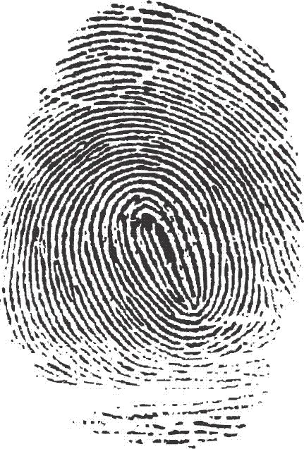
There are 3 classes for all fingerprints based upon their visual pattern: ARCHES, LOOPS, and WHORLS.
Fingerprint Factoid:
60% of people have loops,
35% have whorls,
and 5% have arches
Fingerprint Basics
Ridges = Black line structures
Valleys = Space between the ridges
Did you know? Dactyloscopy is the study of fingerprint identification. Police investigators are experts in collecting “dactylograms”, otherwise known as fingerprints.

Slide 4
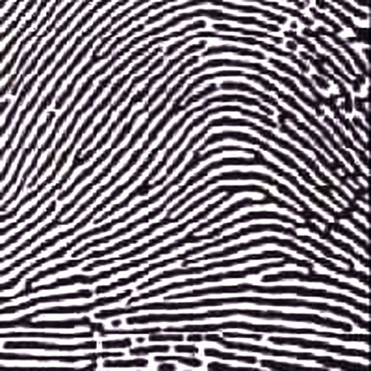
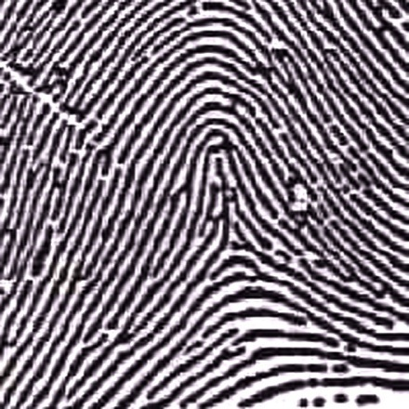
ARCHES
Arches are the simplest type of fingerprints that are formed by ridges that enter on one side of the print and exit on the other.
Spike or “tent”
Fingerprint Basics
Plain Arch
Ridges enter on one side and
exit on the other side.
Tented Arches
Similar to the plain arch,
but has a spike in the center.

Slide 5
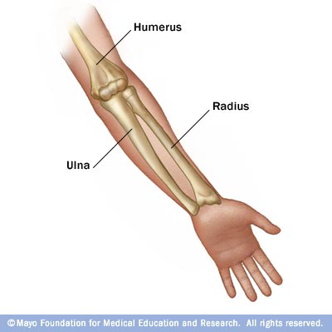
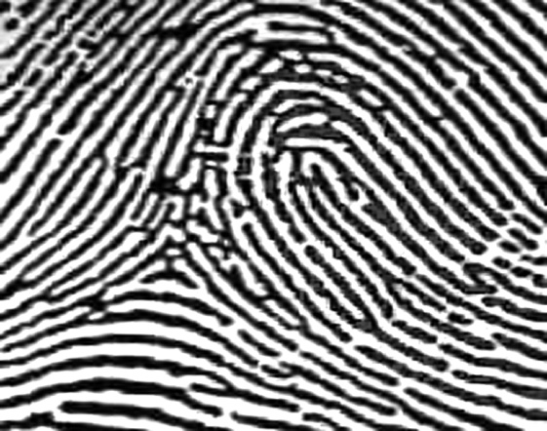
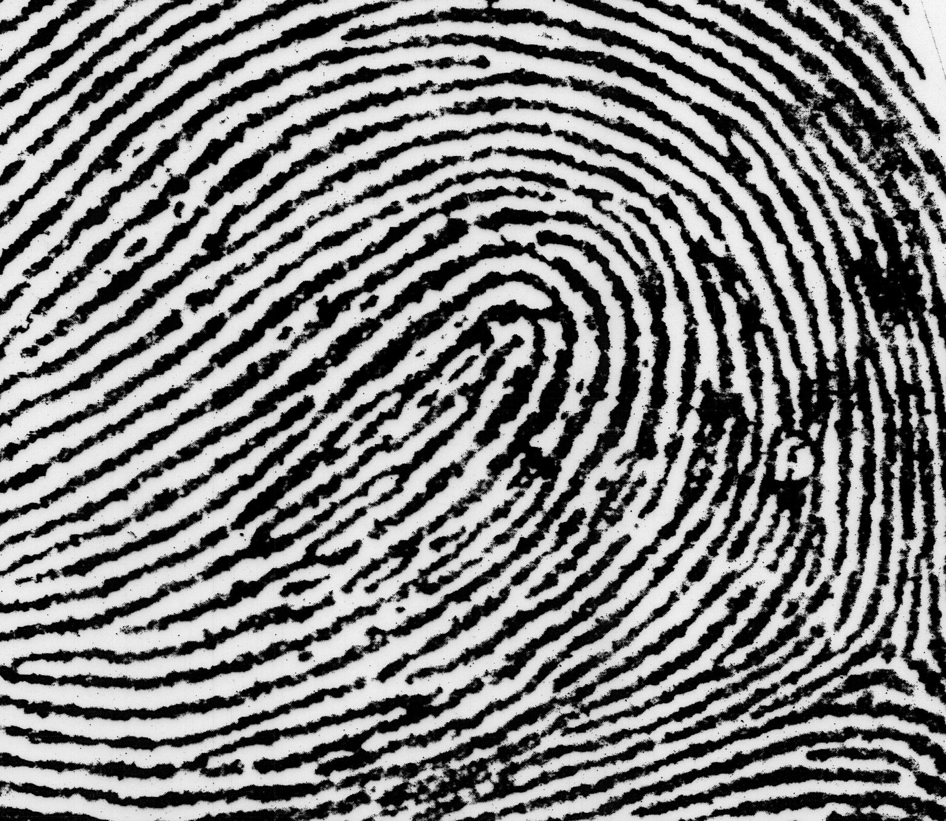
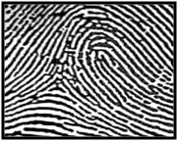
LOOPS
Loops must have one delta and one or more ridges that enter and leave on the same side. These patterns are named for their positions related to the radius and ulna bones.
Fingerprint Basics
Delta
L – Radial Loop
R - Ulnar Loop
L – Ulnar Loop
R - Radial Loop

Slide 6
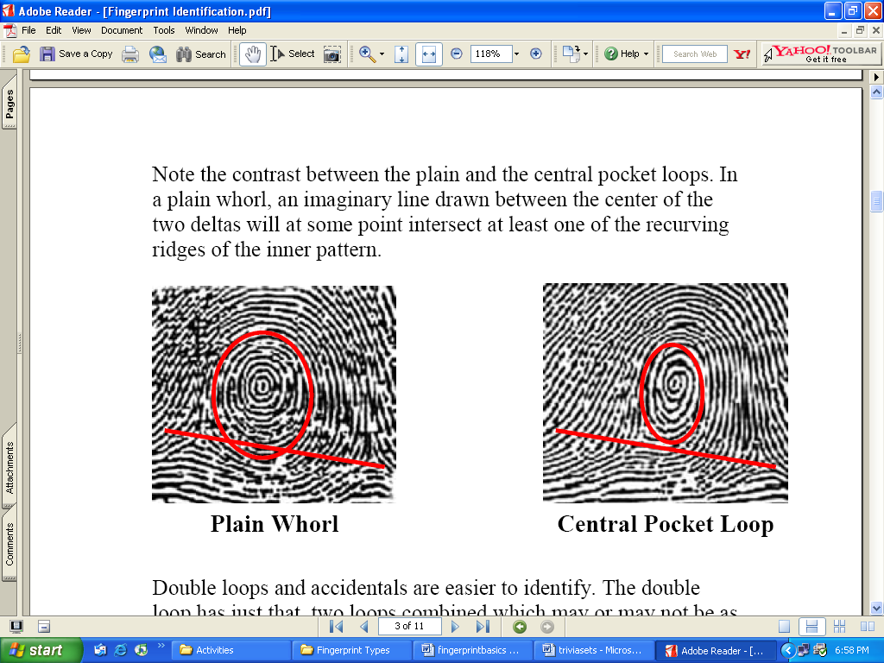
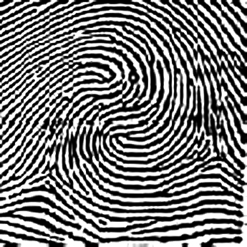
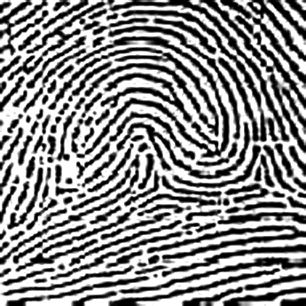
WHORLS
Whorls have at least one ridge that makes (or tends to make) a complete circuit. They also have at least two deltas. If a print has more than two deltas, it is most likely an accidental.
Central Pocket Whorl
Plain Whorl
Fingerprint Basics
Delta
Delta
Delta
Delta
Double
Loop
Whorl
Accidental
Whorl
Delta
Delta
Delta
Delta

Slide 7
Fingerprint Challenge: Identify each fingerprint pattern.
Plain Whorl
Double Loop
Radial Loop
A
B
Fingerprint Basics
Left Hand
Right Hand
Tented arch
PLAIN arch
C
D
Right Hand
E
Right Hand
Left Hand
Notes:
Answers: A – Plain Whorl, B – Double Loop Whorl, C – Radial Loop, D – Tented Arch, E – Plain Arch

Slide 8
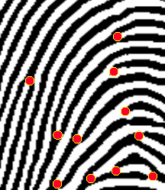
Part B: Ridgeology
Ridgeology: The study of the uniqueness of friction ridge structures and their use for personal identification.¹
The uniqueness of a fingerprint can be determined by analyzing its ridges and valleys.
Fingerprints also have minutiae points, which are useful in matching a fingerprint to a specific person.
Fingerprint Basics
Did you know?
The koala is one of the few mammals (other than primates) that has fingerprints. In fact, koala fingerprints are remarkably similar to human fingerprints; even with an electron microscope, it can be quite difficult to distinguish between the two.
¹Introduction to Basic Ridgeology by David Ashbaugh, May 1999 Image from http://www.cs.usyd.edu.au/~irena/minutia.gif

Slide 9
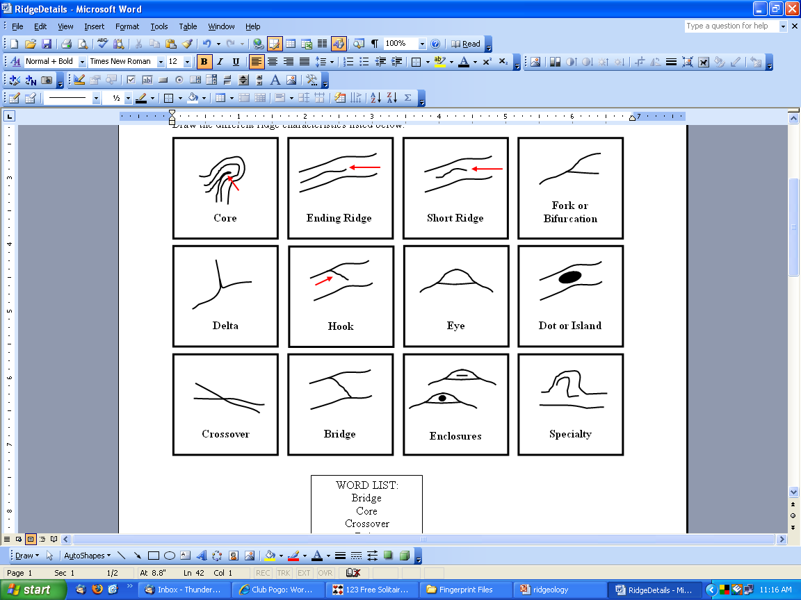
Ridge Structures
Fingerprint Basics
Use these characteristics as points of identification when comparing fingerprint samples. The more points you can find in common, the better the match!

Slide 10
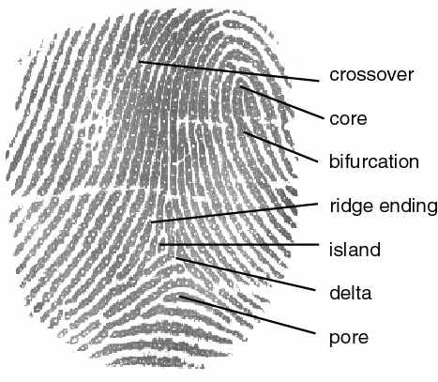
Ridge Characteristics
EXAMPLE
Crossover
Core
Bifurcation (fork)
Fingerprint Basics
Ridge ending
Scar
Island
Delta
Pore
http://cnx.org/content/m12574/latest/properties.jpg

Slide 11
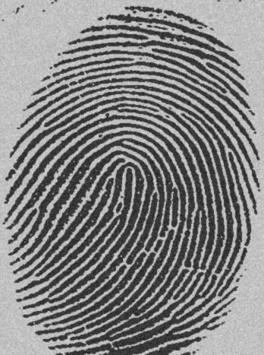
What pattern do you see?
Loop
DOT
(or Island)
Ending Ridge
Fork
Fingerprint Basics
Short Ridge
How many different ridge structures do you see?
Scar
http://www.dkfz.de/tbi/projects/bmcv/images/iu_it246_04s_fingerprint1.jpg

Slide 12
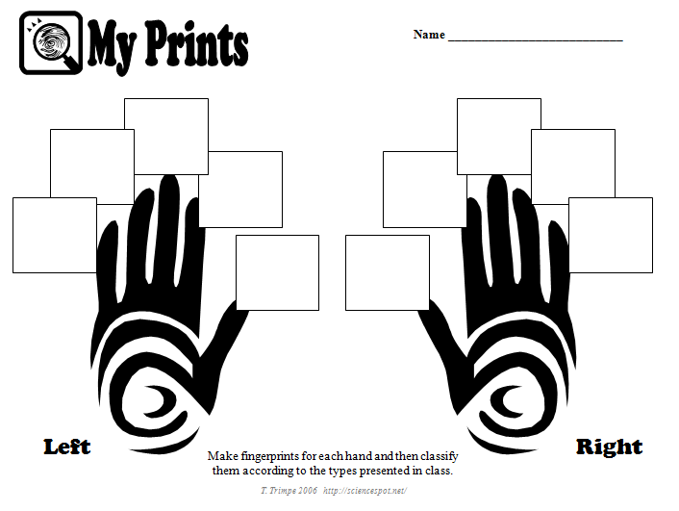
Your Turn: My Prints Worksheet
Fingerprint Basics

Slide 13
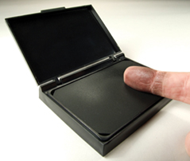

Directions
1st – Roll the “pad” portion of your thumb over the ink pad from the left side of your thumb to the right. You do not have to push down very hard!
2nd – Roll the “pad” portion of your thumb from the left side of your thumb to the right on the BACK of your paper to make a thumbprint.
Fingerprint Basics
Practice making prints on the BACK of your My Prints
worksheet BEFORE you do the prints on the FRONT!
3rd – Continue this process to make a fingerprint of all ten fingers on the FRONT of your “My Prints” worksheet
4th –Use your notes and a magnifying lens to help analyze your fingerprints. Label each one with the pattern name and then write the number of each pattern you have.

Slide 14
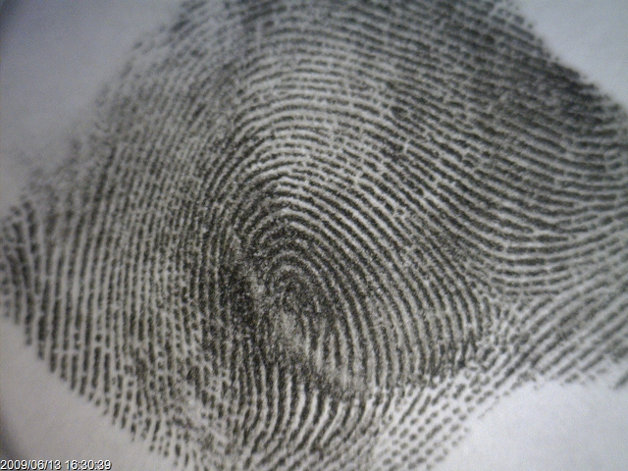
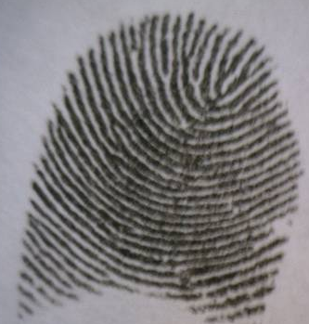
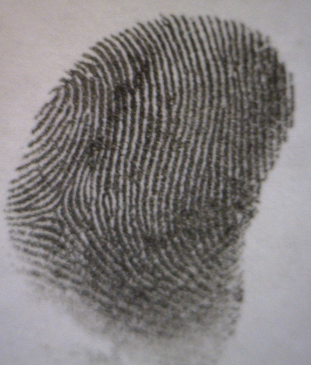
It’s time to make
some prints!
Fingerprint Basics
Avoid Partial Prints
GOOD PRINT
Get as much of the top part of your finger as possible!

Slide 15
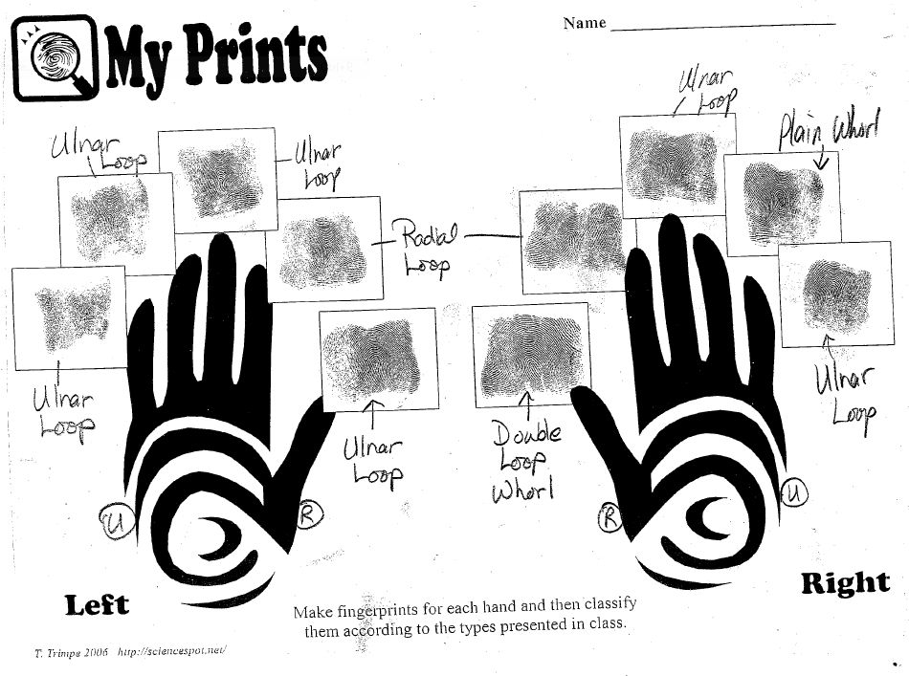
Identify the CLASS for each print and answer the question. Label with the specific type of pattern.
Fingerprint Basics
How many of each main pattern do you have?
Arches = _______ Loops = ______ Whorls = _______

Slide 16
Ridge Structures - CIRCLE & LABEL at least FIVE different ridge structures on your MY PRINTS page.
Fingerprint Basics
How many of each main pattern do you have?
Arches = _______ Loops = ______ Whorls = _______
(Not 5 ridge structures on each finger!)

Slide 17
Fingerprint Analysis
Compare your My Prints worksheet to
those of your classmates.
Which pattern was most common?
Which ridge structure was least common?
Which fingerprint was the most unique?
Fingerprint Basics
Do your observations match the “facts” shared when we started this lesson?
60% → Loops
35% → Whorls
5% → Arches

