Slide 1
Teacher Notes:
The student digital slide for this episode is available at https://docs.google.com/presentation/d/1MhtweWywBDY5Qa9LF87g_SE3sjzjvkAnLFLALcOeDAc/edit?usp=sharing
IMPORTANT: Make a copy of the student notebook before you assign it on your LMS. It is view-only and I am not able to approve access outside my own students.
The full student digital notebook (with all the slides for the digital lessons and activities) is available at https://docs.google.com/presentation/d/14eIEiGacRXMsDyuUxiEsSM2m4YOAtIlfmD4O4YsLdPI/edit?usp=sharing. It is set up for standard paper (8.5x11) in landscape mode for easier printing when needed.
A DRAFT of the general outline of the digital lessons (with corresponding slide #s for the student notebook) is available at https://docs.google.com/document/d/15wxjmL-uHQPXDKOxmZXtU_gxy9dphEuyC1P4jzP-9mA/edit?usp=sharing . It is based on 44-minute class periods with 7th & 8th grade students.
Preview presentations before using with your classes as many slides have animations and links you will need to use.
I do Science Starters at the beginning of each class period. A collection of starters for Forensics is available on my lessons plans page at https://sciencespot.net/Pages/classforsci.html .
CSI Unit Training Materials
Case Study:
Zodiac Killer
Fill in the answers as you watch the video. We will go over them if you miss any!
T. Tomm Updated 2023
https://sciencespot.net
First Break @ 5:15 – Stop the video to review the next 2 slides.
This Photo by Unknown Author is licensed under CC BY

Slide 2
1. When did the first crime occur? The second crime? What evidence did the police recover from the scenes?
2. When did the third crime occur? What was found near the victim? What did the killer know about the victims?
3. Which constellations related to the crimes? How?
1st → March 1990
2nd → 3 weeks later
Found a 9mm bullet
CSI Unit: Case Study – Zodiac Killer
3rd → 2 months later
Note with a threat to kill 12 people one for each astrological sign.
Orion and the Seven Sisters – They were not visible on the nights of the attacks.

Slide 3
https://www.youtube.com/watch?v=JdooNFsqhqc
Discussion Questions
A. When did the first Zodiac killer appear? Where?
B. Is this the same person? Why or why not?
C. How would he know the victim’s birthdays?
D. How would you rate the Zodiac’s intelligence?
CSI Unit: Case Study – Zodiac Killer
Next Break @ 10:00 – Stop the video to review the next 2 slides.

Slide 4
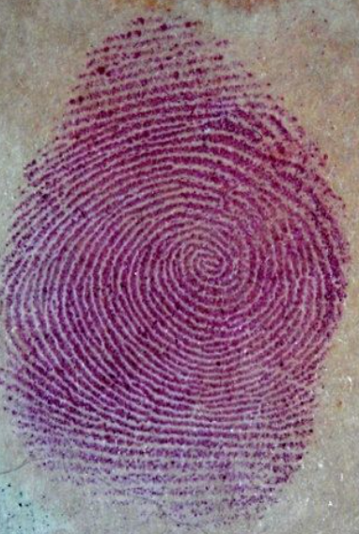
4. What did investigators learn from the handwriting analysis of the letters?
5. When did the astronomer predict the next attack would occur? Why?
6. What did the police learn from the note left with the fourth victim?
7. How is ninhydrin used?
8. In what year were the next three victims killed? What was different about the eighth victim?
They learned that the letters were written by two different people.
June 21st (summer solstice) → the next time the two constellations would NOT be visible in the sky.
They learned that he knew the victim was a Cancer and were able to get a fingerprint. He claimed he was not a copycat killer.
CSI Unit: Case Study – Zodiac Killer
It reacts with amino acids in skin oils to reveal fingerprints.
1994
8th victim → was also Taurus (same as earlier victim)

Slide 5
https://www.youtube.com/watch?v=5nMCYJg-1as
What do you think now?
A. Is this the same person? Why or why not?
B. How would you rate the Zodiac’s intelligence?
CSI Unit: Case Study – Zodiac Killer
Next Break @ 14:10 – Stop the video to review the next slide.

Slide 6
9. How did police link the suspect to the Zodiac crimes? List at least 4 pieces of evidence & how it was used.
Signature?
Used a symbol that investigators knew from the Zodiac letters.
Handwriting samples?
His handwriting matched the handwriting in earlier letters.
Fingerprints?
His thumbprint also matched the prints from earlier letters.
Grooves on bullets?
The toolmarks on his zipguns matched the marks on the bullets
His DNA matched that found on the last letter.
DNA?
CSI Unit: Case Study – Zodiac Killer
10. What was the outcome of the case? How did he know information about the victims?
232 years in prison
Police believe he looked in the wallets and it was just a coincidence that they had different signs.

Slide 7
https://www.youtube.com/watch?v=5nMCYJg-1as
End of Video Discussion Questions
A. What evidence was the most important to solving the crime? Why?
B. How would you rate the Zodiac’s intelligence?
CSI Unit: Case Study – Zodiac Killer

