Slide 1

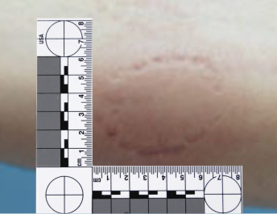
Teacher Notes:
The student digital slide is available at https://docs.google.com/presentation/d/1k_I6AvEmLR3UerZLd4VKirDghm7k0ad5o0ln8BEnA3Y/edit?usp=sharing
IMPORTANT: Make a copy of the student notebook before you assign it on your LMS. It is view-only and I am not able to approve access outside my own students.
The full student digital notebook (with all the slides for the digital lessons and activities) is available at https://docs.google.com/presentation/d/14eIEiGacRXMsDyuUxiEsSM2m4YOAtIlfmD4O4YsLdPI/edit?usp=sharing. It is set up for standard paper (8.5x11) in landscape mode for easier printing when needed.
A DRAFT of the general outline of the digital lessons (with corresponding slide #s for the student notebook) is available at https://docs.google.com/document/d/15wxjmL-uHQPXDKOxmZXtU_gxy9dphEuyC1P4jzP-9mA/edit?usp=sharing . It is based on 44-minute class periods with 7th & 8th grade students.
Preview presentations before using with your classes as many slides have animations and links you will need to use.
I do Science Starters at the beginning of each class period. A collection of starters for Forensics is available on my lessons plans page at https://sciencespot.net/Pages/classforsci.html .
CSI Unit Training Materials
Case Study:
Tourist Trap
Complete the slide as we watch the video.
T. Tomm Updated 2023
https://sciencespot.net
https://www.youtube.com/watch?v=OpN-LSIoeYg
T. Tomm 2007 Updated 2023 https://sciencespot.net/
Warning: There is cursing in this video. Not all words are bleeped or blocked out.
This Photo by Unknown Author is licensed under CC BY

Slide 2
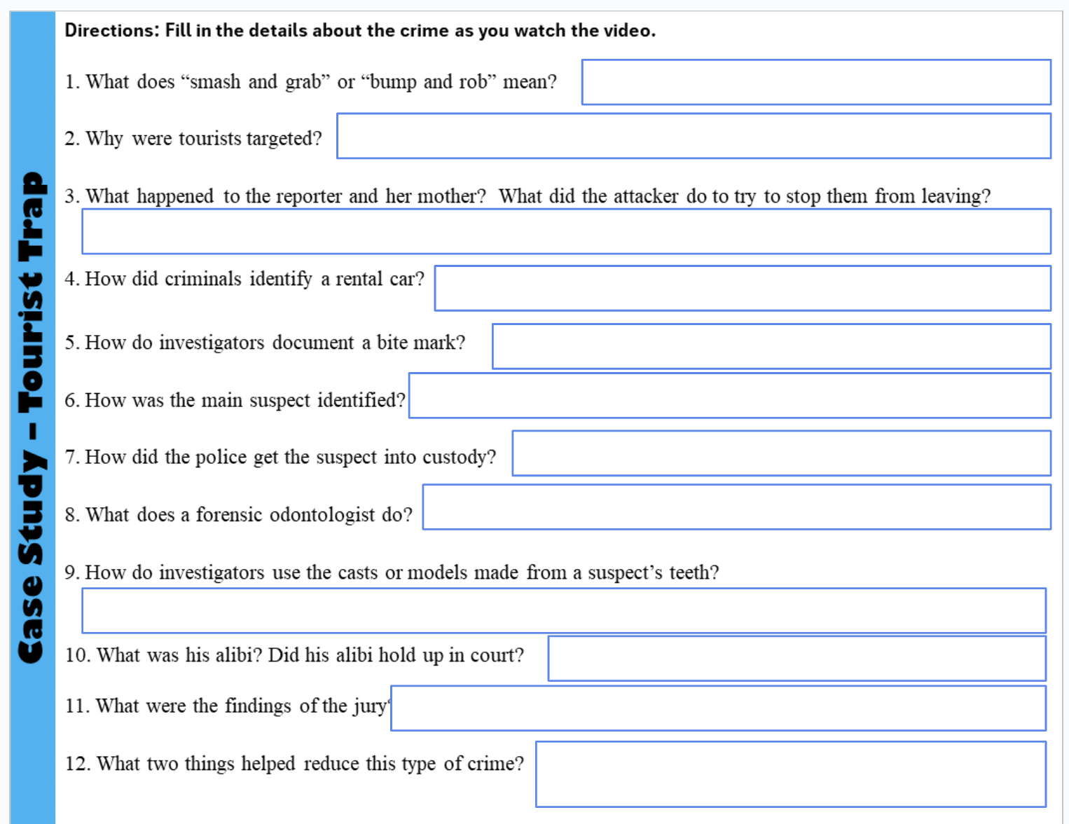

Fill in the slide as you watch the video.
We will stop several times to review the evidence.
First Break @ 6:00 – Stop the video to review the next slide.

Slide 3
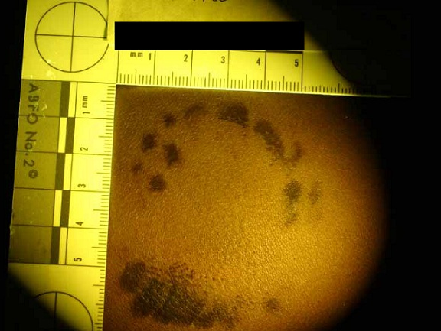
1. What does “smash and grab” and “bump and rob” mean?
2. Why were tourists targeted?
3. What happened to the reporter and her mother? What did the attacker do to try to stop her from leaving?
4. How did criminals identify a rental car?
Criminals use another car to cause an accident (SMASH or BUMP) and then steal from the victims (GRAB or ROB).
Easy to identify – driving rental cars, looking at maps, etc.
Usually have cash and other valuables that are easy to sell.
They were assaulted on their way to the airport.
He bit her arm – through the muscle.
Case Study: Tourist Trap
1 – Bumper stickers → rental company.
2 – License plates → started with a “y” or a “z”.
5. How do investigators document a bite mark?
1 –PHOTOGRAPH the bite mark using different lighting effects – regular, infrared, ultraviolet.
2 – They use an L-shaped RULER to document the MEASUREMENTS of the bite mark.
http://abfo.org/home/bitemark4/
Next Break @ 10:44 – Stop the video to review the next slide.

Slide 4
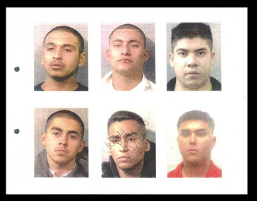
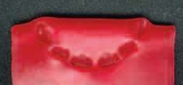
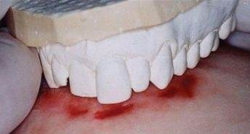
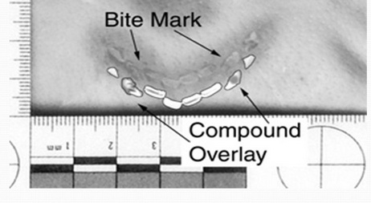
https://www.texasobserver.org/lining-up-a-conviction/
6. How was the main suspect identified?
7. How did the police get the suspect into
custody?
The victim picked him out of a photo array.
He attacked another man (in a rental car.)
(Son was a cop and he also bit the man.)
8. What does a forensic odontologist do?
Studies DENTAL PROFILES to help identify suspects or victims.
Case Study: Tourist Trap
9. How do investigators use the casts or models made from a suspect’s teeth?
1 – WAX IMPRESSIONS (compare to bite marks)
2 - PLASTIC OVERLAYS
(compare to photos)
Watch the rest of the video to complete your slide.

Slide 5
10. What was his alibi? Did his alibi hold up in court?
11. What were the findings of the jury?
12. What two things helped reduce this type of crime?
The suspect said he was at work.
No - Why not?
Guilty
1 – Increased surveillance of the area.
2 – Rental cars removed identifiers - bumper stickers and changed license plates
Case Study: Tourist Trap

