Slide 1
Teacher Notes:
The student digital slide is available at https://docs.google.com/presentation/d/11sGFrmf3tUP9zQXrosxnBQhDRP4_bbjSDFRQa3NR99g/edit?usp=sharing
IMPORTANT: Make a copy of the student notebook before you assign it on your LMS. It is view-only and I am not able to approve access outside my own students.
The full student digital notebook (with all the slides for the digital lessons and activities) is available at https://docs.google.com/presentation/d/14eIEiGacRXMsDyuUxiEsSM2m4YOAtIlfmD4O4YsLdPI/edit?usp=sharing. It is set up for standard paper (8.5x11) in landscape mode for easier printing when needed.
A DRAFT of the general outline of the digital lessons (with corresponding slide #s for the student notebook) is available at https://docs.google.com/document/d/15wxjmL-uHQPXDKOxmZXtU_gxy9dphEuyC1P4jzP-9mA/edit?usp=sharing . It is based on 44-minute class periods with 7th & 8th grade students.
Preview presentations before using with your classes as many slides have animations and links you will need to use.
I do Science Starters at the beginning of each class period. A collection of starters for Forensics is available on my lessons plans page at https://sciencespot.net/Pages/classforsci.html .
CSI Unit Training Materials
Case Study: Purrfect Match
Complete the slide as we watch the video.
T. Tomm Updated 2023
https://sciencespot.net
https://www.youtube.com/watch?v=_8x-JL3MalU
T. Tomm 2007 Updated 2023 https://sciencespot.net/
This Photo by Unknown Author is licensed under CC BY

Slide 2
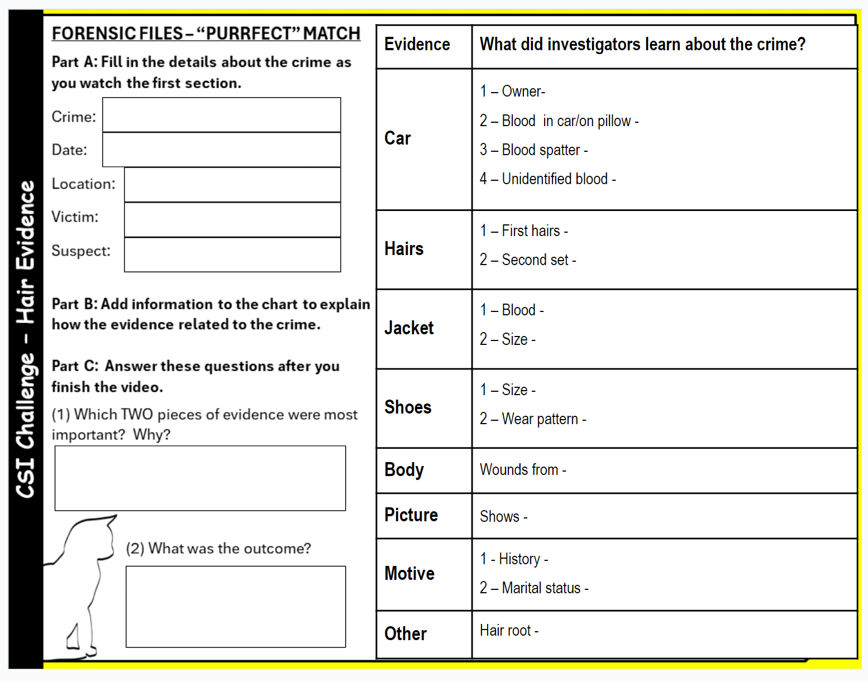
FORENSIC FILES: PURR-FECT MATCH
Fill in the Part A as you watch the first segment video.
We will stop several times to review the evidence.

Slide 3
FORENSIC FILES: PURR-FECT MATCH KEY
What was the crime?
Type of Crime:
Date:
Location:
Victim(s):
Suspect(s):
Homicide?
10/7 – Car reported 10/3 – Date of disappearance
October 1994
Prince Edward Island, Canada
Shirley Duguay
Doug Beamish (Husband)

Slide 4
Let’s investigate more … fill in your chart as we explore the evidence.

Slide 5
Evidence | What did it tell the investigators about the crime?
Car | 1 – Owner - 2 – Blood in car/on pillow - 3 – Blood - 4 – Unidentified blood-
Hairs | 1 – First hairs – 2 – Second set-
Jacket | 1 – Blood - 2 – Size-
Shoes | 1 – Size - 2 – Wear pattern-
Body | 1 – Wounds from
Picture | Shows -
Motive | 1 – History – 2 – Marital status -
Other | Hair root –
Shirley
Matched to Shirley
Medium impact spatter
Matched to Snowball
Matched to Shirley
Matched to Snowball
Matched to Shirley
Would fit Doug
Same as Doug
Similar to Doug’s pattern
Shovel
Shows Doug wearing the jacket
Doug had history of violence
Separated – not divorced
DNA matched to Snowball

Slide 6
Part C: Answer the questions.
What did you pick?
Why?
Beamish was charged with murder; convicted and sentenced to 18 years in prison

