Slide 1

Teacher Notes:
The student digital slide is available at https://docs.google.com/presentation/d/1-nLW_06WOE1LhbHrglKK9npTefhlSS8pNMqhHiGKvEY/edit?usp=sharing
IMPORTANT: Make a copy of the student notebook before you assign it on your LMS. It is view-only and I am not able to approve access outside my own students.
The full student digital notebook (with all the slides for the digital lessons and activities) is available at https://docs.google.com/presentation/d/14eIEiGacRXMsDyuUxiEsSM2m4YOAtIlfmD4O4YsLdPI/edit?usp=sharing. It is set up for standard paper (8.5x11) in landscape mode for easier printing when needed.
A DRAFT of the general outline of the digital lessons (with corresponding slide #s for the student notebook) is available at https://docs.google.com/document/d/15wxjmL-uHQPXDKOxmZXtU_gxy9dphEuyC1P4jzP-9mA/edit?usp=sharing . It is based on 44-minute class periods with 7th & 8th grade students.
Preview presentations before using with your classes as many slides have animations and links you will need to use.
I do Science Starters at the beginning of each class period. A collection of starters for Forensics is available on my lessons plans page at https://sciencespot.net/Pages/classforsci.html .
CSI Unit Training Materials
Case Study:
Dog Day Afternoon
Complete the slide as we watch the video.
T. Tomm Updated 2023
https://sciencespot.net
https://www.youtube.com/watch?v=2juQby4Rio4
T. Tomm 2007 Updated 2023 https://sciencespot.net/
This Photo by Unknown Author is licensed under CC BY

Slide 2
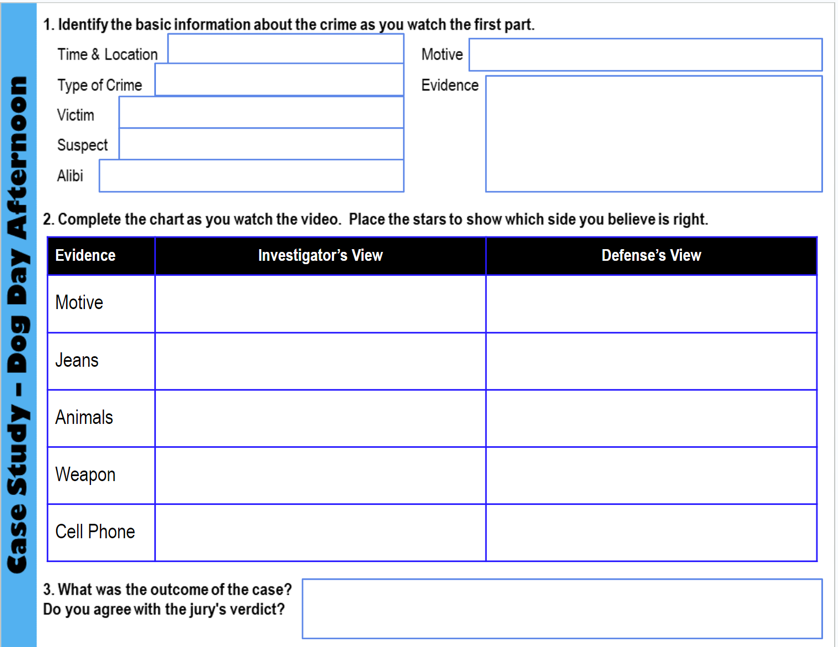
Fill in the #1 as you watch the first segment video.
We will stop several times to review the evidence.

Slide 3
Where did this crime occur?
Who was the victim? Who is the suspect?
When did the crime occur?
What did the husband say during the 911 call?
What did the detective find at the crime scene?
What type of wounds did the medical examiner find?
7. What was the cause of death?
Palm Beach County, Florida
Kathy Lamb
Jeff Lamb
June 15, 2004
Jeff discovered his wife bleeding all over the place.
He found the wife (a white female) bleeding severely with blood all over the living room. They also found three dogs (one in a cage, one in the hallway, and another dog was in a bedroom.)
The victims head had wounds from blunt force trauma, lacerations (cuts), contusions (bruises), and abrasions.
Homicide (Blunt Force Injuries)

Slide 4
8. What was distinctive about the head wound?
9. What type of tool was believed to have made the head wounds?
What evidence was collected from the dogs? What did it tell the investigators?
11. What clue did the husband give to the investigators about a possible motive?
Did the investigators believe the husband's story?
13. What was Jeff's alibi?
They were in the shape of a hexagon
A tire iron (but none was found at the scene).
Clippings of the dogs nails and swabs for DNA were taken. All the DNA was canine (dog).
He reported that jewelry (ring, earrings) and a box of money was missing from the house
No, other items that would have normally been taken (Kathy's purse with cell phone, cash, and credit cards) were left at the house.
He said he was at work and his co-workers supported this.

Slide 5
14. Fill in the chart based on what you learn from watching the rest of the episode.
Detail/ Evidence | Investigator's View | Defense's View | Your Opinion
Motive | He was planning to remarry and stole money. He needed her insurance money ($29,000) and wanted attention. | He was not planning to remarry and said he was not motivated by money. | I or D?
Jeans | There was blood on them, but there were different blood stains (some from transfer, but others from impact spatter.) DNA tests proved the blood was from Cathy. They say the blood was on the jeans as a result of the attack of his wife. | The blood was from a dog shaking its fur. Their expert said there was not enough blood to support the idea that he was at the scene. The expert also demonstrated how a dog shaking could have created those impact spatters. | I or D?

Slide 6
14. Fill in the chart based on what you learn from watching the rest of the episode.
Detail/ Evidence | Investigator's View | Defense's View | Your Opinion
Dogs | Kathy's dogs, Nipper and Dakota, had more severe wounds than Jeff's dog, Bandit. Investigators think Kathy's dogs would have attacked a stranger, which suggested the dogs knew the person who attacked her. | They say no one knows where the dogs were during the attack and it is all just speculation (not facts). Their expert believes the dogs were hit by the intruder before the attack and they were unable to fight back. | I or D?

Slide 7
14. Fill in the chart based on what you learn from watching the rest of the episode.
Detail/ Evidence | Investigator's View | Defense's View | Your Opinion
Weapon | It was found at the husband's work. The shaped matched the head wounds, but there was no other evidence (fingerprint or other) on it. The size and shape of the wounds matched the tire iron. | There was nothing on the tire iron that connected it to the husband. The expert demonstrated differences between the wounds and the tool to show that it didn't "fit" the crime. | I or D?

Slide 8
14. Fill in the chart based on what you learn from watching the rest of the episode.
Detail/ Evidence | Investigator's View | Defense's View | Your Opinion
Cell Phone | His cell phone records show him traveling south towards his residence and cell phone towers place him in the area near the time of the crime. | The cell phone tower evidence is not accurate. Anything he did earlier in the day doesn't matter. | I or D?
It’s time for you to decide …
guilty or innocent? Why?

Slide 9
25. What was the outcome of the case?
Do you agree with the jury's verdict?
They found him guilty of murder.

