Slide 1
Teacher Notes:
The student digital slides for this unit are available at https://docs.google.com/presentation/d/14QpxIdbjv8hXIOGug5pkuWNbU6z8Hbq41-6q8DJACPs/edit?usp=sharing
IMPORTANT: Make a copy of the student notebook before you assign it on your LMS. It is view-only and I am not able to approve access for your students.
The FULL digital notebook (with all the slides for the digital lessons and activities) is available at https://docs.google.com/presentation/d/14eIEiGacRXMsDyuUxiEsSM2m4YOAtIlfmD4O4YsLdPI/edit?usp=sharing. It is set up for standard paper (8.5x11) in landscape mode for easier printing when needed. Paper versions are available for this unit on my Forensic Science page at https://sciencespot.net/Pages/classforsci.html
A DRAFT of the general outline of the digital lessons (with corresponding slide #s for the student notebook) is available at https://docs.google.com/document/d/15wxjmL-uHQPXDKOxmZXtU_gxy9dphEuyC1P4jzP-9mA/edit?usp=sharing . It is based on 44-minute class periods with 7th & 8th grade students.
Preview presentations before using with your classes as many slides have animations and links you will need to use.
I do Science Starters at the beginning of each class period. A collection of starters for Forensics is available on my lessons plans page at https://sciencespot.net/Pages/classforsci.html .
CSI Unit Training Materials
Crime Scene Basics
Topics include types of evidence, crime scene protocol, & forensic science careers
T. Tomm Updated 2023
https://sciencespot.net
This Photo by Unknown Author is licensed under CC BY

Slide 2
Part A: Basic Vocabulary
CRIME SCENE: Any physical location in which a crime has occurred or is suspected of having occurred.
PRIMARY: The original location of a crime or accident.
SECONDARY: An alternate location where additional evidence may be found.
SUSPECT: Person thought to be capable of committing a crime.
Crime Scene Basics
ACCOMPLICE: Person associated with someone suspected of committing a crime.
ALIBI: Statement of where a suspect was at the time of a crime.
MOTIVE: Reason a person commits a crime, such as money, hate, or jealousy.
Source: http://www3.sc.maricopa.edu/ajs/crime_scene_technician.htm

Slide 3
Part B: CSI Personnel
POLICE OFFICERS are typically the first to arrive at a crime scene. They are responsible for securing the scene so no evidence is destroyed and detaining persons of interest in the crime.
DETECTIVES - Interview witnesses, victims, and consult with the CSI unit to investigate by following leads provided by testimonial and physical evidence.
CSI UNIT - Documents the crime scene in detail and collects any physical evidence using the correct tools, equipment, and procedures.
CRIMINALISTS - Scientists who analyze, compare, identify and interpret physical evidence to provide clues about a crime; often specialize in specific types of evidence
Crime Scene Basics
Source: http://science.howstuffworks.com/csi.htm

Slide 4
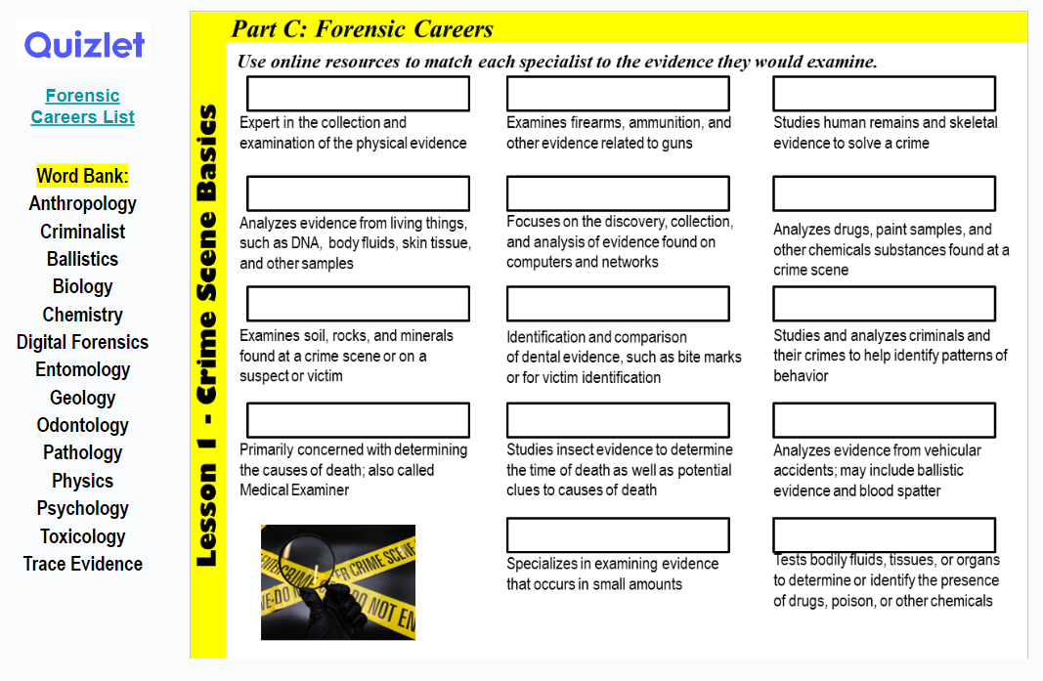
PATHOLOGIST (or MEDICAL EXAMINER) - May be present to determine a preliminary cause of death and/or time of death.
Forensic SPECIALISTS (entomologists, anthropologists, and psychologists) may be called in if the evidence requires expert analysis.
Your assignment:
Crime Scene Basics
Click the link to access the vocab on Quizlet.
Use the word bank to help you fill in each box.
Which 3 would you want to be?
https://quizlet.com/782837635/forensic-careers-flash-cards/?x=1qqt

Slide 5
Forensic Science Careers Answer Key
Anthropology
Criminalist
Ballistics
Biology
Chemistry
Digital Forensics
Entomology
Geology
Odontology
Pathology
Physics
Psychology
Toxicology
Trace Evidence
Criminalist
Ballistics
Anthropology
Biology
Digital Forensics
Chemistry
Geology
Odontology
Pathology
Crime Scene Basics
Pathology
Entomology
Physics
Trace Evidence
Toxicology
Crime Scene Careers - https://www.youtube.com/watch?v=n8Dj6c_IuXU
Source: http://science.howstuffworks.com/csi.htm

Slide 6
Part D: CSI Protocols
Step 1: Interview
Determine what happened, what crime took place, how was the crime committed, and identify all the people involved – suspects, victims, eyewitnesses, etc. The information at this stage may not be factual, but it will give the investigators a place to start.
Step 2: Examine
Identify the point of entry and point of exit as well as outline the general layout of the crime scene, which will help identify areas with possible evidence.
Step 3: Document
Create a record of the scene by taking photographs, recording videos, or making sketches to show the layout of the crime scene and the locations of specific, such as the exact position of a deceased victim or other footprints within a crime scene.
Step 4: Process
Process the crime scene by collecting physical evidence from the crime scene for further analysis by a crime laboratory. Evidence needs to be collected following proper procedures and using the correct equipment as well as storage containers (evidence bags, sealed vials, etc.)
Crime Scene Basics
ADD TO NOTES
Bag & Tag stage –AFTER everything is documented
Adapted from http://www.feinc.net/cs-proc.htm

Slide 7
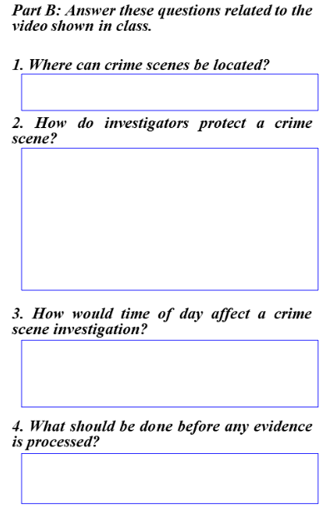
Add notes to your slide as you watch the video.
1. Can be anywhere (inside, outside, car) and none are the same.
2. Prevent contamination by wearing “bunny suit” and gloves
Protect evidence - from weather & people with tents
Crime Scene Basics
Use specific procedures & the correct equipment to gather evidence
3. Limits time to gather evidence – lights at night to brighten the scene.
4. Document the entire scene with notes, pictures, videos BEFORE any evidence is processed
https://video.link/w/fR1ic

Slide 8
Career Connections
Choose ONE career related to Forensic Science. The career does not have to be on the Quizlet list!
Research the career to decorate the cover by adding the items listed below:
Name of the specialty
Description
List the evidence they would examine and explain the clues it would provide about a crime.
List equipment they may use in their job.
Find at least two pictures representing this career.
Crime Scene Basics
https://www.liveabout.com/criminology-careers-6504719
Source: http://science.howstuffworks.com/csi.htm

Slide 9
Career Connections
Choose ONE career related to Forensic Science. The career does not have to be on the Quizlet list!
Research the career to create a poster by adding the items listed below:
Name of the specialty
Description
List the evidence they would examine and explain the clues it would provide about a crime.
List equipment they may use in their job.
Find at least two pictures representing this career.
Crime Scene Basics
https://www.postermywall.com/
Alternate Version: Paper Format
https://www.liveabout.com/criminology-careers-6504719
Source: http://science.howstuffworks.com/csi.htm

